Slide 1


‘Early literacy: National policies and evidence-based guidance’
May 2026

Slide 2

Session overview
Background to EEF
National policies
Moving from evidence access to evidence use
Policy levers
Working with schools

Slide 3
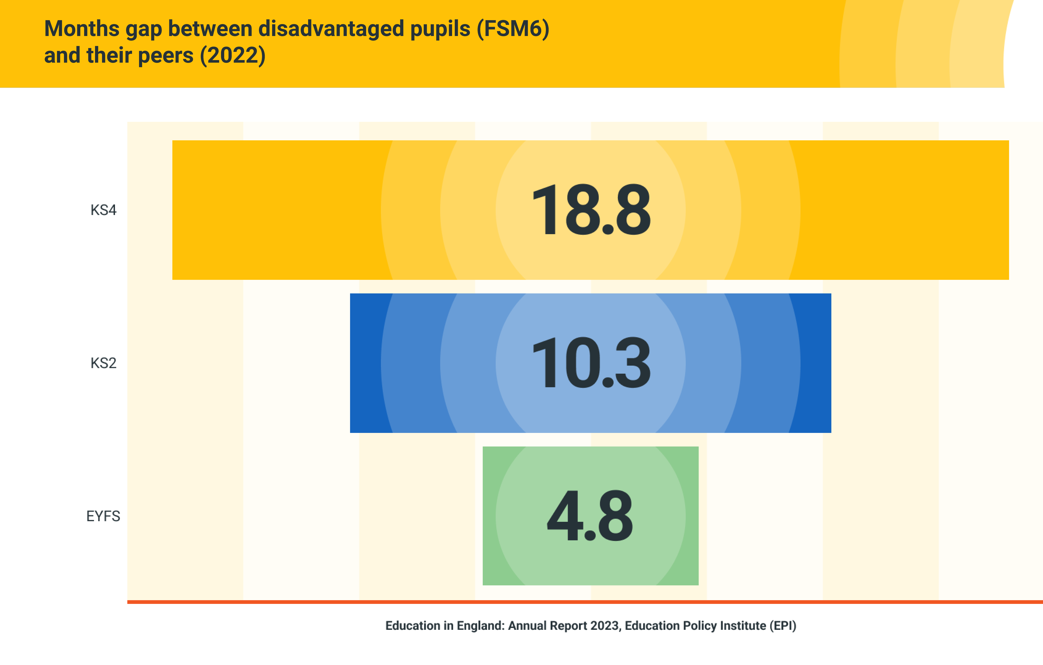
Background:
Education in England in 2011
Sudden increase in school autonomy
Very few studies with rigorous methodologies for measuring efficacy (fewer than 5 RCTs)
Most research only available in academic journals
Skepticism on whether randomised controlled trials are possible – “Schools will never agree to be randomised”
Evidence not frequently used in decision making

Slide 4
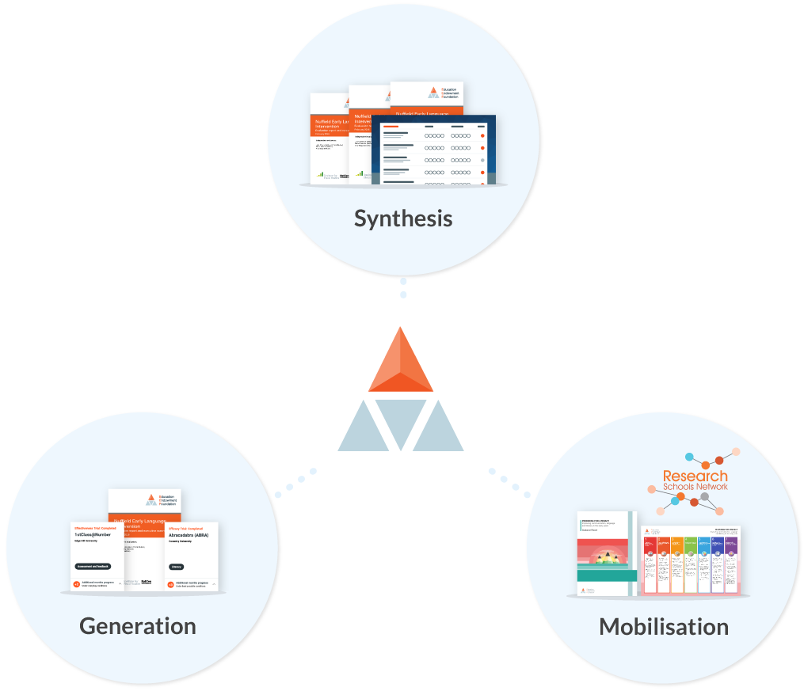

Background:
Education Endowment Foundation

Slide 5
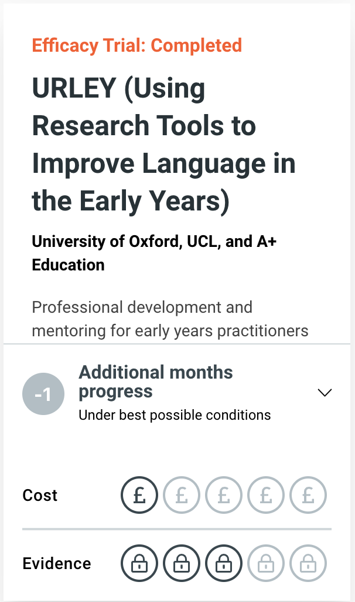
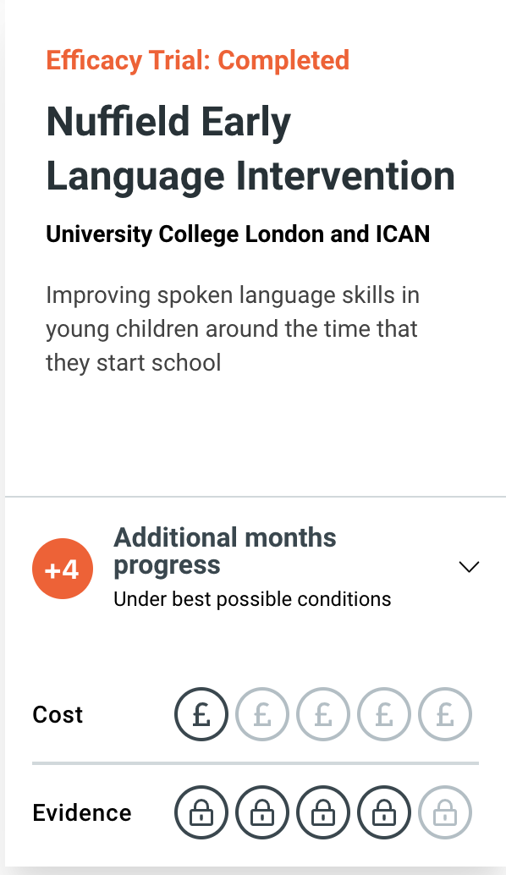

Evidence Generation:
Rigorously answering the questions that matter

Slide 6
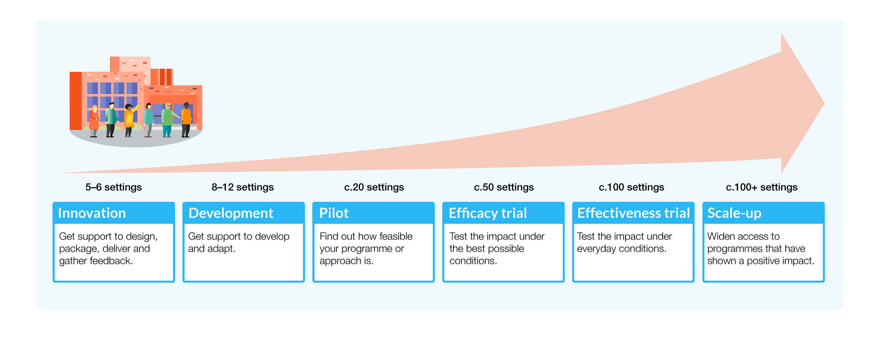
Evidence Generation:
Building pipelines of evidence

Slide 7
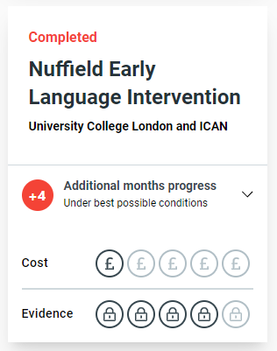


Evidence Generation:
Scaling with policy makers
Intervention scaled with 11,000 schools

Slide 8
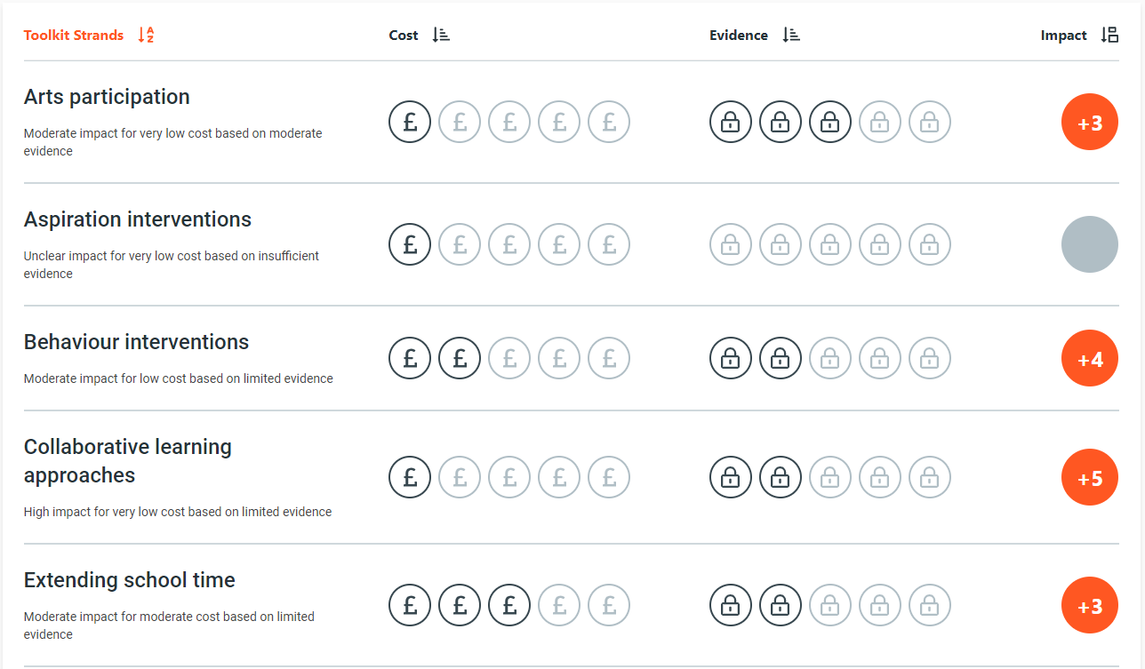
Evidence Synthesis:
The Teaching and Learning Toolkit
An accessible resource used by 70% school leaders in England:
A summary of over 5000 studies, regularly updated with the latest evidence
Summarising impact, security and cost of 30 different approaches
Not a step-by-step recipe for impact but a useful reference point to be combined with professional expertise
Notes:
Toolkit is our flagship evidence resource – which is used by 70% of school leaders
It is based on a systematic search from the evidence base – it is possible to cherry pick evidence to prove what you want – but we avoid this through a transparent and pre-specified process
When using the Toolkit it is crucial to:
Consider cost, security and impact together – some approaches may be effective but very expensive – like reducing class size
Look beyond the headlines – behind every average impact there is variation – it is possible to implement approaches with much higher or much lower impact than the average. Within the text of each topic area we discuss the things that have influenced the impact in the past – e.g. whether approaches are more suitable for younger children or in maths rather than English
Combine the evidence with your professional expertise – the Toolkit provides a summary of past research, but applying research requires you to think about your context and how to implement the approach successfully.

Slide 9
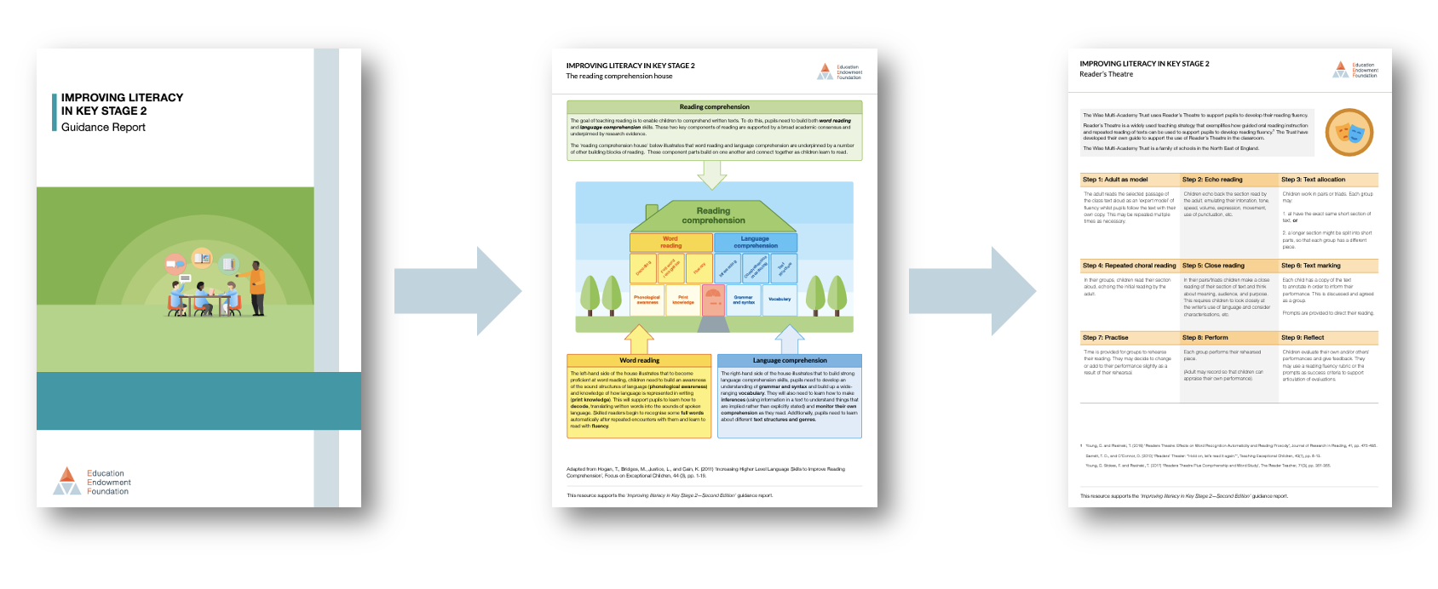
Evidence Mobilisation:
Guidance reports and tools

Slide 10
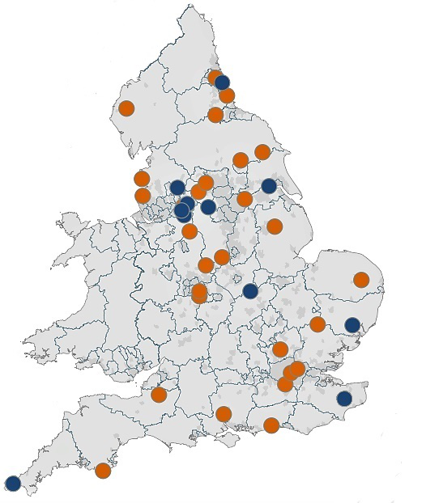
Evidence Mobilisation:
Research School Network
The Research School Network acts as a bridge between evidence and practice

Slide 11

National policies

Slide 12
National policies:
In 2011, the EEF launched with a £125 million endowment to build research evidence into the school system to inform decision-making in schools e.g. EEF Toolkit
The Phonics Screening Check was piloted in 2011 – it became statutory in 2012 for year 1 pupils
In 2011, the Department for Education began formally validating systematic phonics programmes
In 2013, researchED and similar grassroots teacher movements became more popular with English school teachers and leaders (including engaging with evidence on reading)
In 2015 onwards, OFSTED inspection reports increasingly highlighted phonics as an important component of effective early reading instruction
In 2018, a small number of primary school ‘English Hubs’ (34) were created to support implementation of early reading (particularly phonics and ‘reading for pleasure’)
In 2023, the Department for Education introduced the National Professional Qualification for Leading Literacy (NPQLL)
Notes:
The National Professional Qualification for Leading Literacy (NPQLL) in England was introduced in 2023 by the Department for Education.

Slide 13


National policies:
National policies + Grassroots engagement

Slide 14
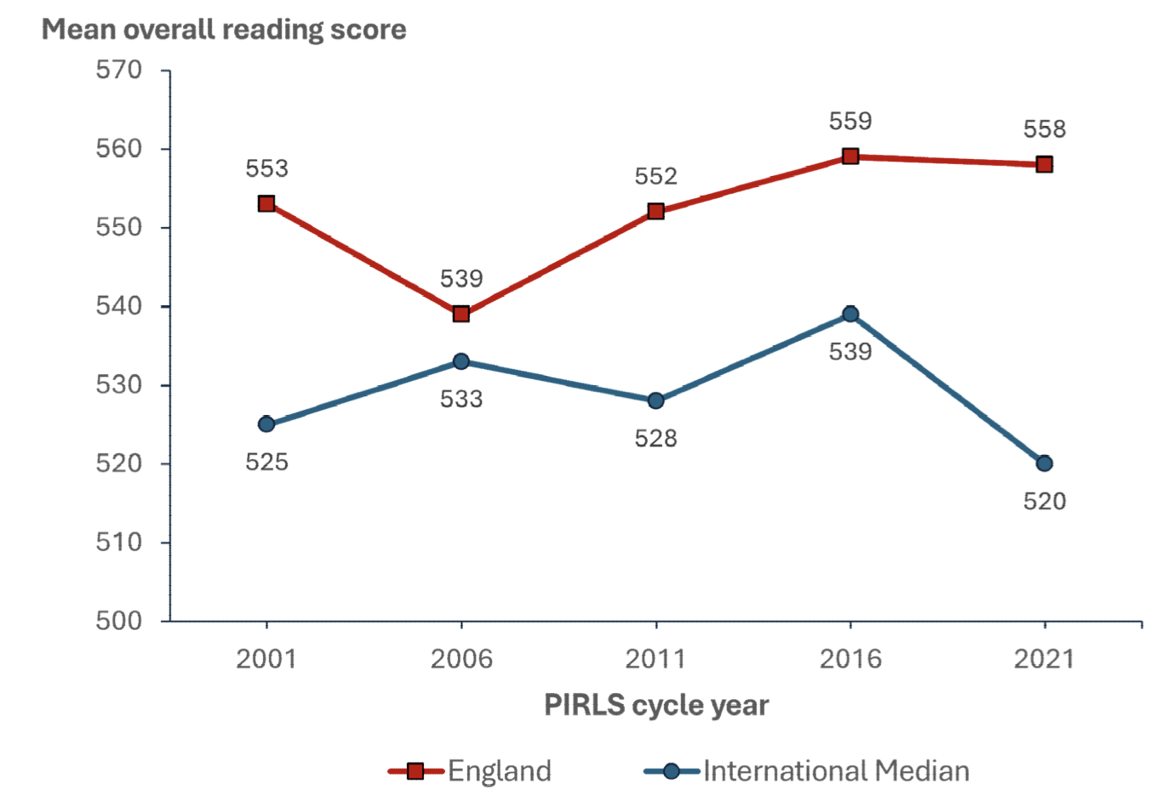
National policies:
Reading successes in PIRLS (Progress in International Reading Literacy Study, 2021)

Slide 15
National policies:
Reading successes in PIRLS (Progress in International Reading Literacy Study, 2021)
Progress in International Reading Literacy Study (PIRLS) 2021 achieved highest ever international ranking for reading (4th out of 43 countries)
….but
40 score-point average gap between FSM-eligible (disadvantaged) and non-FSM pupils in England (roughly one year of progress).

Slide 16


National trends:

Slide 17
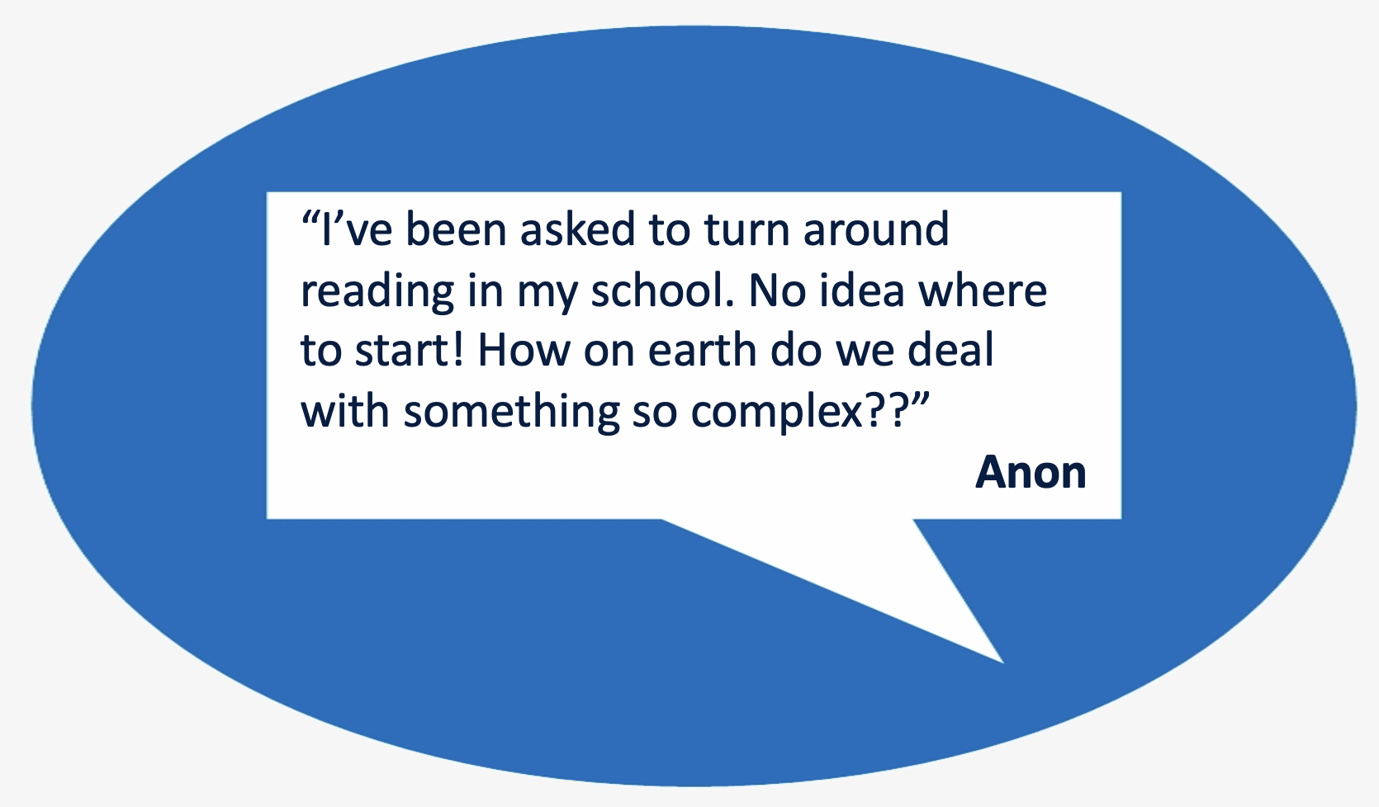
National trends:

Slide 18
National policies:
Reflections and questions
What national policies related to curriculum and assessment best support early literacy?
What robust evidence do we need to support those policies?
What methods to we have to scale excellence with early literacy?
What evidence-based resources help build capacity for teachers and leaders?
What networks do we need to foster in the teaching profession to share knowledge and positively influence early literacy?
How do we support effective implementation in challenging school contexts?
How can we combine ‘top down’ policies with ‘bottom up’ engagement?

Slide 19
Moving from evidence access to evidence use

Slide 20





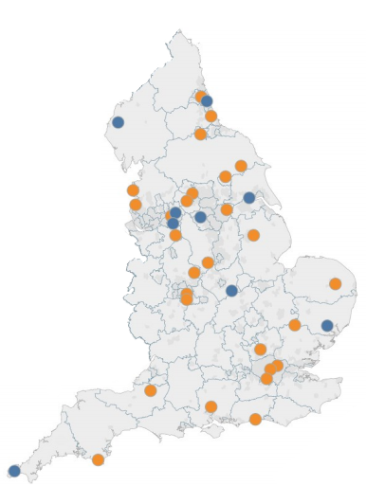
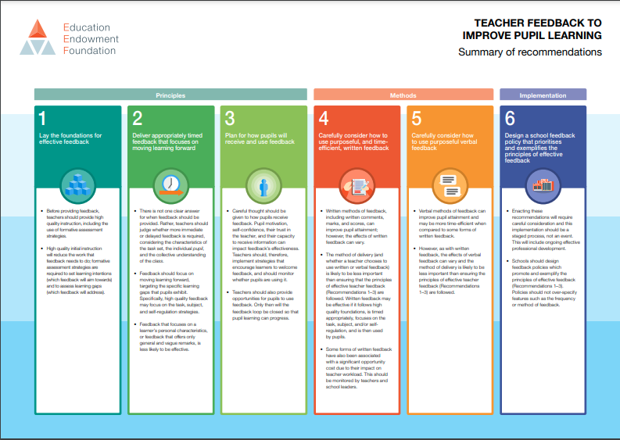

Evidence mobilisation
A variety of approaches
Accessible resources
Communities of practice
Policy engagement
Scale up activity
1
2
3
4

Slide 21

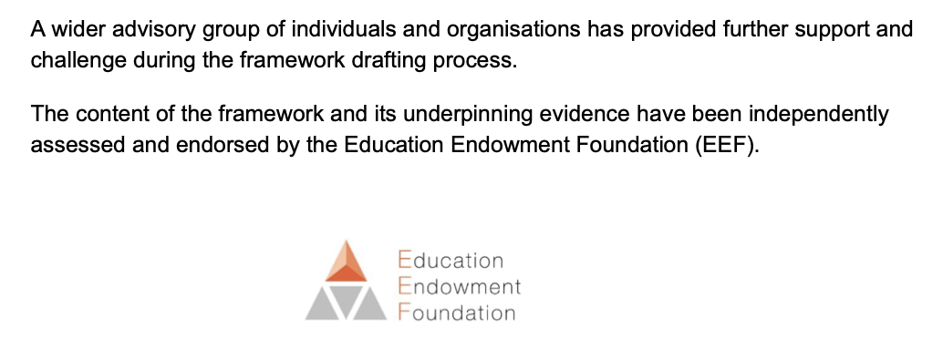
Case study 1
Embedding evidence in policy

Slide 22
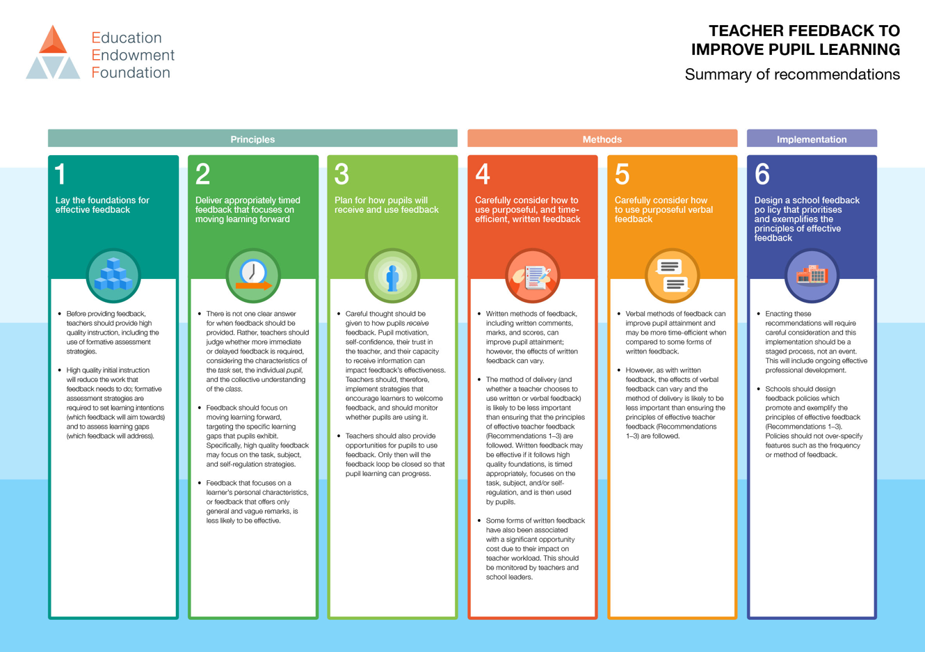
Case study 2
Promoting school-led research use
Evidence needs to be relevant, actionable and appropriately applied to context
Schools and researchers are both required to create appropriate recommendations

Slide 23

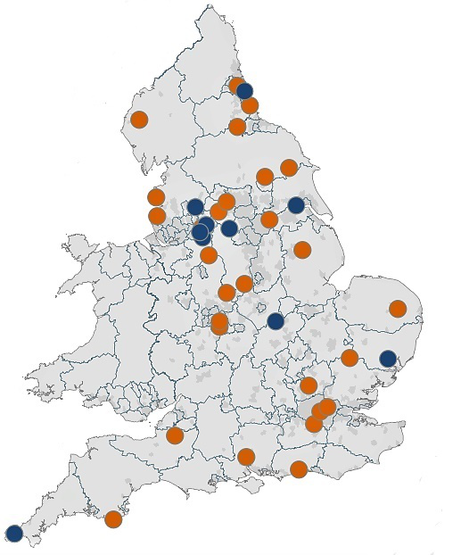

Case study 2
Communities of practice

Slide 24
A theory of evidence use
underpinning both approaches

Slide 25
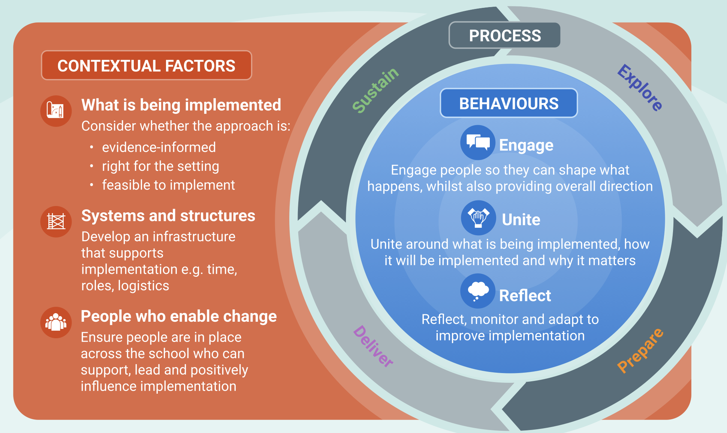

Slide 26
Final thoughts

Slide 27

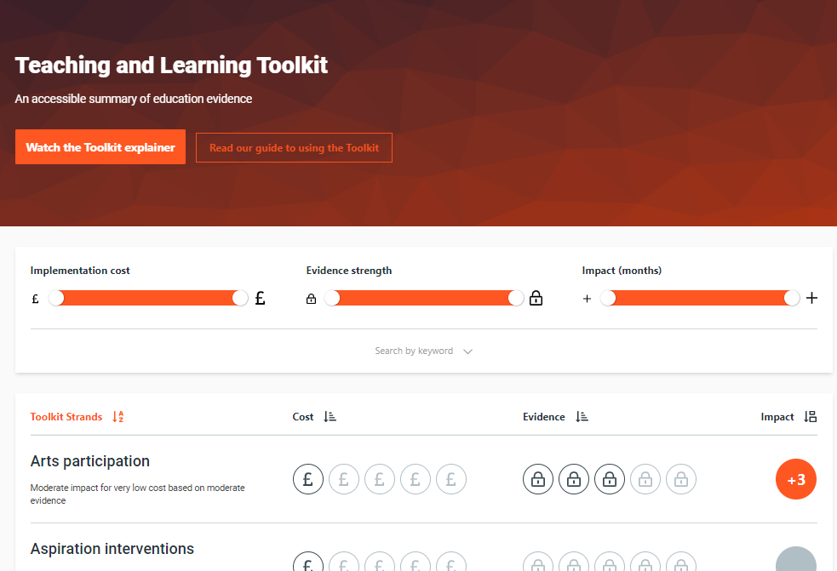
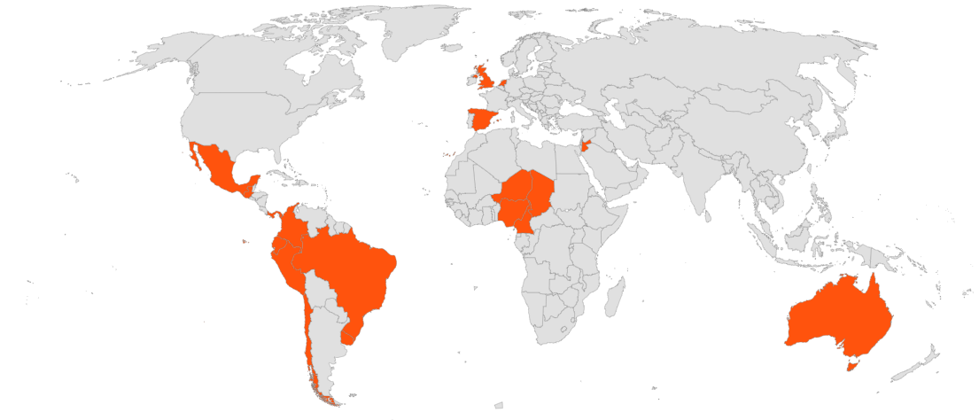
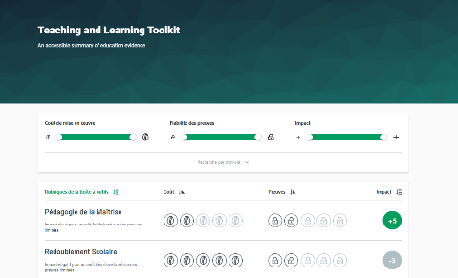
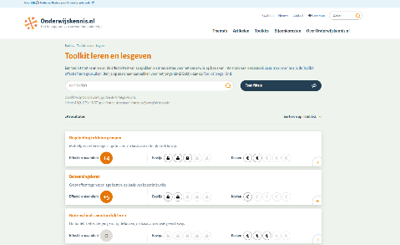
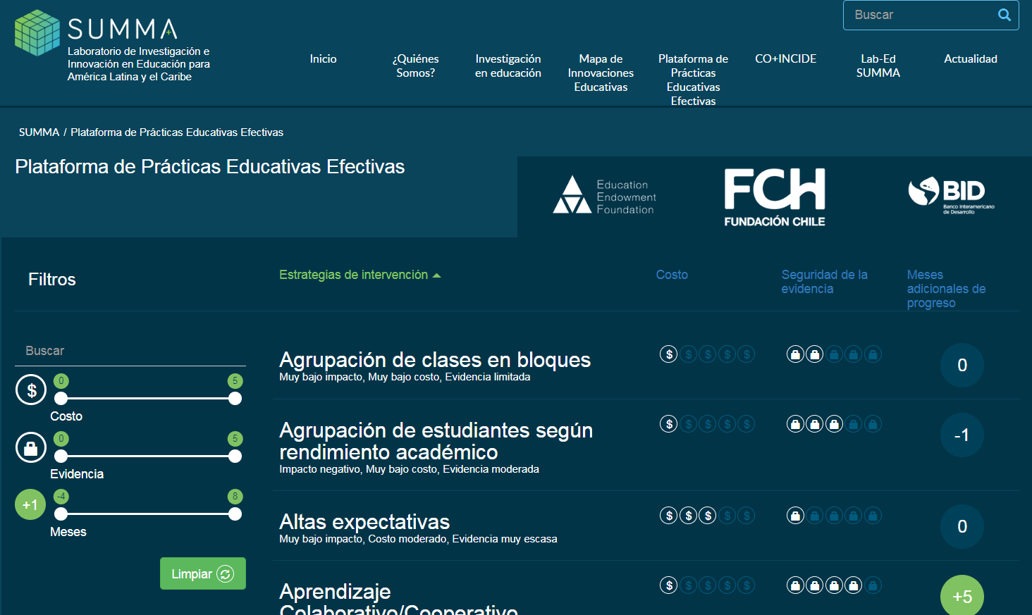
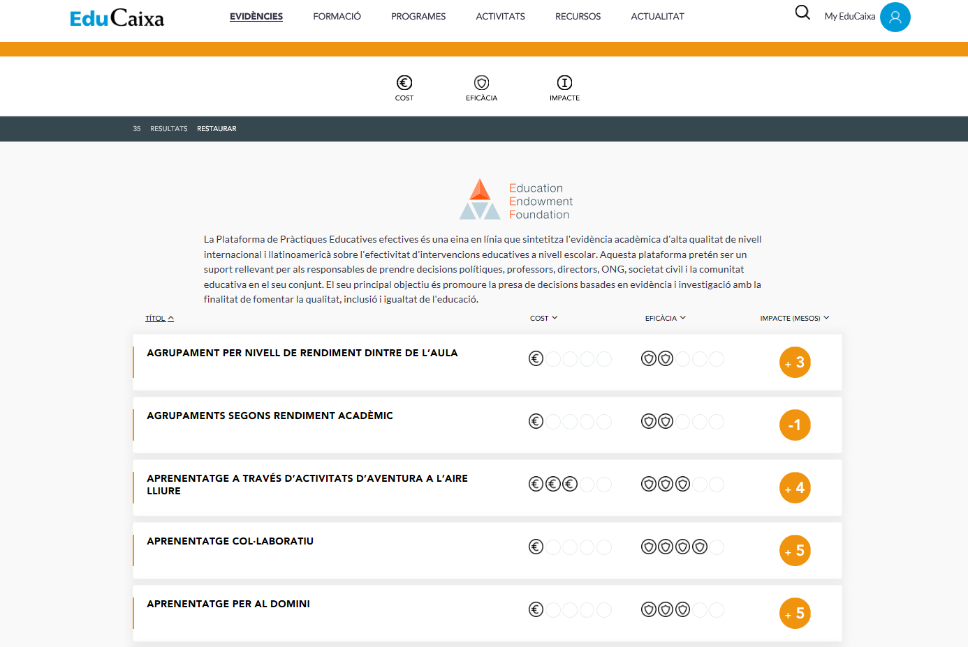
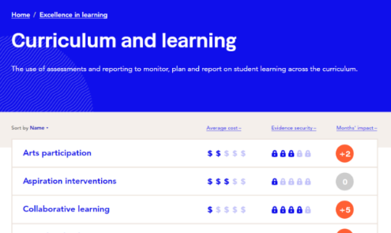
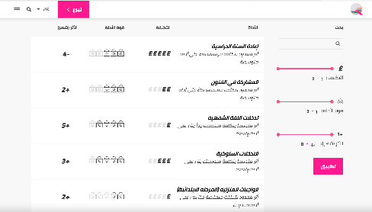
Evidence-use in education is a global movement
Notes:
Our approach to the global network
We believe our approach to generating and using evidence to improve teaching and learning is internationally relevant. That is why we are committed to global collaboration - More and better evidence of high-potential approaches and programmes will feed directly into the global evidence synthesis on which our Teaching and Learning is based. This will also help us to fill gaps more quickly in the evidence base for the benefit of all teachers and students.
Thanks to the generous support of the BHP Foundation, the EEF has established 6 international partnerships covering 20 countries across the globe that are keen to further integrate evidence into their education systems.
Through this work we aim to support the emergence of a network of organisations across the globe with the collective capacity to increase the volume, quality, and use of evidence, leading to better decisions in schools and better learning outcomes for students.
Our key partnerships are: SUMMA working across Latin America and the Caribbean, Queen Rania Foundation in Jordan, La Caixa in Spain, Evidence for Learning in Australia and, The Netherlands Initiative for Education Research and eBASE in Cameroon working across The Lake Chad Basin.
Much like our work in England, the work we undertake with our international partners has three elements:
Evidence Synthesis – Contextualising and translating the Teaching and Learning Toolkit for other contexts – as you can see from the map the Toolkit has been translated by all our partners.
To date, the Toolkit has been translated into Arabic, Catalan, Spanish, Portuguese, Dutch and French
The Toolkit has been contextualised for audiences in countries spanning four continents including an intensive contextualisation process to make the Toolkit more transferable to Low and Middle-Income Countries (LMCIs) with the inclusion of additional studies produced in LMIC settings.
Evidence Generation – Funding trials to fill evidence gaps in partner countries through the £5 million Global Trials Fund, supported by the BHP Foundation, which establishes a pipeline of high-quality trials, targeted at the most significant data gaps in the global evidence base, and/or targeted to themes of strategic interest to partners. More and better evidence of high-potential approaches and programmes will feed directly into the global evidence synthesis on which our Teaching and Learning is based. This will also help us to fill gaps more quickly in the evidence base for the benefit of all teachers and students. The GTF has currently funded 11 evaluations spanning four continents
Evidence Dissemination – Developing effective means of dissemination in different contexts, for example, a network of research schools or evidence hubs which guide and support practitioners in the development and implementation of locally generated ideas to ensure they are aligned with evidence, implemented with fidelity and evaluated.
The tragedy of COVID-19 pandemic has also revealed an underlying need for urgent collaboration and research co-construction across the globe and we have worked with our partners to address the common global education challenges impacting children and young people’s outcomes.

Slide 28

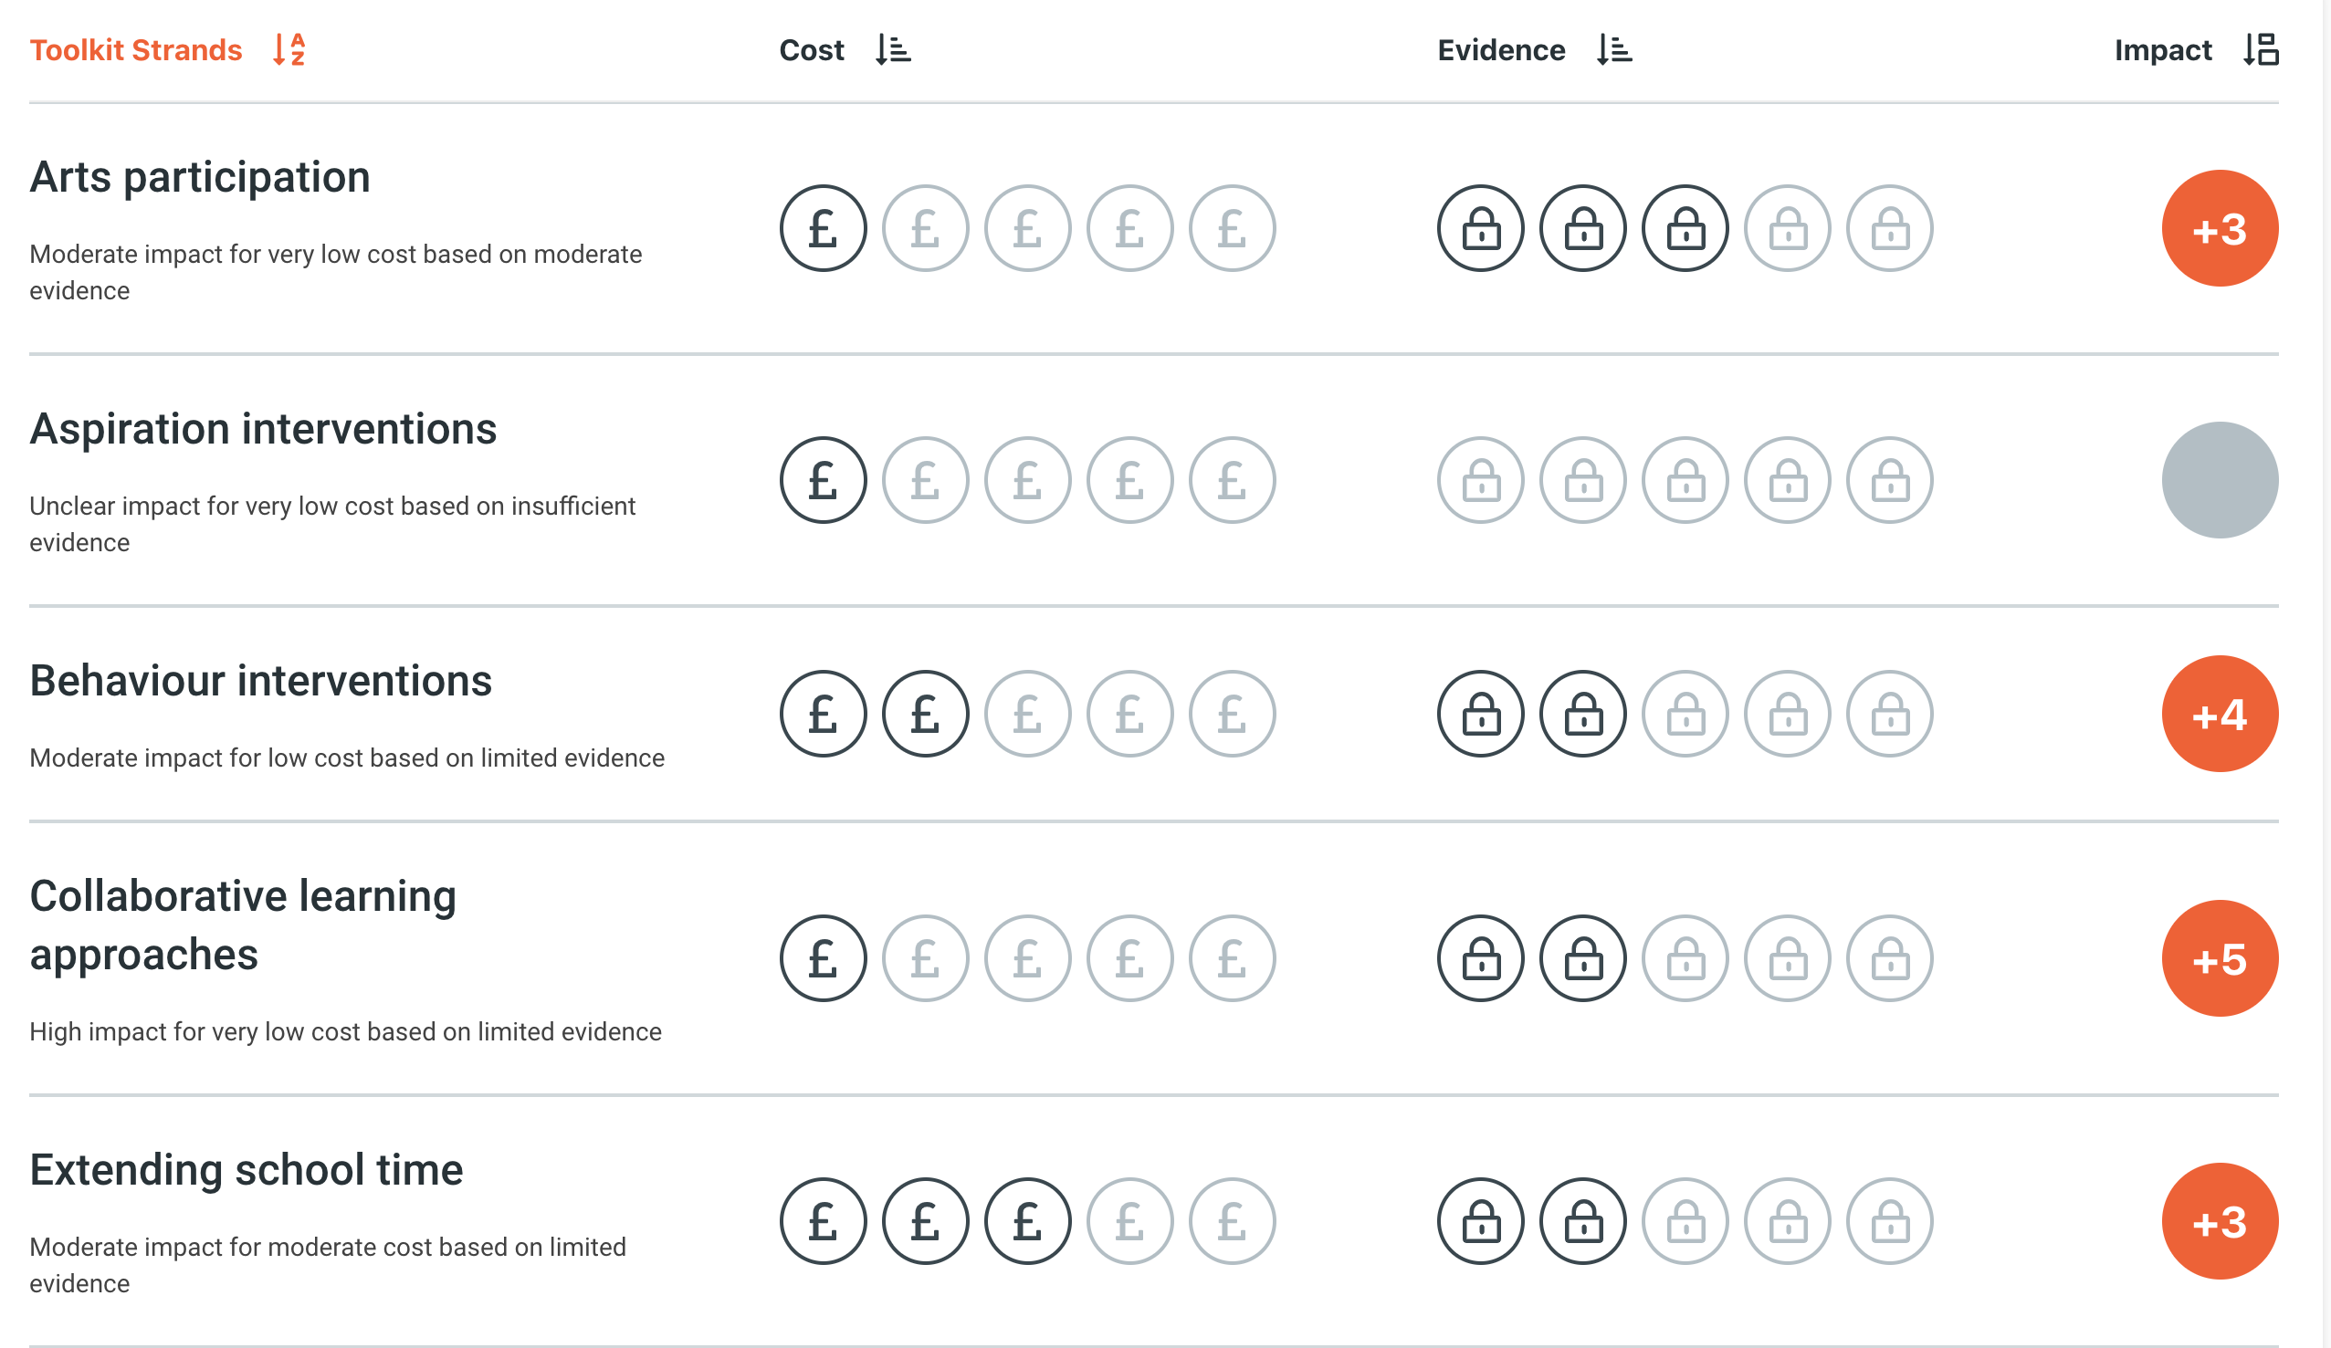



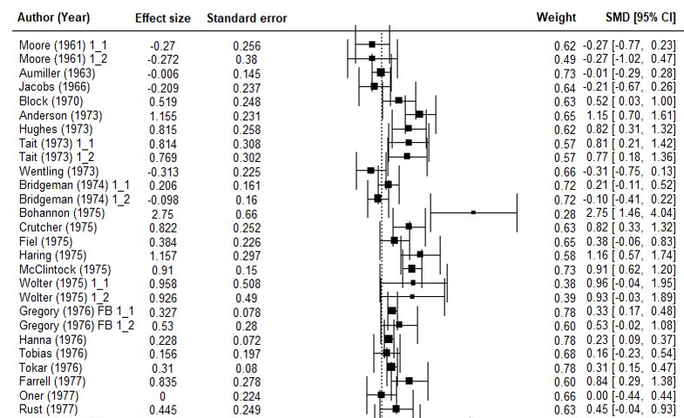
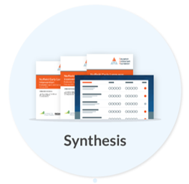





Evidence-use to improve literacy requires national and international infrastructure
Shared standards
Peer learning
Methodological innovation

Slide 29



Returning to education in England 2011 – what progress have we made?
Sudden increase in school autonomy
Very few studies with rigorous methodologies for measuring efficacy (fewer than 5 RCTs)
Most research only available in academic journals
Skepticism on whether randomised controlled trials are possible – “Schools will never agree to be randomised”
Evidence not frequently used in decision making
Literacy outcomes resilient after the COVID-19 pandemic
Literacy a sustained policy priority
70% of senior leaders use EEF’s Toolkit
of all primary schools found EEF resources useful during the pandemic
90%
1.7m children involved in EEF projects
16,000+ schools, nurseries and colleges taking part (over half of all schools in England)

Slide 30
National policies:
Reflections and questions
What national policies related to curriculum and assessment best support early literacy?
What robust evidence do we need to support those policies?
What methods to we have to scale excellence with early literacy?
What evidence-based resources help build capacity for teachers and leaders?
What networks do we need to foster in the teaching profession to share knowledge and positively influence early literacy?
How do we support effective implementation in challenging school contexts?
How can we combine ‘top down’ policies with ‘bottom up’ engagement?

Slide 31

Questions?

