Slide 1
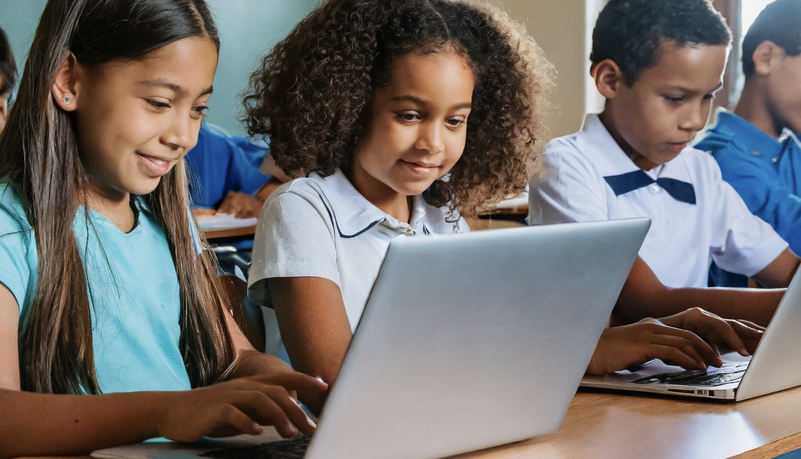

Literacy Policies Around the Globe
Ann Kennedy
TIMSS & PIRLS International Study Center
EDULOG 2026, May 5th, 2026

Slide 2
Reading As a Policy Priority
What is the Progress in International Reading Literacy Study (PIRLS)?
What information about education policies and reading curricula does the PIRLS Encyclopedia offer?
How can PIRLS data be used to monitor reading achievement and evaluate education policies?
When will PIRLS 2026 data become available?
Notes:
Reading comprehension is critical to students’ academic growth across subjects and to meaningful participation in everyday life, including economic activity, civic engagement, or personal enrichment.
Concerns in recent years (post-COVID) about declining academic achievement and uneven learning recovery have led to a heightened focus on evidence-based approaches to improve reading outcomes. Policy initiatives aimed at strengthening reading literacy curricula have implications for schools, teachers, and students. Broader efforts aligned with global priorities such as UNESCO’s Sustainable Development Goal 4 [SDG 4] call for improved quality and equity across education systems.
International large-scale assessments, such as the IEA’s Progress in International Reading Literacy Study (PIRLS) play an important role by providing consistently administered measures of reading achievement along with rich contextual data on home and school environments in which students learn to read.

Slide 3
IEA’s Progress in International Reading Literacy Study
Notes:
The International Association for Evaluation of Educational Achievement (IEA) has been conducting assessments of mathematics, science, and reading comprehension since the 1960s. Inaugurated in 2001, the IEA’s Progress in International Reading Literacy Study (or PIRLS) is one of EA’s flagship assessments.

Slide 4
What Is PIRLS?
An assessment of reading achievement at the fourth grade
Provides contextual data for a comprehensive picture
Targets the fourth grade as a critical point in reading education
Administered every 5 years since 2001
Offers trends for participating countries and benchmarking participants across the cycles
Notes:
PIRLS targets the fourth grade as a critical point in reading education, as it is the point in schooling when students are transitioning from decoding words and demonstrating basic comprehension to reading to acquire and use new vocabulary and build on information, particularly across the curriculum.
Since its inception in 2001, PIRLS has seen a growing number of participating countries. 35 countries participated in 2001, whereas the past two cycles have had more than 55 countries.
PIRLS 2021 and 2026: 57 countries

Slide 5
What Does PIRLS Assess?
PIRLS assesses reading comprehension as described in the PIRLS Reading Assessment Framework.
Reading literacy is defined as:
the ability to understand and use those written language forms required by society and/or valued by the individual. Readers can construct meaning from texts in a variety of forms. They read to learn, to participate in communities of readers in school and everyday life, and for enjoyment.
The framework is updated with each cycle to include current reading research and developments in reading education.

Slide 6
PIRLS Reading Achievement
Purposes for Reading
Literary Experience
Acquire and use Information
Processes of Comprehension
Focus on and Retrieve Explicitly Stated Information
Make Straightforward Inferences
Interpret and Integrate Ideas and Information
Evaluate and Critique Content and Textual Elements
Literary passages and information texts (including online tasks) represent a range of engaging content and reflect students’ authentic reading experiences

Slide 7
PIRLS Contextual Questionnaires
Student Questionnaire
Students’ home environment, experiences in school, and reading attitudes and habits outside of school
Home Questionnaire (Parents/Primary Caregivers)
Home environment, students’ early childhood education, parents’ education and occupation, and parents’ reading activities and attitudes
Teacher Questionnaire (Students’ Primary Reading Teachers)
Classroom contexts for reading instruction and teacher characteristics
School Questionnaire (School Principals)
School characteristics and availability of school resources
Contextual Framework reviewed and updated with every cycle
Notes:
Provide valuable data about the home and school environments in which students learn to read and form reading habits and attitudes.

Slide 8
The PIRLS Encyclopedia: Describing Education Policy and Reading Curricula

Slide 9
The PIRLS Encyclopedia: Education Policy and Curriculum in Reading
Curriculum Questionnaire
Country Chapters
Background information about language/reading curricula and education policies
School entry policies
Language of Instruction
Fourth Grade Language/Reading Curriculum
Teacher and Principal Preparation
Descriptions of the structure and organization of the country’s education system
Details of the reading curriculum
Professional development for teachers and school leadership
Information about reading initiatives

Slide 10
Highlights from PIRLS 2021: Teacher Preparations
Just over half of all participating countries in PIRLS 2021 reported changes to policies within the past 15 years (i.e., 2011 or later).
Common changes included:
Increased number of course hours
Higher education requirements
Introduction (or updates to) examinations or licensing systems
Creation of (or updates to) standards for professional teachers
Notes:
The preparation route for teachers and principals of students at grade 4 typically requires a university degree and requires some supervised practicum.
Over half the participating countries in PIRLS 2021 require passing a qualification exam or completing a mentoring program, probationary teaching period, or induction program.
30 countries (over half) reported changes to policies within the past 15 years.
Course hour increases: Austria, Brazil, Ireland, and Slovenia
Exams/Licensing systems: Australia, Georgia, Iran, Kazakhstan, Sweden, and the UAE
Guidelines/teacher standards: Australia, Bulgaria, Hong Kong, Poland, New Zealand, and Russia

Slide 11
Highlights from PIRLS 2021: Principal Preparations
Most countries require teaching experience
More than half require completion of a leadership training program
Fewer than half of all participating countries in PIRLS 2021 reported changes to policies within the past 10 years (i.e., 2011 or later).
Common changes included:
Higher education requirements (leadership or degree programs)
Introduction (or updates to) licensure and certification systems
Creation of (or updates to) standards
Notes:
Majority require principals of schools with fourth-grade students to have teaching experience.
Over half the countries require completion of a specialized school leadership training program.
Only 23 countries with recent changes but regionally diverse: Albania, Austria, Bulgaria, Canada, England, Georgia, Germany, Israel, Kazakhstan, Lithuania, Macao, Montenegro, Morocco, Portugal, Qatar, Russia, Saudi Arabia, Spain, Turkiye, the UAE, and USA
Most common changes:
Leadership programs or degrees: Albania, Austria, Macao, Montenegro, Portugal, Russia, and Turkiye
Licensure/Certification: Canada, Qatar, Serbia Spain, Turkiye, and the UAE
[In two countries, England and Georgia, requirements for specific training or examinations were abolished.]

Slide 12
Highlights from PIRLS 2021: Reading Curricula
The majority of countries have a national curriculum for fourth-grade language/reading instruction.
Reading is often part of the curriculum for language instruction rather than as a separate curriculum area
Also integrated across the curricula in more than half the countries
Notes:
Countries without a national curriculum have state/provincial curricula.
Only French Belgium and Spain reported that reading was not presented as part of the language instruction OR as a separate curriculum area but instead was ONLY integrated across the curriculum.

Slide 13
Highlights from PIRLS 2021: Curriculum Details
In 2021, several countries were in the process of updating the reading curriculum
Newly introduced curricula (2020-2021) reported in Brazil, Egypt, Hungary, Kazakhstan, Norway, Oman, and Saudi Arabia
25 countries with changes introduced between 2016-2019
In some countries, the curriculum is reviewed and modified in each academic year
About half of the countries’ curricula specify a specific percentage of instructional time devoted to reading
About two-thirds of the curricula place some emphasis on digital reading skills
Notes:
Two thirds of countries’ curricula specify that 25% or more of instructional time is devoted to reading instruction. The minimum amount of instructional time was reported in Saudi Arabia (12%); 10 countries reported at least 30% of instructional time devoted to reading (Hong Kong having the highest at 42%)
Digital reading skills emphasized included: strategies for reading digital texts, looking up information to research a topic online, or critical evaluation of information on websites.

Slide 14
Using PIRLS to Monitor Achievement and Education Policies

Slide 15
PIRLS As a Reliable Source for Evaluation
PIRLS is the global standard for monitoring reading achievement at the fourth grade
Recognized by UNESCO as a source for evaluating progress towards targets of its Sustainable Development Goal 4 (SDG 4)
Provides reliable and comparable data for countries to monitor student achievement and other outcomes and evaluate the effectiveness of newly implemented strategies or initiatives on a large scale
Helps countries to identify weaknesses to be reviewed and addressed through future revisions to existing policies
Notes:
PIRLS is recognized as a reliable international large-scale assessment that serves as a source for evaluating progress towards the targets of Sustainable Development Goal 4 (SDG 4), quality education for all, as part of UNESCO’s 2030 Agenda for Sustainable Development. Most relevant goals include Targets 4.2, addressing aspects of early childhood/preprimary education, Target 4.5, addressing gender equality, Targets 4.a, addressing effective learning environments.

Slide 16
Performance at the International Benchmarks
Incorporates descriptions of literary and informational texts
Describes reading comprehension skills and strategies demonstrated by students who reached each of the four international benchmarks: Low (400), Intermediate (475), High (550), and Advanced (625)
Descriptions are contextualized using items answered successfully by students at each benchmark, enhancing the information beyond the percentage of students reaching the benchmarks

Slide 17
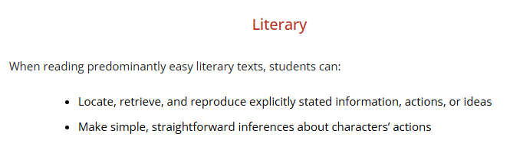
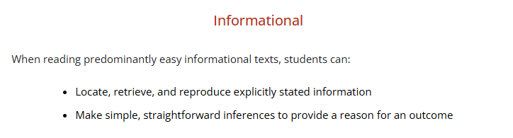
Low PIRLS International Benchmark (400)

Slide 18
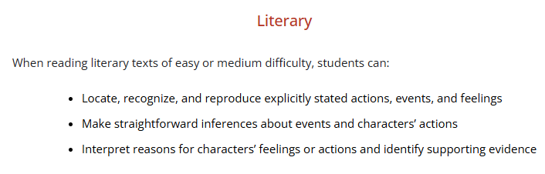
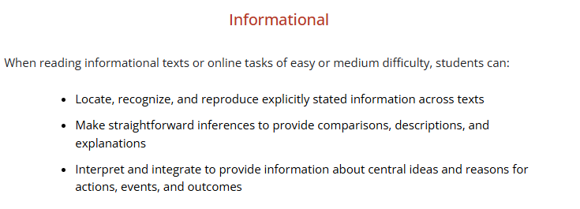
Intermediate PIRLS International Benchmark (475)

Slide 19

Reading Achievement at the International Benchmarks
Four PIRLS 2021 International Benchmarks
Advanced (625)—A Difficult Target—7%
High (550)—36%
Intermediate (475)—75%
Low (400)—94%
Percentages for Portugal are the same as the international median percentages based on 43 countries

Slide 20
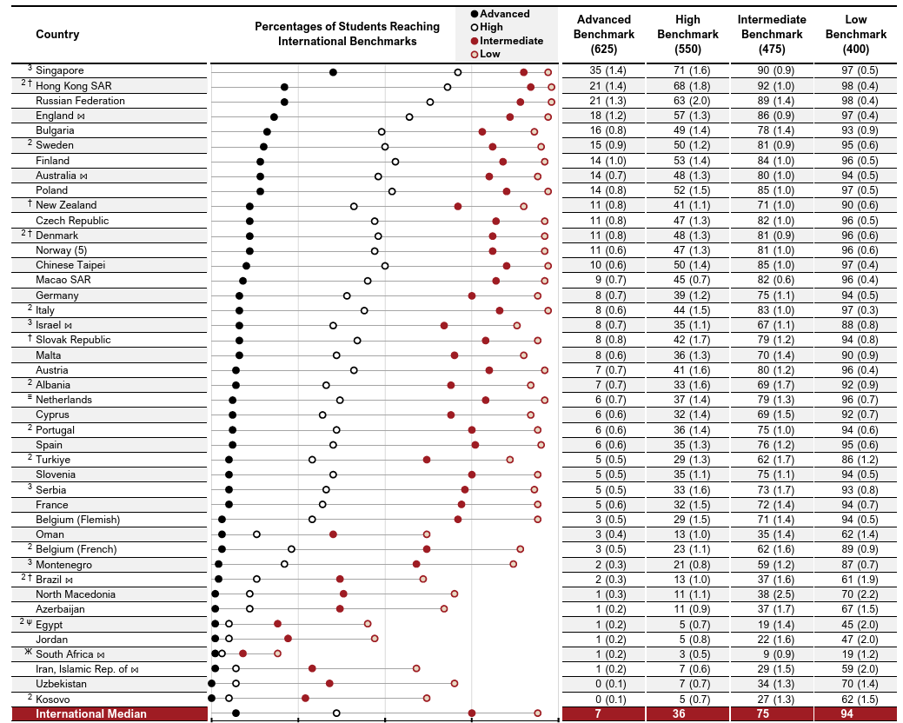
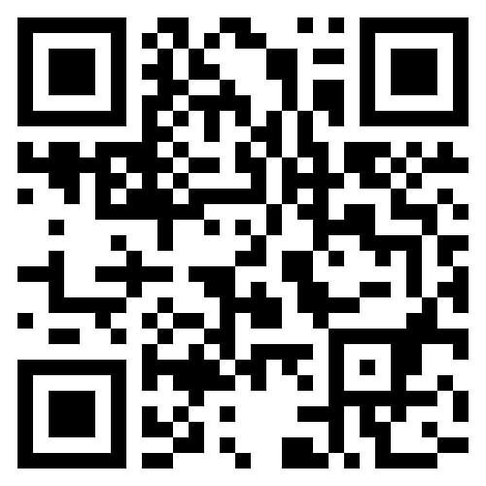
PIRLS 2021 International Results
Notes:
This table shows graphically the percentage of students reaching each of the international benchmark.
In the majority of countries, nearly all students reach at least the Low International Benchmark. However, there are 3 countries where less than half of the students reach at least the low benchmark (Egypt, Jordan, and South Africa).
The percentage of students reaching the Advanced International Benchmark ranges from 0% in Uzbekistan and Kosovo to 35% in Singapore

Slide 21
PIRLS Reading Achievement: Trends
Trends 2016-2021 32 Countries
3 Countries Higher Average Achievement
8 Countries Same Average Achievement
21 Countries Lower Average Achievement
Trends 2011-2016 40 Countries
18 Countries Higher Average Achievement
12 Countries Same Average Achievement
10 Countries Lower Average Achievement
Notes:
Countries also use trend results to evaluate their trajectories across the 5-year cycles.
The upward trends between 2011 and 2016 were in retreat in 2021.
3 countries with higher achievement in 2021: Egypt, Oman, and Singapore

Slide 22

PIRLS Reading Achievement: Girls and Boys
Girls had higher reading achievement than boys in 51 of 57 countries
Continues a long-standing pattern since PIRLS 2001, and evident in other reading assessments
On average, the gap was substantial (19 points)

Slide 23
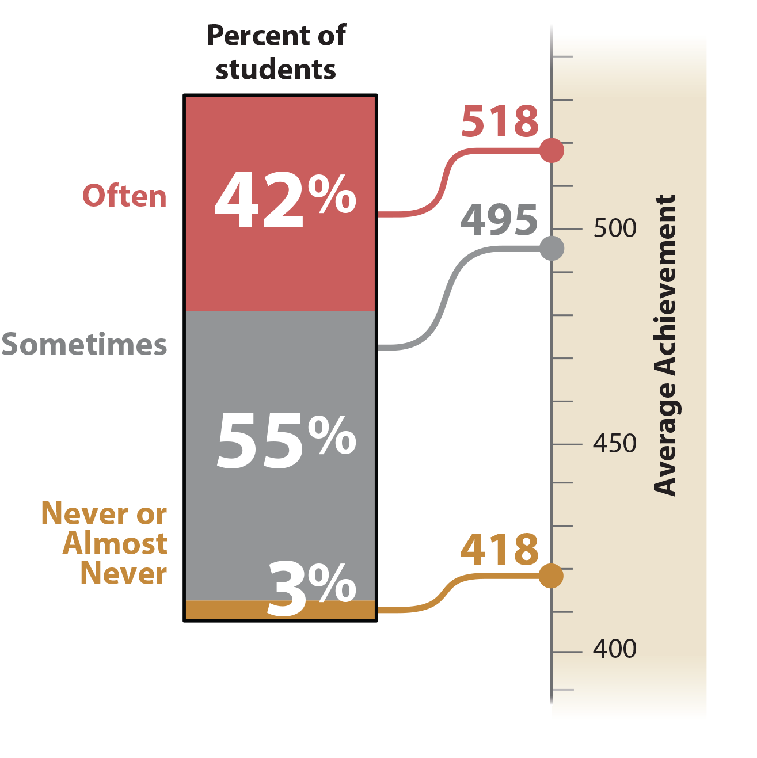
Home Early
Literacy Activities
Before Primary
School
Based on reading, telling stories, singing songs, etc.
There is a strong
relationship
between early
literacy activities
and reading
achievement, and most students’ parents often or sometimes did early literacy activities with
their children.

Slide 24
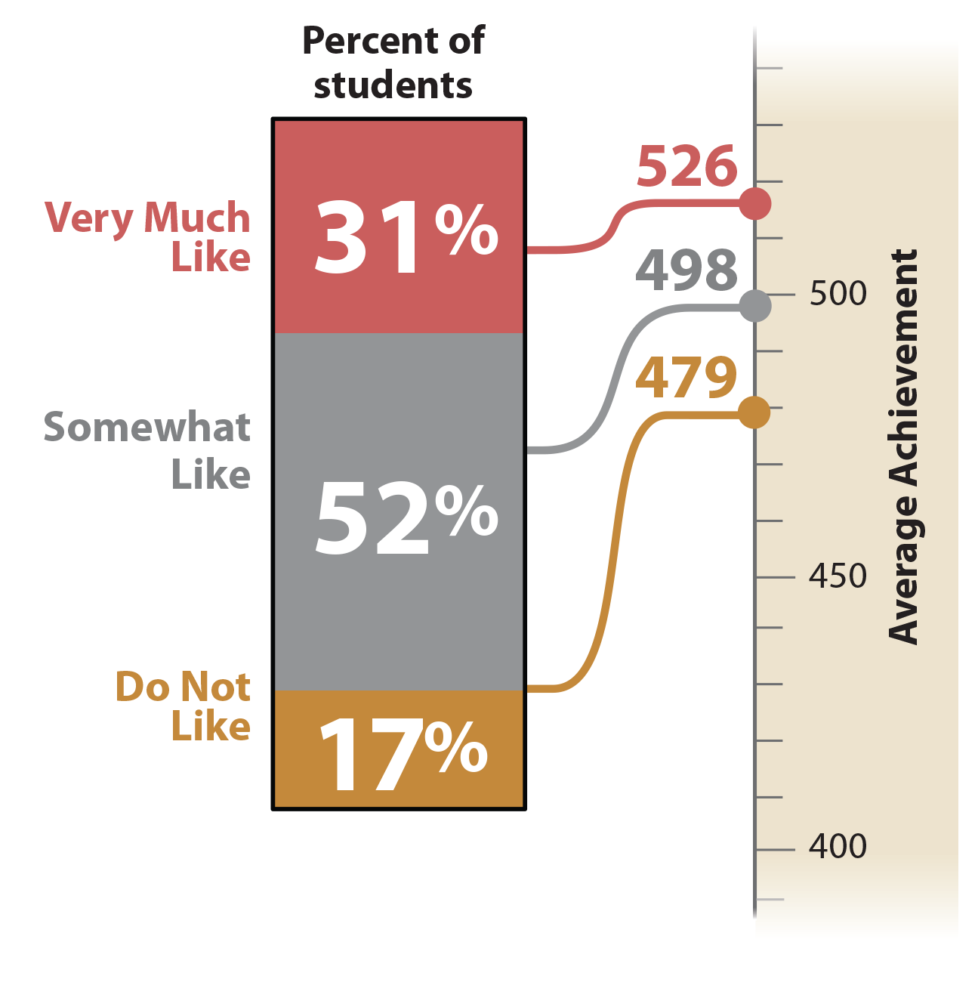
Parents Like
Reading
How much parents
like reading has a
positive relationship
with students’ reading
achievement.
On average, students whose parents very much like reading have higher reading
achievement than
students whose
parents somewhat
like reading or do not like reading.

Slide 25
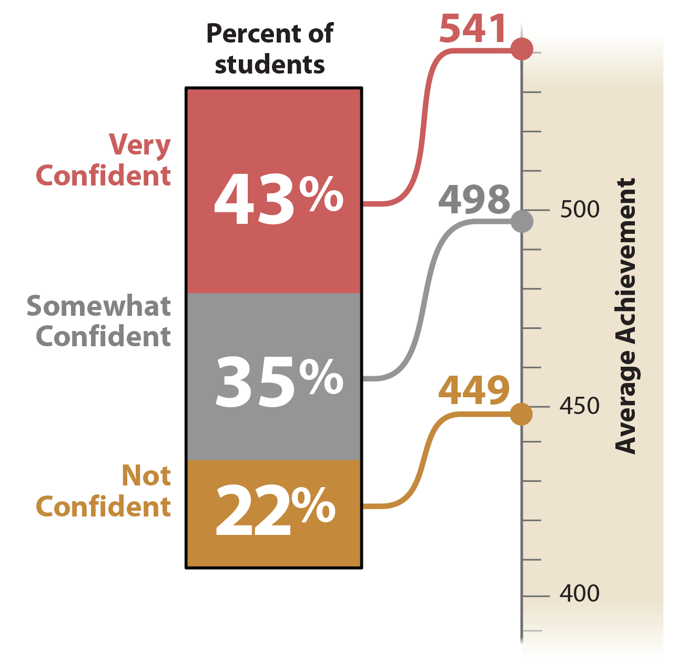
Students Confident
in Reading
Reported confidence in reading had a strong positive relationship with reading achievement.
Students who are very
confident in reading had higher reading achievement, on average, than students who were somewhat confident or not confident in reading.

Slide 26
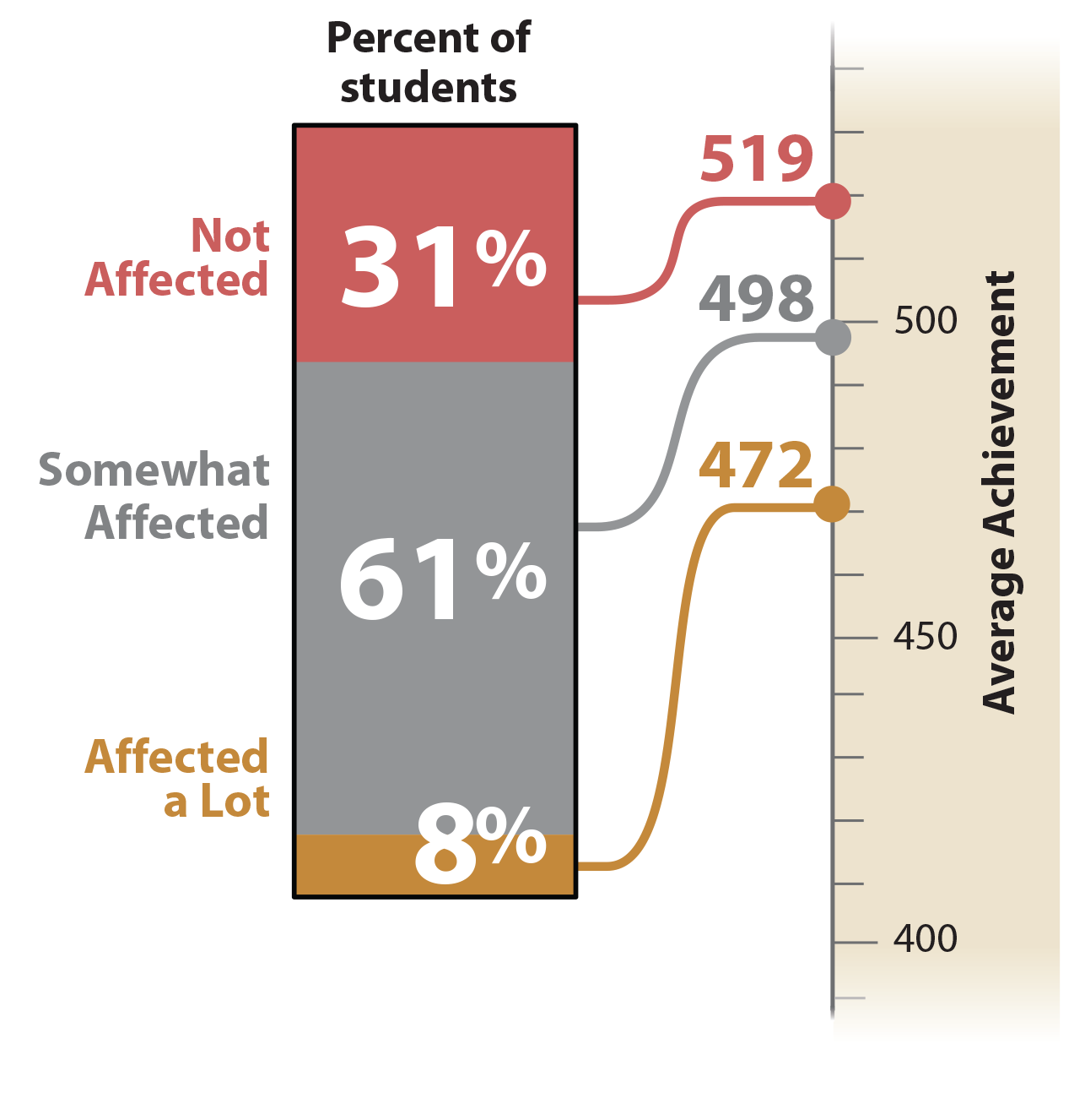
Instruction Affected
by Reading
Resource Shortages
Most students attended
schools that are either
not affected or somewhat affected by reading resource shortages.
Students in schools that were not affected by
reading resource
shortages have higher reading achievement, on average, than students in schools that were
somewhat affected or affected a lot.

Slide 27
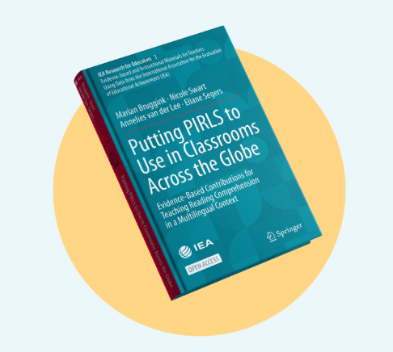
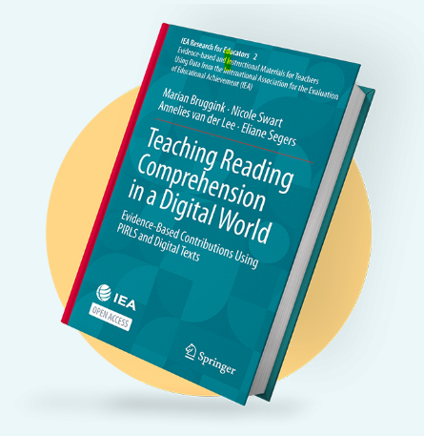
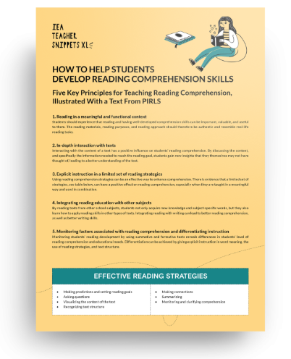
IEA Publications Supporting Research and Policy Discussions
PIRLS Insights Reports
IEA Compass: Briefs in Education
IEA Research for Educators
IEA Teacher Snippets
https://pirls2021.org/insights/
https://www.iea.nl/publications
Notes:
Three Insights Reports from PIRLS 2021: 1) Aspects of Student Well-being and Reading Achievement 2) COVID-19 Resources in PIRLS 2021, and 3) Socioeconomic Status in PIRLS 2021
IEA Research for Educators Volume 1: Putting PIRLS to Use in Classrooms Across the Globe (Translation to Portuguese in progress)
Volume 2: Teaching Reading Comprehension in a Digital World
Teacher Snippet (accompanying Vol. 1): How to Help Teachers in the Classroom (Translation in Portuguese available) The teacher snippet describes 5 key principles with a set of limited strategies for instruction to help enhance comprehension

Slide 28
Summary and PIRLS 2026

Slide 29
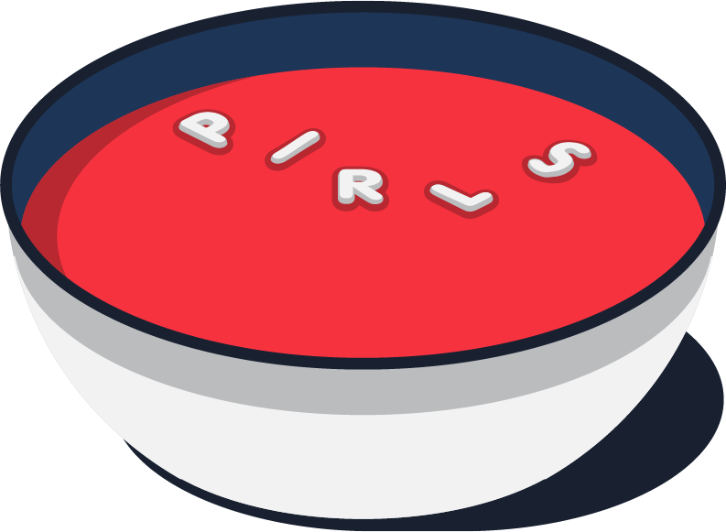
Summary
PIRLS provides system-level monitoring in a global context.
Countries can use PIRLS to evaluate curriculum reform and other strategies addressing several aspects of reading comprehension and factors related to reading achievement.
PIRLS should be only ONE source used to inform education policy; enhancing available information from other assessments, case studies, and stakeholder conversations.

Slide 30
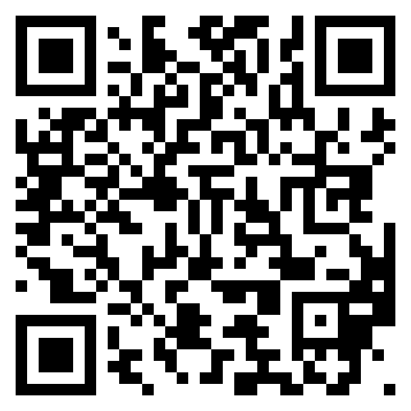
Upcoming PIRLS 2026 International Results and Database
PIRLS 2026 is currently being administered in 57 countries
The PIRLS 2026 Encyclopedia and Curriculum Questionnaire data will be available in November 2027
International results will be published in December 2027
The international database will be available to researchers in February 2028

Slide 31

THANK YOU!
Thank You!

