Slide 1


From Data to Action- A Senior Leader’s Perspective
Caroline Lang
Headteacher
Longsands Community Primary School
Notes:
Began teaching in 2000
Majority of career working with 4-7 years (KS1)
Anchorsholme Academy- 630 students- became Key Stage 1 lead in 2011
English lead- passion for phonics and early reading
2014 became Assistant Headteacher with responsibility for phonics, reading and writing, Assessment and staff training
Introduction of Success for all phonics and reading after poor reading results
Part of the review team for the DFE approved phonics scheme FFT Success for All Phonics
Involvement in Apex project- early adopter of the Reading Assessment Programme and introduction of tutoring programme ‘Tutoring with Alphie’ which then evolved to become ‘Tutoring with Lightning Squad’ and supported Apex project research into the impact of school based vision screening for all students (literally an eye opener!)
I saw the impact that high quality teaching paired with a systematic approach to assessment and early intervention had when pupil outcomes soon rose to above national averages at all key assessment points
April 2024- I left to pursue a role as Headteacher at Longsands Community Primary School

Slide 2
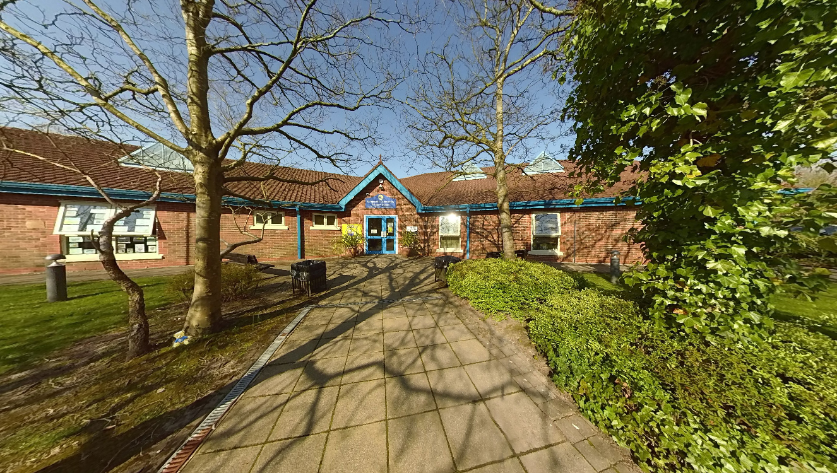
My School Context
213 pupils aged 4 to 11
24% of our 4 to 7 year olds do not speak English as their first language
Over 50% of our 4 to 6 year olds are summer born
In 2023-24 pupils outcomes showed a three year decline

Slide 3
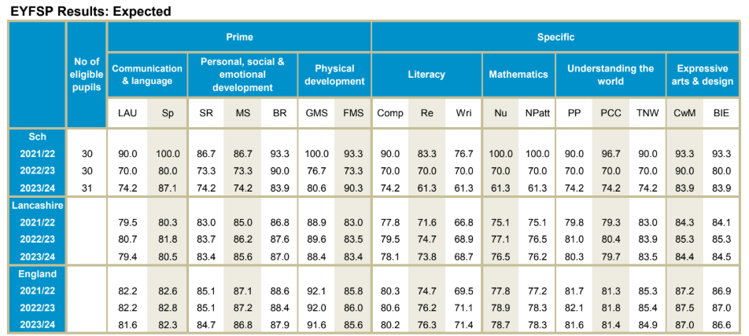
Literacy outcomes for our 5 year olds had been declining since 2021

Slide 4
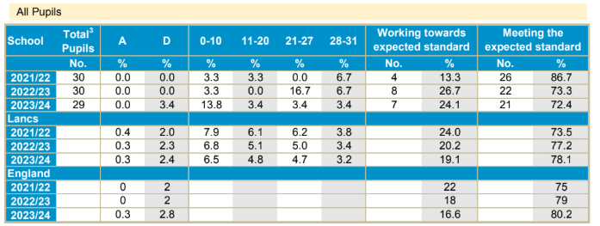
This pattern was repeated for our 6 year olds in the national phonics screening check

Slide 5
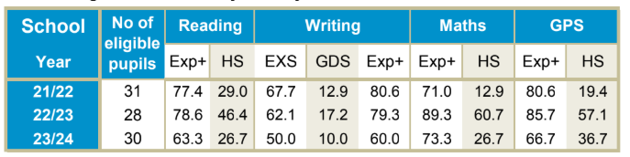
And our 11 year olds in their statutory national assessments
Exp+
Pupils reaching or exceeding the expected standard for 11 year olds
Notes:
How did the school get to this point and how were these children being set up to fail?
Not intentional- circumstancial
A curriculum that did not meet the needs of pupils
Keep up without any opportunity to catch up- no targeted teaching, all children received the same regardless of their starting points, ability or progress
A lack of regular assessment meant gaps were not identified early enough and for our 7 year olds, those gaps had widened over 3 years

Slide 6
Data driven decisions
April- July 2024
Introduction of FFT Reading Test
Introduction of Tutoring with Lightning Squad intervention programme
Investment in staff training
Review of the existing phonics and early reading programme
September 2024
Introduction of FFT Success for All Phonics in September 2024
ALL staff trained
Notes:
ROLE OF SENIOR LEADERS
Set priorities
Ensure consistency
Allocate resources based on need
Data → action
Staff training- all staff working with 4- 7 tear olds are trained in delivery of the phonics programme and reading test
5 members of support staff trained in delivering Tutoring with Lightning Squad
Supporting pupils with phonic development and decoding gaps

Slide 7
How soon are gaps identified?
Within the first 6 weeks of schooling, all 4/5 year olds are assessed
using the Reception Baseline Assessment.
This assesses early language, communication and literacy skills
When a child is highlighted as having gaps in understanding, this is followed
with a Wellcomm assessment- a speech and language screening tool that
identifies communication needs
Specific, play-based activities then target the areas of need for each individual
Oracy comes first…followed by phonics

Slide 8
Using assessment to inform teaching of phonics and early reading
All students begin the programme at the same point
First assessment point after approximately 6 weeks of phonics teaching
Students are then grouped according to stage not age
Currently have 6 phonics groups working across our 4-6 year olds
Staff deployment- our most valuable asset
Notes:
WAVE 1 intervention- quality first teaching
The most experienced/ confident staff work with students identified as having the greatest need
Pace varies according to the needs of children as to reaching styles- some more practical (CC group from 14 to 6 in a term)

Slide 9
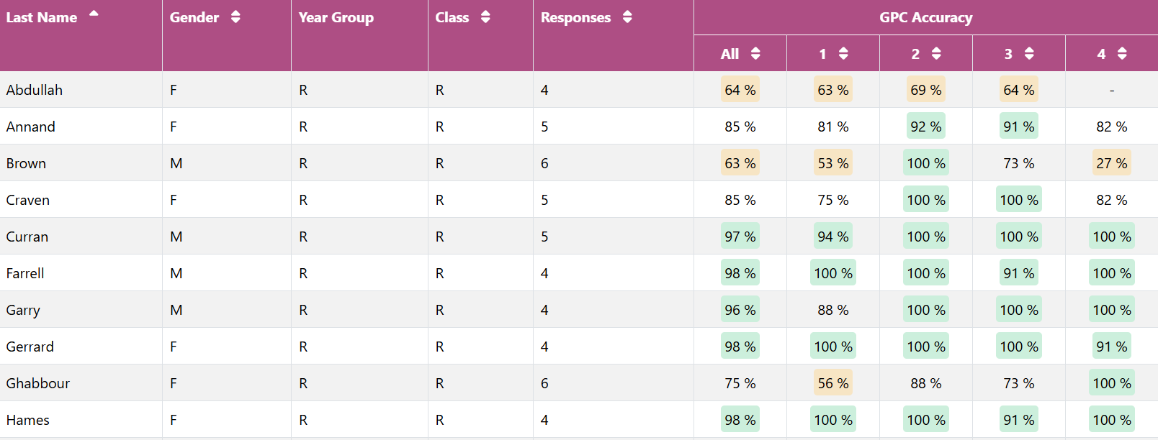
FFT Phonics Assessment
This assessment is carried out approximately every 6 weeks with our 4 to 6 year olds and is aligned to our phonics programme which teaches grapheme phoneme correspondence (GPCs)
Notes:
This level of assessment data enables teachers to group students appropriately- stage not age!
Children are taught in mixed age groups that meet the child where they are at in the journey of learning to read- phonic knowledge, decoding ability and fluency

Slide 10
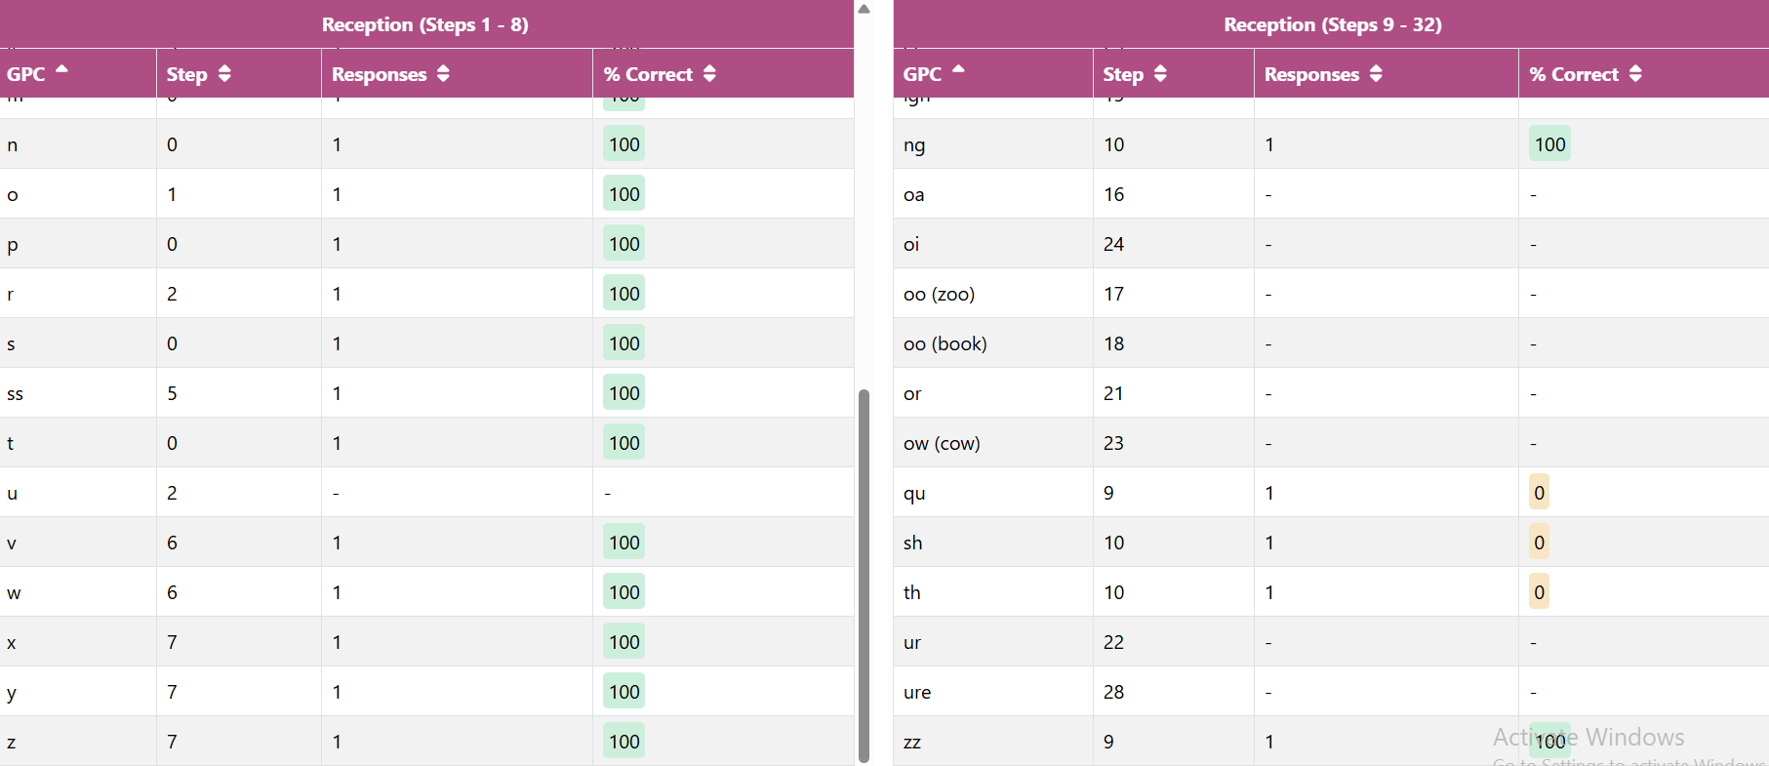
FFT Phonics Assessment
This assessment enables teachers to identify exactly where there are gaps in a student’s understanding
Students can then be grouped appropriately and gaps targeted quickly
Notes:
We call this Wave 1 intervention- subtle adjustments to teaching sequences, consolidation of prior learning and targeted teaching

Slide 11
Decoding & Fluency
FFT Reading Test is used as a baseline for all pupils aged 6 and above
This is an adaptive reading assessment that provides the following for each individual;
Fluency Standardised Score
Fluency Score (Words Correct Per Minute)
Fluency Reading Age
Decoding Score
Decoding Standardised Score
Decoding Reading Age

Slide 12
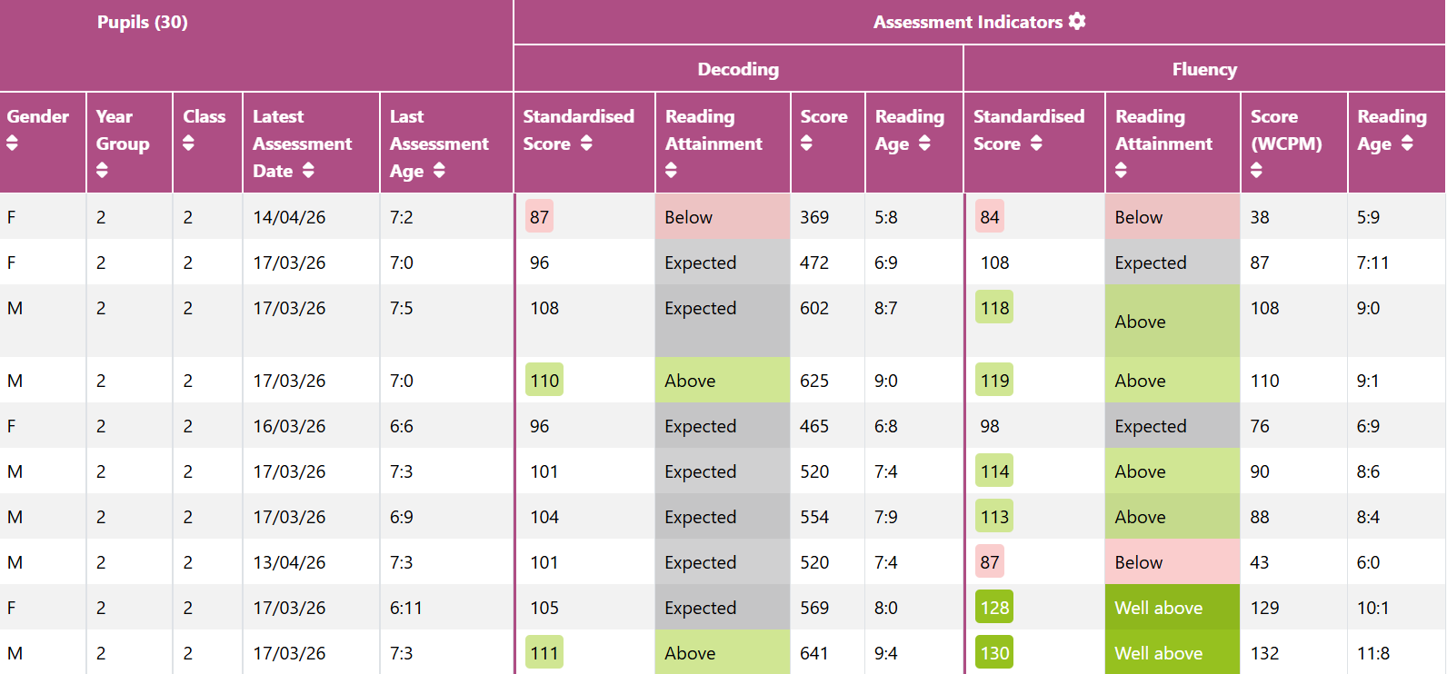
FFT Reading Test
Diagnostic/ summative or both?
Notes:
Pin pointing the areas of need- is it decoding or is fluency or is it both? This determines the type of intervention an individual receives

Slide 13
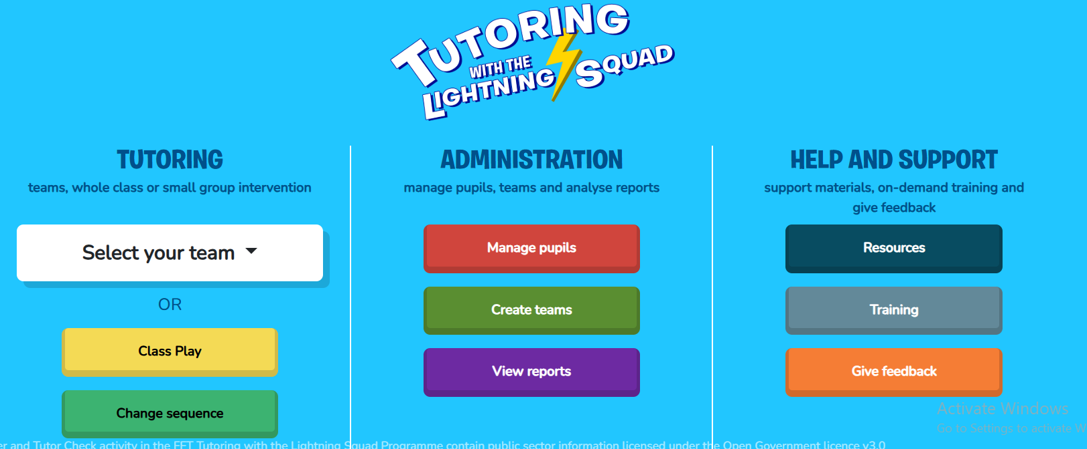
Wave 2 intervention
Sometimes, learning gaps are more significant and longer term intervention is required.
Short, daily sessions (20 minutes a day)
Targeted support- pupils identified from FFT Reading Test
Delivered by trained staff- 5 trained members of staff
Reviewed every 6 weeks
Notes:
Many of our older students had significant learning gaps that had developed over 4 to 5 years of education. A more structured approach to addressing their barriers comes through Tutoring with the Lightning Squad
This intervention programme supports phonic

Slide 14
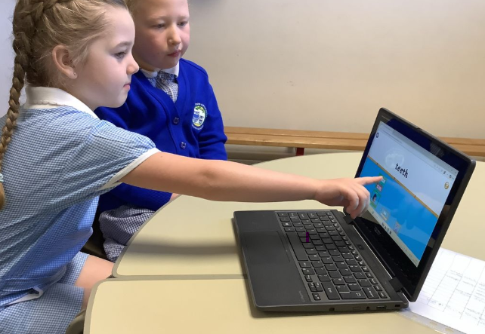
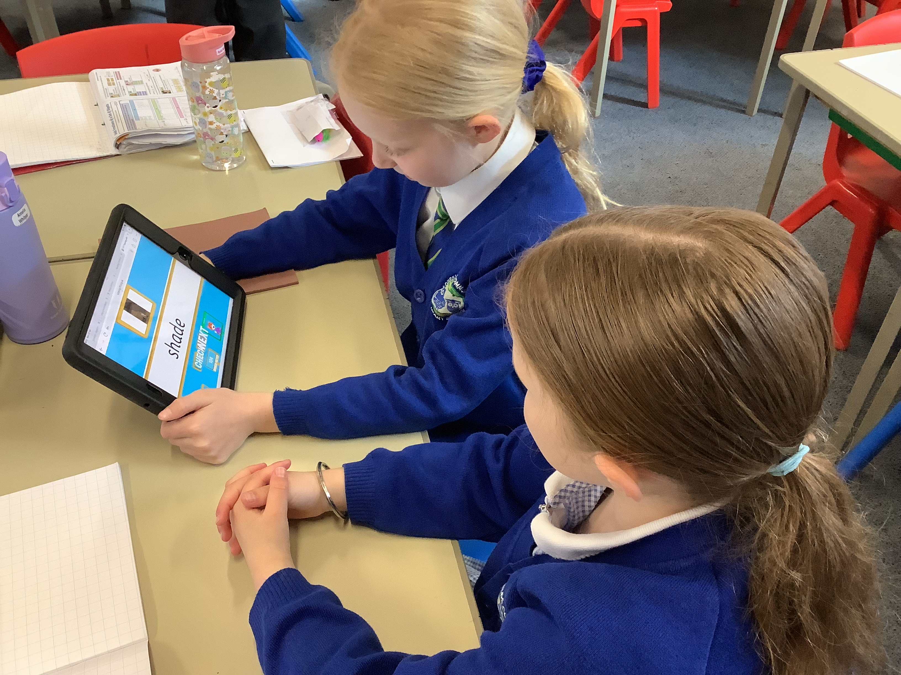
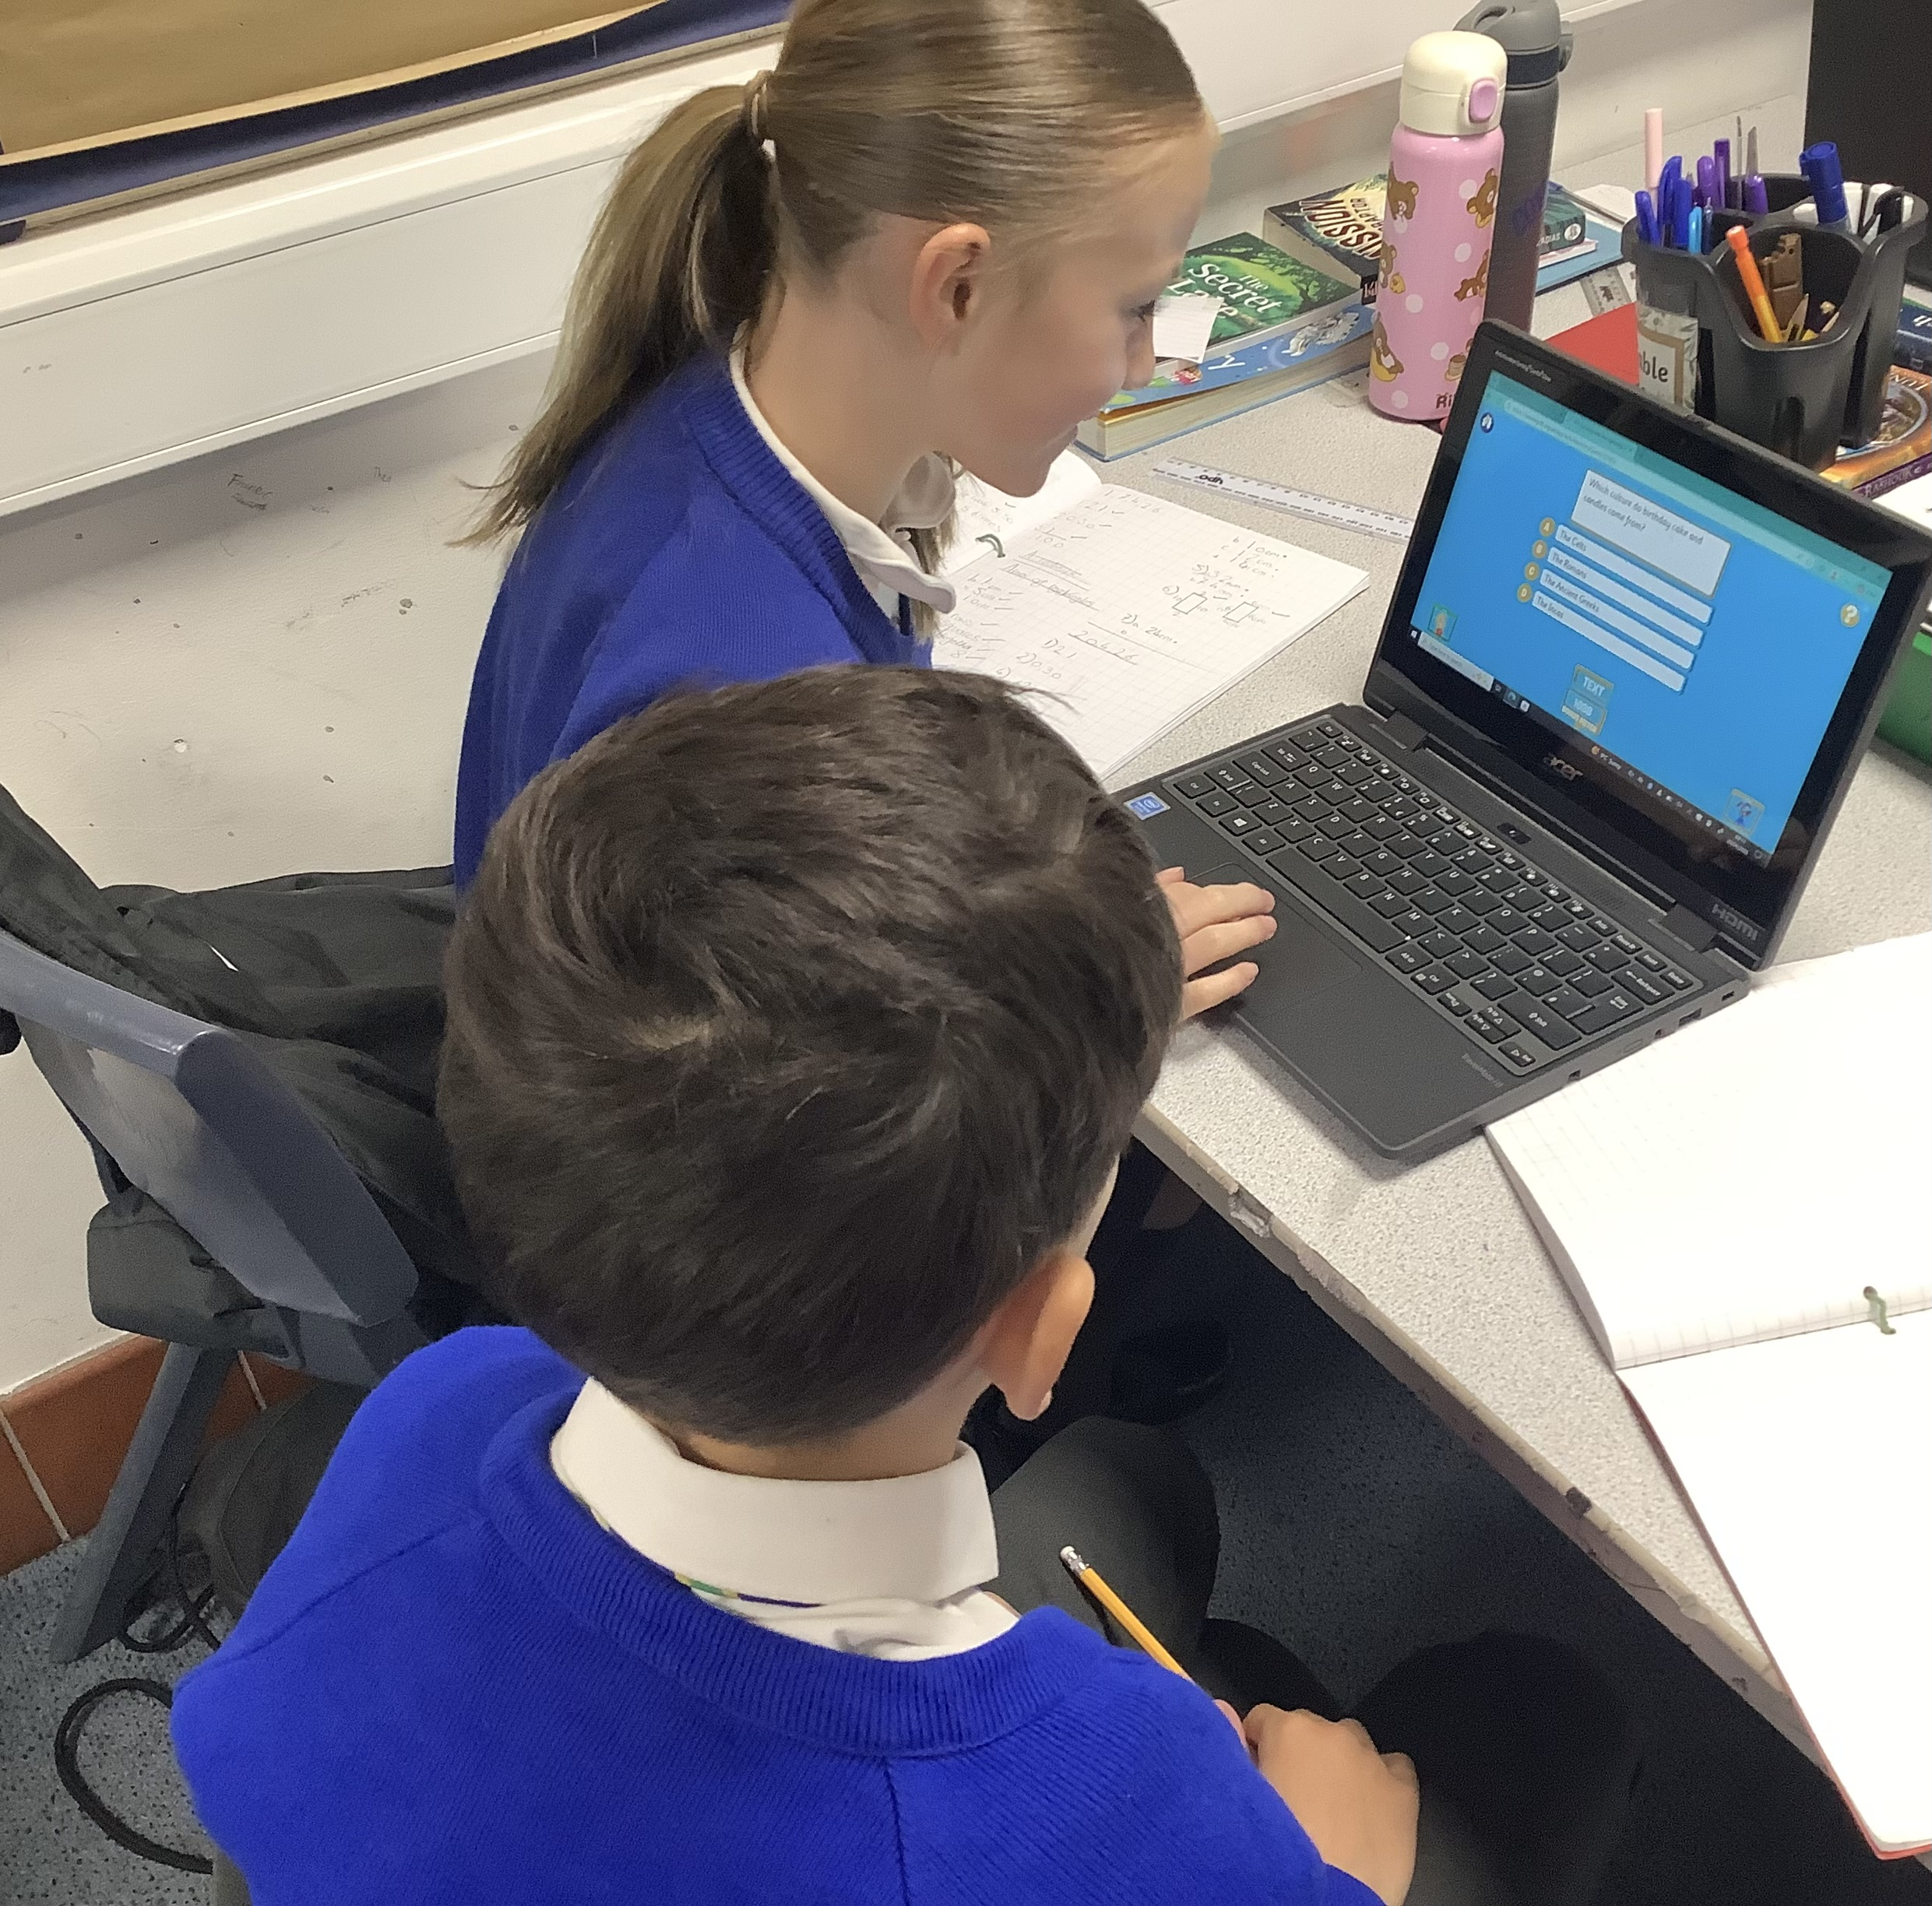
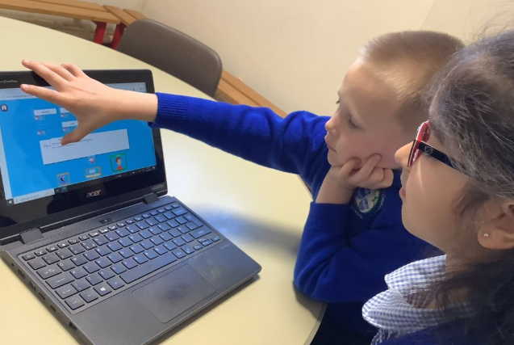

Slide 15
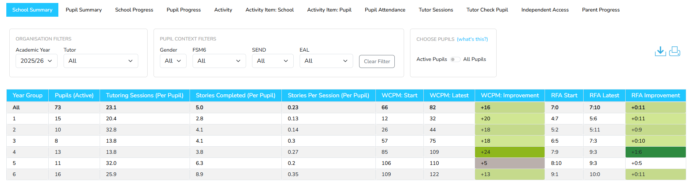
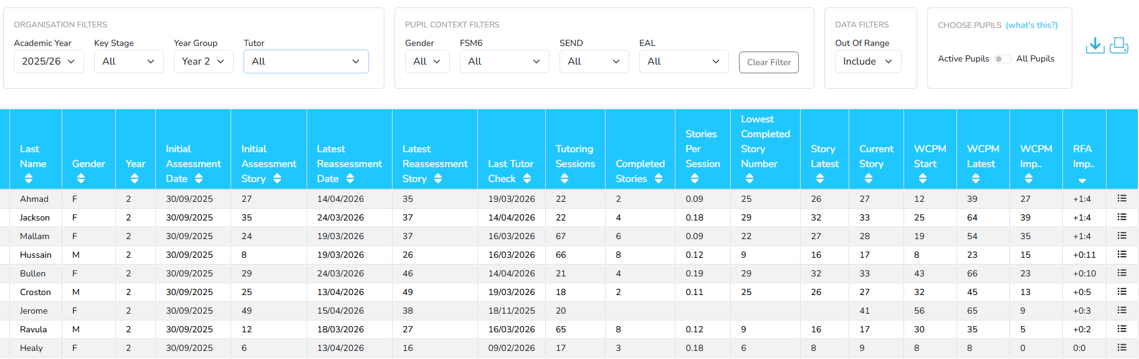
Wave 2 intervention

Slide 16
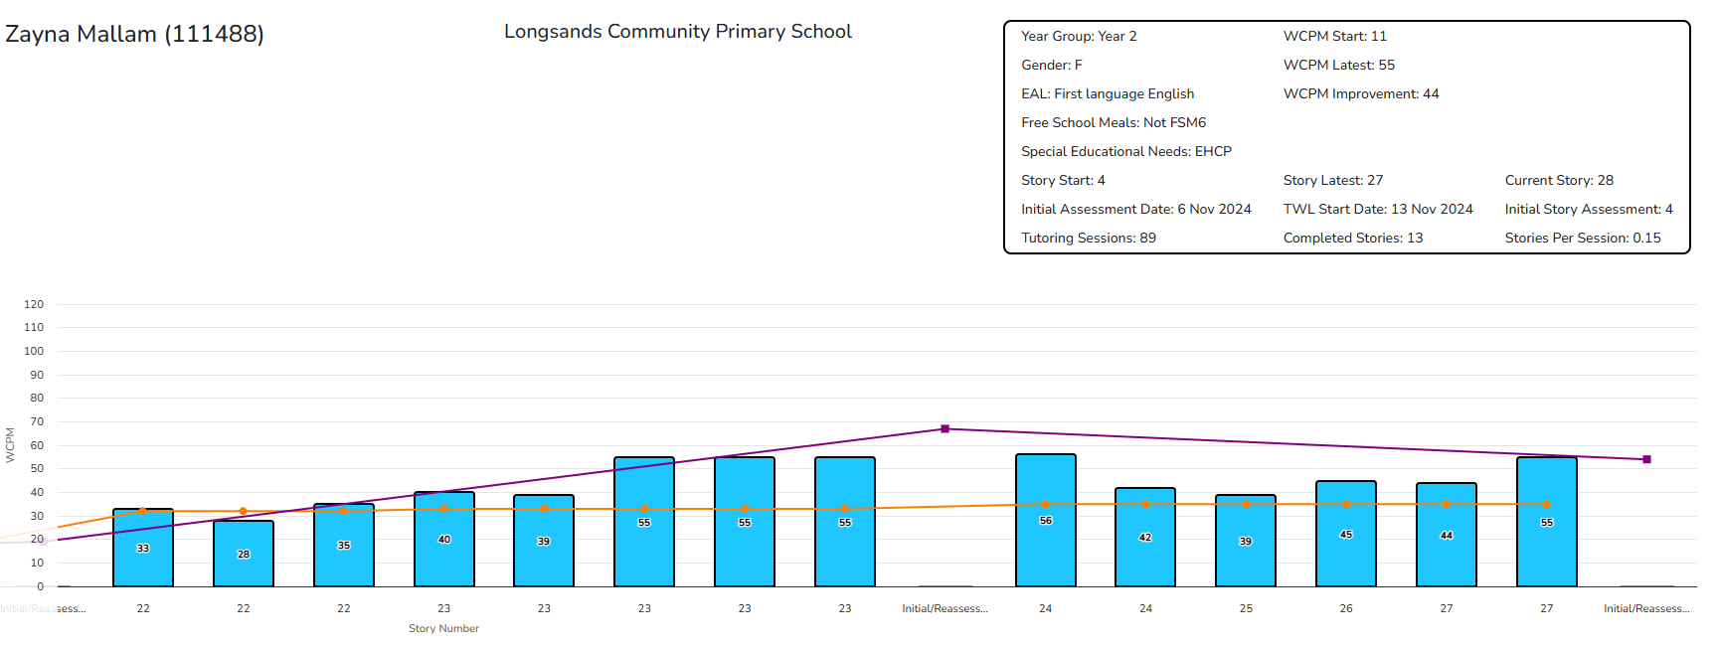
ZM is 7 years old
She has special educational needs
Until the age of 5, she did not speak and was having regular speech and language therapy
She started Tutoring with Lightning Squad in September 2024 with a fluency rate of 14 words correct per minute (WCPM)
It was last assessed at 55 WCPM and her Reading Fluency Age had increased by 1.4 years

Slide 17
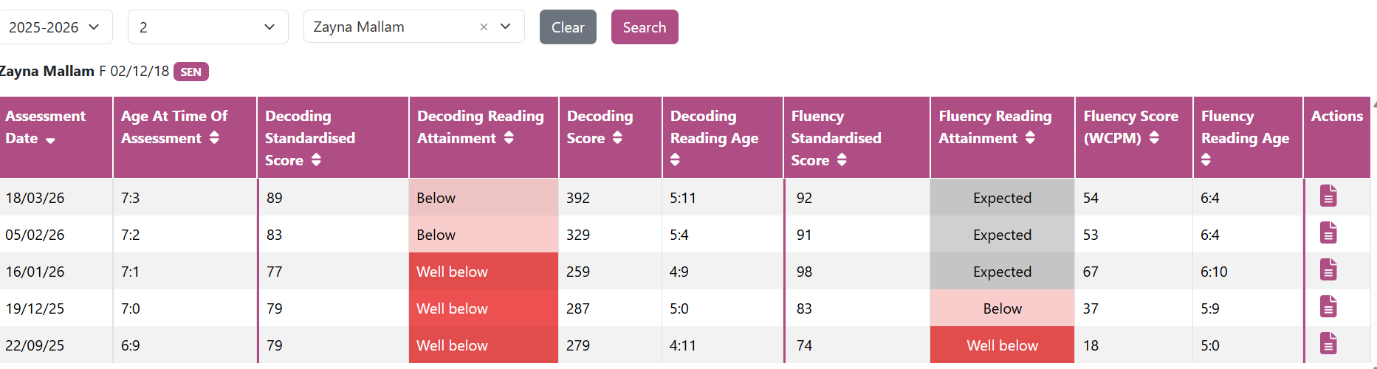

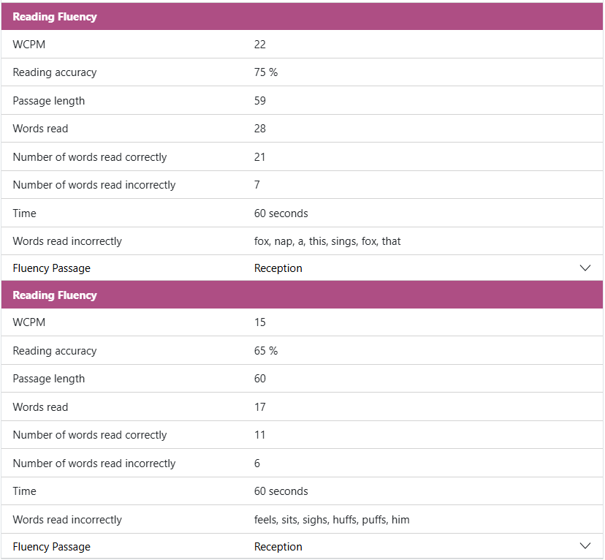
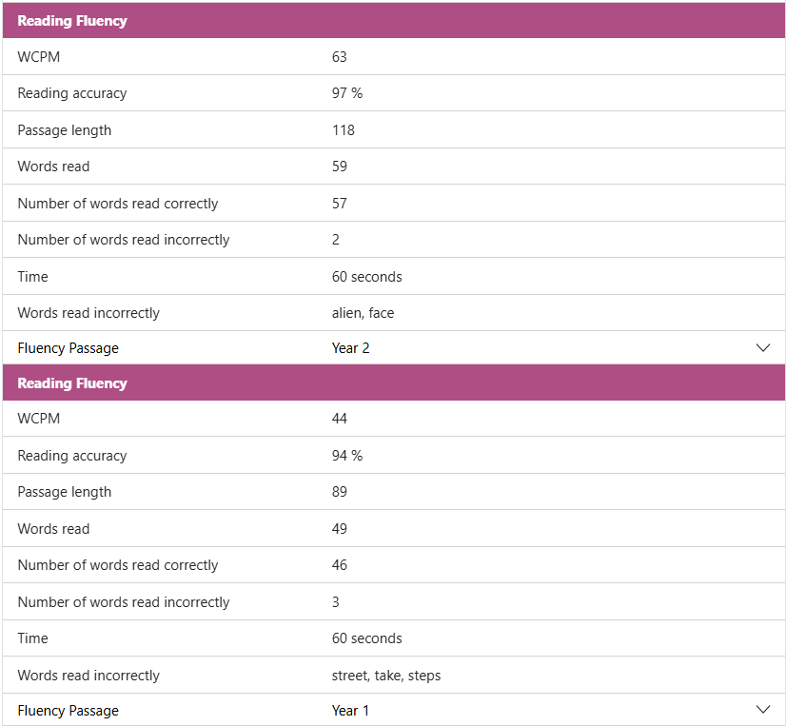

Slide 18
Monitoring Progress
Regular assessment cycles
FFT Reading Test- 6 times per year
FFT Phonics- approximately every 6 weeks
Teaching
Observations- fidelity, consistency and confidence
Learning walks
Track individuals & groups
Compare against benchmarks
Analysis of pupil progress reports within FFT
Repeat gap analysis and identify next steps
Pupil progress meetings every 6-8 weeks
Review impact of interventions
Notes:
Reading test- baseline at start of year and for any children that move to the school

Slide 19

Building Staff Culture
Clear priorities- School Self Evaluation and School Improvement Plan
Regular data discussions- pupil progress meetings
Training on data use- assessment lead, ongoing professional development
Internal moderation- key stage meetings
Collective responsibility
Share progress & targets- formal reports, parents evenings and through the SEND cycle of target setting and review
Parent workshops- phonics and early reading
Support reading at home
Notes:
Priorities are shared with all staff
Accountability- pupil progress meetings with senior leaders

Slide 20
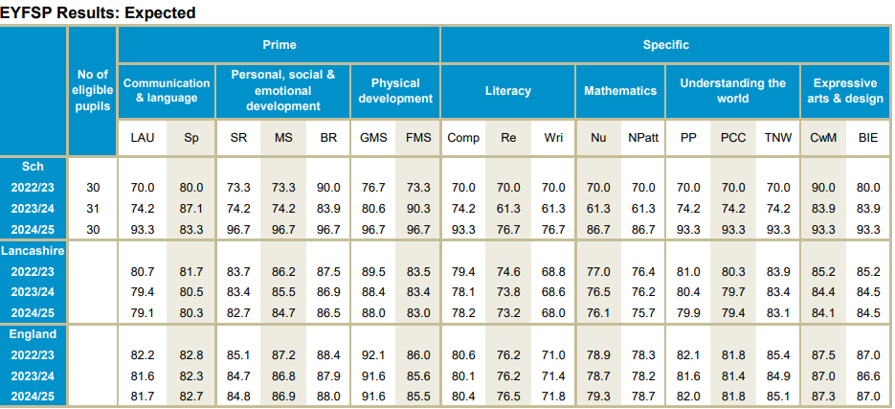
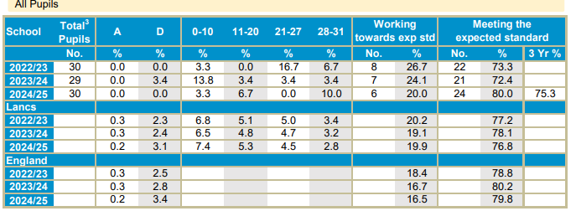
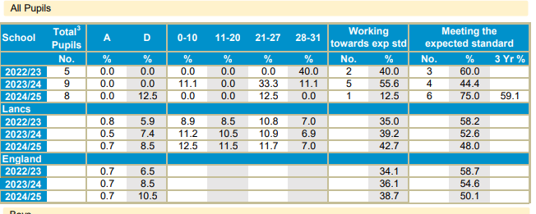
What has been the impact?
5 year olds meeting expecting standard for reading and writing up from 61%to 76%
6 year olds meeting the expected standard in phonics up from 72% to 80%
7 year olds retaking the phonics screening check and meeting expected standard up from 44% to 75%
Our intervention children!
Notes:
And at the end of primary aged 11 outcomes at expected standard for reading went from 66% to 81% and from 52% in writing to 68%

Slide 21
Key Takeaways
Early identification matters
Data must inform action
Culture is key
Things to consider
What are your barriers?
How early do you identify needs?
Next steps?
Notes:
Assessment and the data it provides is only as useful as the actions it drives
Potential barriers- staffing to deliver interventions, cost implication
Staff training and confidence

