Slide 1
Curriculum content for Teacher Preparation and In-Service Professional Development
EDULOG 2026
Porto, Portugal
Jennifer Buckingham
5 May 2026
Executive Director, CESE Policy & Evidence

Slide 2
Overview
How children learn to read
The science of reading
The structures of language
The most effective way to teach
The science of learning
Explicit instruction
Evidence-based frameworks
The importance of knowledge
A non-categorical approach
Assessment and progress monitoring
Planning for teaching and assessment
Notes:
There are many things that a teachers needs to know if we are thinking about the entirety of their professional responsibilities.
Today I am going to focus on the teaching of reading. Of course, in 30 minutes I can only give you the headlines. The actual content would be taught in teacher preparation over months or even years.
There are two essential things that teachers need to know to be effective teachers of reading:
How children learn to read
The most effective way to teach them

Slide 3
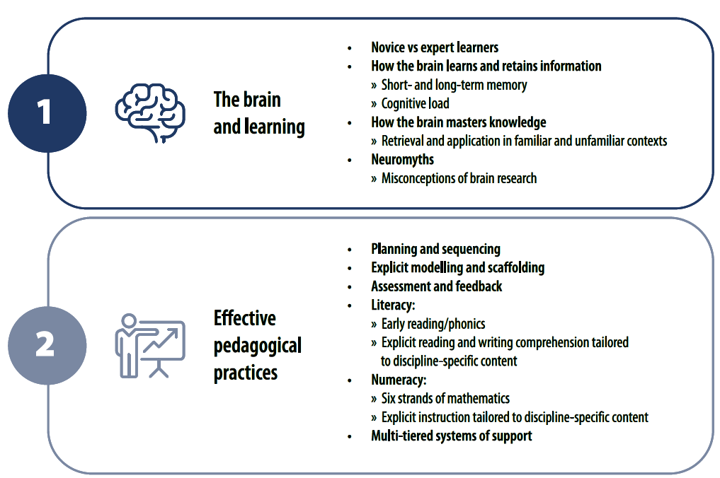
Strong Beginnings: Report of the Teacher Education Expert Panel (2023)

Slide 4
The science of reading

Slide 5
A definition
“[T]he body of work referred to as the ‘science of reading’ is not an ideology, a philosophy,
a political agenda, a one-size-fits-all approach, or a specific component of instruction.
It is the emerging consensus from many related disciplines, based on literally thousands
of studies, supported by hundreds of millions of research dollars, conducted across the
world in many languages. These studies have revealed a great deal about how we learn
to read, what goes wrong when students don’t learn, and what kind of instruction is most
likely to work the best for the most students” (Moats, 2020).

Slide 6
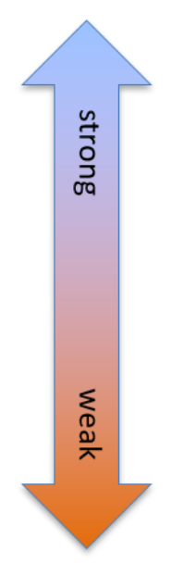
Evidence hierarchy
Gold | Level 1​ | Systematic review or meta-analysis of relevant RCTs​
 | Level 2​ | At least one large RCT​
Silver | Level 3​ | Well-designed controlled trials​
 | Level 4​ | Well-designed cohort studies​ and evaluations
Other | Level 5​ | Systematic reviews of descriptive and qualitative studies​
 | Level 6​ | A single descriptive or qualitative/case study​
 | Level 7​ | Opinion or report of committee​
https://education.nsw.gov.au/about-us/education-data-and-research/cese/evaluation-evidence-bank/evidence-hierarchy
Notes:
Evidence’ has a specific meaning in the science of reading
Teachers don’t need to be experts in research methods but should have enough knowledge to be able to scrutinise claims about research and evidence

Slide 7
Why the quality of evidence matters
Research that is conducted using scientific research protocols is
Reliable
Replicable
Generalisable
Notes:
Research that is conducted using scientific research protocols allows us to have greater confidence that the findings represent the truth.
Following a set of scientific protocols makes the method, interventions, measures and analysis in a study transparent so it can be replicated as closely as possible.
The larger the number of studies and the wider the variety of students and contexts, the more we can expect that the same cause and effect relationship will occur in our own setting.

Slide 8
The structure of language

Slide 9
Orthography – the spelling system
Like English, Portuguese is an alphabetic language.
In alphabetic languages, the sounds in spoken words are represented by letters of the alphabet in written words.
The letters of the alphabet and the accents are a code for the sounds in speech.
They can be decoded to read words or they can be encoded to spell words.
Like English, the spelling of Portuguese words is a function of:
1. phonemes (individual speech sounds)
2. syllables (sound based sub-units)
2. morphemes (meaning based sub-units)
Notes:
At the most basic level, spoken and written language has two main components
The words we use.
The order in which we use them.
The words we use have their own substructures. The orthography of a language is the way words are constructed.

Slide 10

One word, three sub-lexical structures
Phonemes:
/t/ /e/ /l/ /ɛ/ /f/ /o/ /n/ /i/
Syllables:
te-le-fone
Morphemes:
tele- (“far”) + -fone (“sound”)

Slide 11
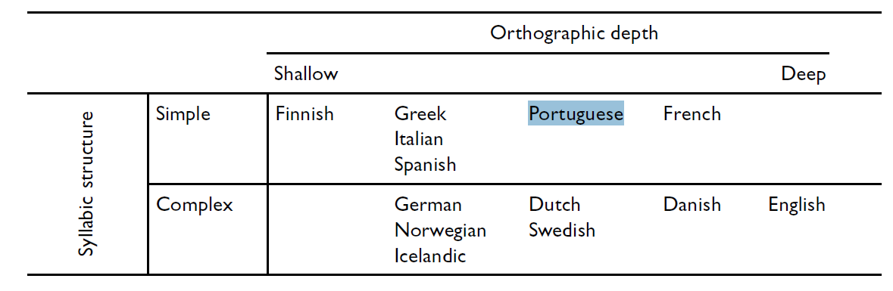
Orthography – the spelling system
Children learn to read more easily in languages with a shallow orthography and simple syllabic structure.
Portuguese has been described as having a moderately deep orthography.
The alphabetic code is reasonably regular but dual processing of phonemes and morphemes is required to read many words .
Seymour, Aro and Erskine (2003)

Slide 12
Tiny visual differences have dramatic effects
One tiny line transforms:
A grapheme from from <P> to <R>
A phoneme from /p/ to /r/
A word from PAT to RAT
Notes:
As skilled decoders and readers it is easy to underestimate the sophisticated visual and auditory discrinimation required to detect the differences between letters.

Slide 13
Syntax – the organising system
Syntax is the order in which words and phrases are arranged in a sentence.
A small change in the order of words in a sentence can change its meaning, by a little or to mean the complete opposite.
I almost failed every test. ⇨ You passed, but barely.
I failed almost every test. ⇨ You did very badly.
      I like Kate more than Alex. ⇨ Kate is your favourite.
      I like Alex more than Kate ⇨ Alex is your favourite.

Slide 14
Evidence-based frameworks of reading

Slide 15
Evidence-based frameworks
Simple View of Reading
Cognitive Foundations Model
The Five ‘Big Ideas’ or components of reading
The importance of knowledge

Slide 16
Scientific evidence-based theoretical frameworks or models of reading
According to Hoover and Tunmer (2020), a framework
        “… provides a way for reading professionals to think about reading and its development and gives them mechanisms that, coupled with such understanding, will help them link what children must know to become strong readers to what teaching can best provide through the competent use of available tools.”
Notes:
Theoretical (sometimes called conceptual) frameworks or models are used in all disciplines and attempt to represent the factors that contribute to an occurrence, and the way in which those factors relate to each other.
For researchers, it allows specific hypotheses to be tested and either supported or refuted, and build a coherent evidence base.

Slide 17
Frameworks are useful because they…
Increase the likelihood that all of the essential aspects of reading development are included in planning and guidance
Reduce the likelihood that instruction and assessment might become heavily skewed toward one set of skills or knowledge
Reassure school leaders and teachers that a policy or professional learning that is focused on one aspect of reading does not mean that others are dismissed or neglected
Provide a structure that it is understood, accepted and implemented consistently

Slide 18
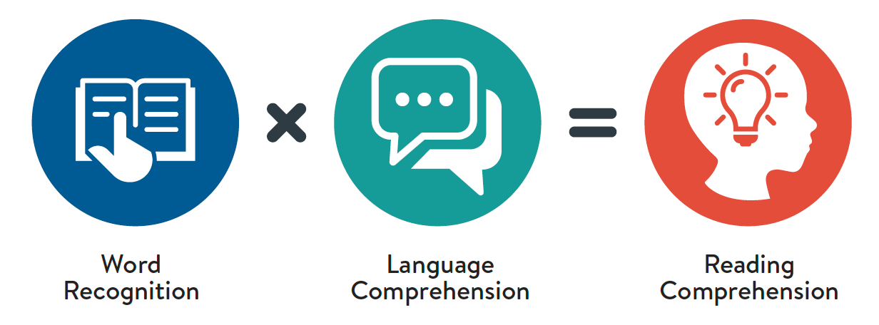
Simple View of Reading
Gough & Tunmer (1986). Image from Wheldall et al. (2023)
Notes:
We must start with the Simple View of Reading which was is usually attributed to a journal article by Philip Gough and William Tunmer in 1986 or by Wesley Hoover and Philip Gough in 1990.
The simple view of reading has been tested in the highest quality experimental and empirical research studies in multiple languages in multiple countries and has been found to be a robust theory of reading. These studies have shown that if we measure students’ ability to accurately read words, whether in a list or a passage, and we also measure their ability to understand spoken language, we can very accurately predict their reading comprehension.
One of the reasons that this research has been so consistent and compelling is because there are pure measures of the two factors. Word recognition (which was originally called decoding) can be measured in a pure way through non-word or pseudo-word assessments. Vocabulary is not a confounder in these assessments. Language comprehension can be assessed through an oral language assessment that involves no reading, so word recognition is not a confounder.
We know that there is more to reading than just this, but it turns out there’s not a lot more. Although oral reading fluency – the ability to recognise words both accurately and quickly – is strongly correlated with reading comprehension, research has not consistently shown that it makes a significant independent contribution in addition to the 2 factors. It seems to depend on the phase of reading development of the students and to some extent on the complexity of the orthography.

Slide 19
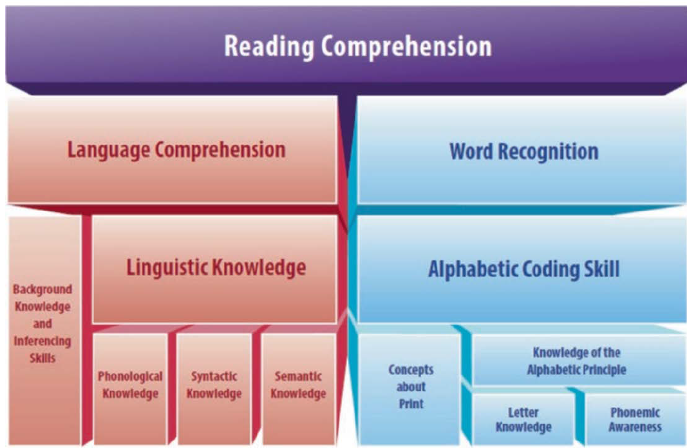


Cognitive Foundations Framework
Hoover & Tunmer (2019)
Notes:
The Cognitive Foundations Framework is relatively new. It was developed by two of the researchers behind the Simple View of Reading, Wesley Hoover and Bill Tunmer.
The CFF extends the Simple View of Reading. It shows the hierarchical and nested nature of the subskills of the two factors. The message is not that these various skills develop in an entirely discrete way – we know that phonemic awareness does not need to be completely developed before learning alphabetic coding, they progress together, but a basic level of PA makes learning alphabetic coding easier. There are interconnected and bidirectional relationships amongst all these components.
The CFF deconstructs and defines the components of reading and provides a more detailed map for teachers and curriculum developers and planners.
You might be wondering at this point, what about the 5 ‘keys’ to reading, which have been consistently proven to be the essential skills for reading since the US National Reading Panel report was published in 2000.
These are still the foundations of reading – and you can see them represented in the Simple View of Reading and the Cognitive Foundations Framework, but they are not a model or framework.
None of these reading frameworks prescribe methods of teaching. For that, we need to look more closely at another body of evidence which we will come to shortly.

Slide 20
Five ‘Big Ideas’ or components of reading
Component | Description
Phonemic awareness | The ability to identify and manipulate the distinct individual sounds in spoken words.
Phonics | The ability to decode words using knowledge of letter-sound relationships.
Fluency | The ability to read with appropriate speed, accuracy and prosody.
Vocabulary | The ability to understand the meanings of a wide variety of words.
Comprehension | The ability to understand the meaning and intent of a whole text.

Slide 21
The SVoR in European Portuguese
Word recognition
Word reading accuracy
Oral reading fluency
Morphological awareness
Language comprehension
Non-verbal reasoning
Vocabulary
Listening comprehension
Notes:
Researchers at the University of Minho have conducted a number of studies of the subcomponents of the Simple View of Reading to validate it as a framework for reading in Portuguese.
Their findings support the fundamental roles of word recognition and listening comprehension, but their findings have extended the model beyond these basic descriptions.
In Portuguese, listening comprehension exerts a stronger influence on reading comprehension than word recognition, which is an expected finding in an orthography with intermediate depth.
However, they also found that oral reading fluency was a moderate direct predictor of reading comprehension in primary school. Although the word recognition component of the Simple View encompasses automatic recognition of words, these findings relate to passage reading fluency.
In subsequent studies, it was found that the strength of the relationship between fluency and comprehension decreased and stabilised over time. Once students achieve a threshold level of word recognition and then fluency, their growth in reading comprehension is largely determined by their language comprehension. Language comprehension is a broad skill with many elements. The Minho research team found that non-verbal reasoning was a significant factor but once students had become relatively fluent readers.
It is important to note that although listening comprehension plays a larger role in reading comprehension in Portuguese in the early stage of reading development than in English, the basic principle of the Simple View of Reading still holds. Both word recognition and language comprehension are essential for reading comprehension. If either is absent or weak, reading comprehension will be absent or weak.
Ribeiro et al. (2016) Beyond word recognition, fluency, and vocabulary: The influence of reasoning
on reading comprehension, Australian Journal of Psychology, 68, 107-115.
Cadime et al. (2017). The role of word recognition, oral reading fluency and listening comprehension in the simple view of reading: a study in an intermediate depth orthography, Reading and Writing, 30, 591-611.
Fernandes et al (2017). Reading development in European Portuguese: relationships between oral reading fluency, vocabulary and reading comprehension, Reading and Writing, 30, 1987-2007.
De Frietas et al (2027). Morphological awareness, word reading and reading comprehension in Portuguese, Applied Psycholinguistics, 39, 507-525.
Cadime et al. (2024). Does reading fluency mediate the relationship between cognitive-linguistic skills and reading comprehension? A study in European Portuguese, Cognitive Development, 71, 101490.

Slide 22
The importance of background knowledge
The quantity and quality of knowledge that the reader can draw on when reading text is a strong predictor of comprehension.
Knowledge is thought to be organised into networks of connected facts and concepts, called schemata in long term memory.
Knowledge is essential for inference generation – bridging the gap between what is in the text and what is assumed.
Knowledge contributes to the development of a mental model/situation model which is built using aspects of the text and the readers’ existing knowledge. It changes as more information is integrated.
A strong mental model facilitates comprehension and encodes information into long term memory enriching the schemata.
A weak mental model inhibits the ability to make inferences, filter out irrelevant information, identify contradictory information, and overcome text complexity and coherence challenges.
Notes:
Background knowledge is included as a component in the Cognitive Foundations Framework. It’s implicit in the Simple View of Reading in the language comprehension and the Five ‘Big Ideas’ through vocabulary.
However, it is worth talking about separately as it is not always given sufficient attention. In Australian schools, and as I understand it many other places, the teaching of reading and writing has been treated as a discrete skill. Books used for teaching reading have often been storybooks and fiction so children become familiar with the narrative structure, but without systematic building of general knowledge or background knowledge, reading and learning is hindered. It is important for teachers of reading to bear this in mind when choosing texts for reading in the classroom.
Read slide

Slide 23
A bi-directional relationship
Reading comprehension is highly dependent on background knowledge but the relationship is bi-directional. Students need comprehension skills to gain knowledge from reading and vice versa.
In an evidence-based approach to comprehension instruction, skills and strategies are taught explicitly and cumulatively, and gradually integrated..
Comprehension instruction will be most effective if it is taught along with a content-rich curriculum that builds knowledge
Reading comprehension
Knowledge

Slide 24
Effective instruction

Slide 25
Effective instruction
Effective instruction builds the schemata in long term memory that allow not just reading comprehension but all kinds of learning.
Effective instruction is:
Based on the science of learning
Explicit and adaptive
Non-categorical (MTSS)

Slide 26
The science of learning

Slide 27
A definition
”The scientific study of the underlying bases of learning with the goal of describing, understanding, or improving learning across developmental stages and diverse contexts.”
(Privitera, Ng & Chen 2023)
Notes:
https://doi.org/10.1016/j.tine.2023.100206
Privitera, Ng & Chen 2023 found 43 unique definitions of the science of learning in 50 different documents. After analysing the common elements they propose this as a working definition.
---
In my opinion, this is broadly right but lacks a key element and that is the importance of cognitive science as having provided the most applicable and impactful results.
Defending the Science of Learning - by Carl Hendrick
Carl Hendrick: “evolving body of interdisciplinary research, drawing from cognitive psychology, neuroscience, education, and design” and it is :convergent, replicated, and applicable, drawn from decades of rigorous research” “strong evidence about the constituent elements of learning such as memory, encoding, retrieval, and consolidation”

Slide 28
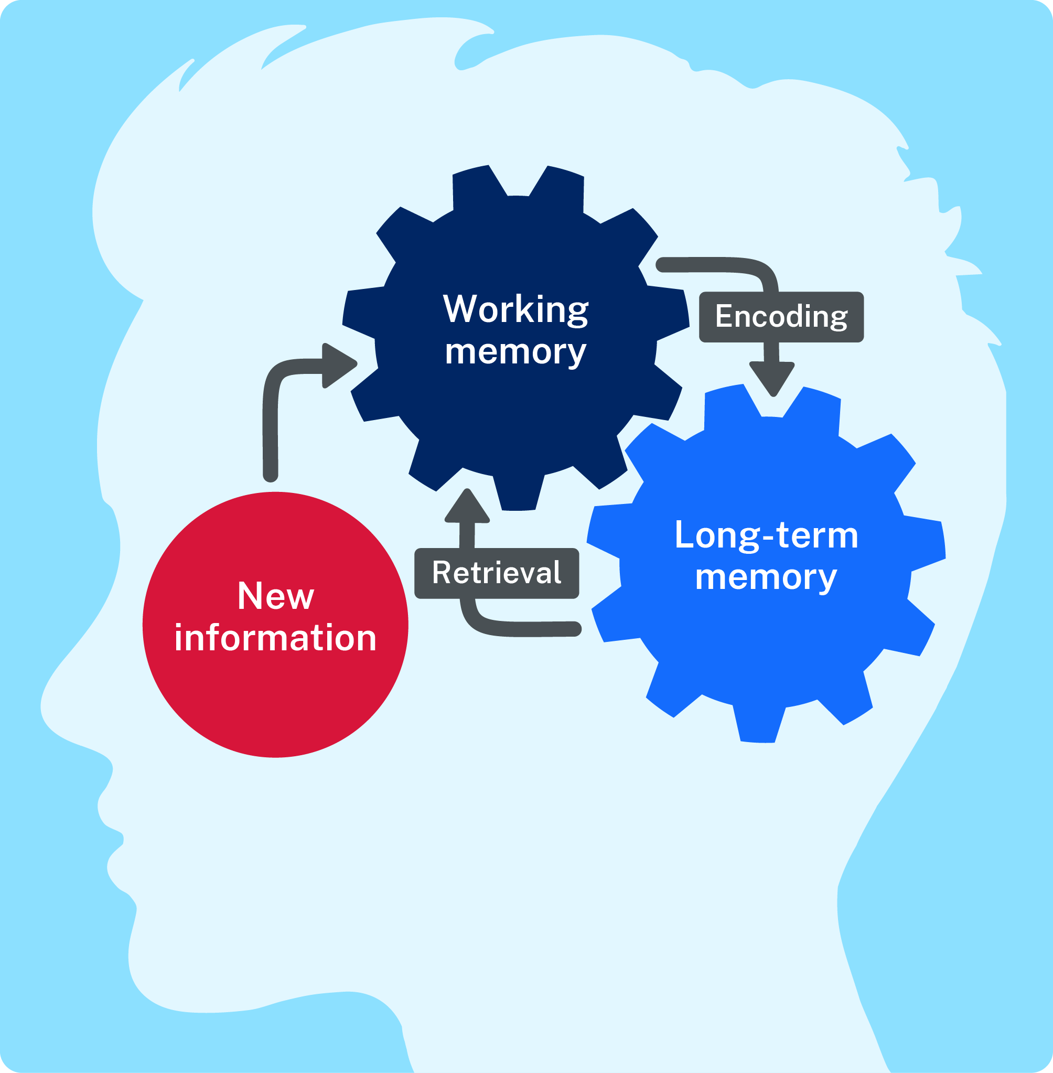
Cognitive models of learning
“Cognitive” = of or relating to the mental processes of perception, memory, judgment, and reasoning
Working memory stores and processes small amounts of information for a short amount time
The learning process starts when attention is focused on new information, and it enters working memory
Long-term memory stores large amounts of information, semi-permanently
Notes:
The science of learning is based on cognitive models of learning and scientific studies of the conditions and practices that lead to the highest rates of retention and application of learning. At the heart of these models is memory.
Learning can be thought of as a change in long-term memory
Cognitive models can help teachers understand the conditions that optimise how students process, store, and retrieve information.
This understanding can guide teachers in choosing instructional approaches that enhance learning.
Working memory is one of the two types of memory cognitive models identify as important for learning.
Working memory is like our cognitive ‘workspace’, where we store and process small amounts of information for a short amount time (Peterson and Peterson 1959). Working memory can only handle information while it is being actively focused on - distractions can cause working memory to lose information.
NOTE: The term ‘working memory’ is occasionally used synonymously with ‘short-term memory’, although some theorists consider these two forms of memory to be distinct. Refer to Cowan (2008) for an overview of the distinctions and similarities between various key theories of short-term memory and working memory.
The second type of memory that is important for learning is long-term memory.
Long-term memory stores large amounts of information, semi-permanently (Atkinson & Shiffrin 1968; Tulving 1972). We do not know what the upper limit of how much we can store in long-term memory is – it is potentially it is limitless, although we can forget information from long-term memory
Note: Though it remains unclear what ‘forgetting’ means in a cognitive sense (refer to Roediger, Weinstein and Agarwal 2010), we can think of it as the inability to intentionally recall information.
Information stored in long-term memory includes:
Episodic memories – these are memories of experiences, and are heavily tied to a specific context
Semantic memories – are facts or concept knowledge and tends not to be tied to a specific single context
Procedural knowledge is knowledge of how to perform various tasks and skills. This might be available at conscious and unconscious levels. For example, not all the knowledge required to ride a bike is something that you could easily put into words – some of that information is unconscious.

Slide 29
Key concepts in the Science of Learning
#1
Cognitive Load
#3
Forgetting curve
#4
Expertise reversal
#2
Schemas
Notes:
Important for teachers to know because it underpins the ’why’

Slide 30
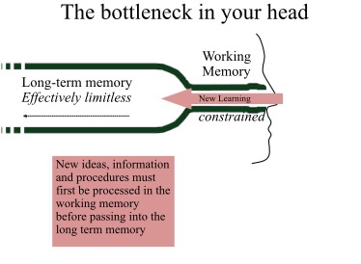
#1 Cognitive Load
Picture credit: Greg Ashman https://gregashman.wordpress.com/

Slide 31
Cognitive load theory
Cognitive load refers to the demands of processing information in working memory (CESE 2017)
When cognitive load exceeds the working memory capacity of a student, there is a greater risk of:
misunderstandings
misinterpretations or confusion
ineffective encoding in long-term memory
learning slowing down.

Slide 32
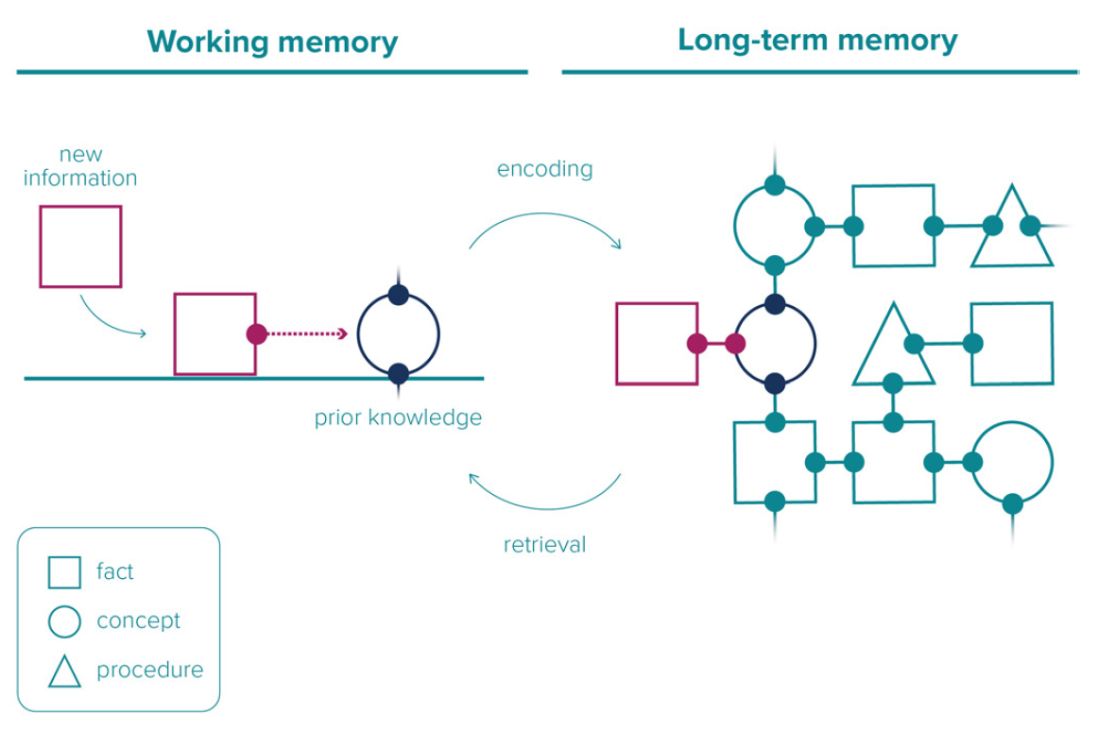
#2 Schemas
Schemas (also called mental models) "are structures that organise knowledge in the mind." (EEF 2021:31).
Image adapted from Australian Education Research Organisation Limited (AERO) (2023) How students learn best and licensed under CC BY 4.0.
Notes:
Schemas (also called mental models) – "are structures that organise knowledge in the mind." (p31 EEF 2021).
When students are learning new knowledge, concepts and skills, they can connect it to pre-existing knowledge to build increasingly complex schemas.
Students develop and demonstrate mastery of their learning by building and applying their schemas, that is building complex schemas increases students’ ability to apply learning in meaningful, creative and complex ways
Note: Mastery is distinct from, but underpins, mastery learning:
Mastery "is the accumulation of knowledge, conceptual understanding and skill, where students both retain knowledge and understand how to use it (P. Brown et al., 2014)" (p18 AERO 2023).
Mastery learning refers to "a way of designing units of work so that each set of tasks focuses on a particular learning objective and students must master a task to move onto the next one." (AERO 2022b).
This diagram shows a concept being retrieved from long-term memory, into working memory, where it is connected to a new fact and then encoded back into long-term memory where it has extended the schema.
An example of this that for a student to learn about respiration in the human body, they need to be able to draw on prior knowledge about human anatomy, cell biology, the characteristics of gases and some technical scientific vocabulary.

Slide 33
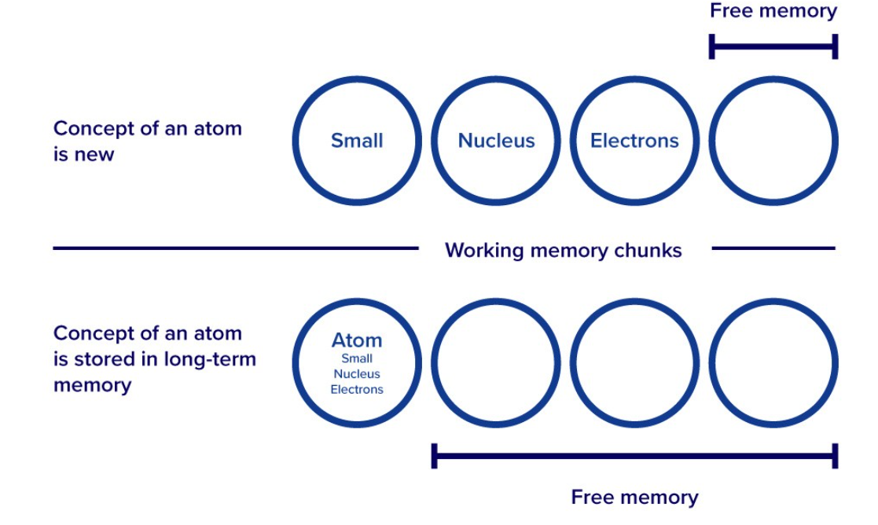
Schemas influence cognitive load
Image adapted from Australian Education Research Organisation Limited (AERO) (2023) Explicit instruction and licensed under CC BY 4.0.
Notes:
Pre-existing cognitive schemas – what students already know about a topic and how well they know it - affect the intrinsic load of a learning task.
Drawing on information that is already stored in students’ long-term memories can help reduce cognitive load . This is because, although there are a limited number of elements (sometimes referred to as ‘chunks’) that can be held in working memory at one time, a schema constitutes only a single element in working memory.
In this way, a high-level schema – with potentially infinite informational complexity – can effectively bypass the limits of working memory (Sweller, van Merrienboer & Paas 1998, p. 255)
AERO’s (2022a) explicit instruction guide (https://www.edresearch.edu.au/summaries-explainers/explainers/explicit-instruction) gives this example of students learning about the concept of an atom.
A student might initially need nearly all their working memory (several elements/chunks) to represent the idea of an atom, leaving no further room to learn about related topics like an atom’s structure or properties. However, when the idea of an atom is learned and accessed from long-term memory, that complex idea will only take up one element/chunk, leaving the rest of working memory free to build on that knowledge.

Slide 34
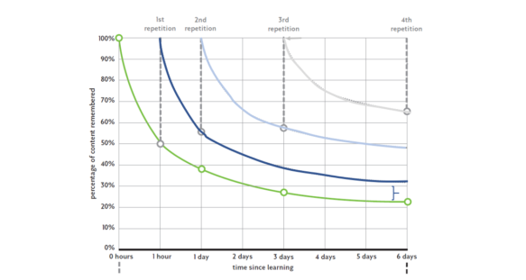
#3 Forgetting curve
Image credit: Oliver Cavigliolli via Doug Lemov https://teachlikeachampion.org/blog/an-annotated-forgetting-curve/
Notes:
We often use the expression ‘steep learning curve’, well there is also something called the forgetting curve.
The forgetting curve was first described by Ebbinghaus in 1885 and studies since then have estimated that learners will forget an average of 80-90% of material within one month.
The picture here is an illustration of the forgetting curve – it will look a bit different depending on the type of content being learned and individual and environmental factors, but the general concept holds.
Revisiting material on multiple occasions can increase retention, especially if it is spaced out over a period of days or weeks.

Slide 35
Repetition and retrieval reduce the forgetting curve
Retrieval practice refers to learning activities that prompt students to intentionally ‘bring to mind’ (retrieve) previously learnt information
It is more than just the simple recall or recitation of facts
Many common, low-cost classroom activities can be used for retrieval practice:
Free writes | Flash cards | Labelling diagrams | Teacher questioning
Brain dumps | Think, pair, share | Exit tickets | Low or no stakes quizzes
Notes:
Repetition is a highly effective teaching strategies. It is rare for a student to learn and remember something they have been told once, and some students need many repetitions.
However, simply re-reading or hearing the information again is not as effective for long term memory as retrieval practice.
Retrieval practice refers to learning activities that prompt students to intentionally ‘bring to mind’ (retrieve) previously learnt information.
each time you practice recalling what you know, the rate and amount of forgetting is reduced somewhat.
retrieving something back into working memory slows the rate of forgetting, but how and when the retrieval happens is important. For the greatest effect, retrieval should be spaced out over increasing intervals of time.
Retrieval practice is more than just the simple recall or recitation of facts. Many common, low-cost classroom activities can be used for retrieval practice.
For example:​
free writes
brain dumps​
flash cards​
think, pair, share​
labelling diagrams​
exit tickets​
teacher questioning​
low or no-stakes quizzes
To encourage all students to actively engage in retrieval processes, activities should involve whole class participation rather than only requiring a response from some students.

Slide 36
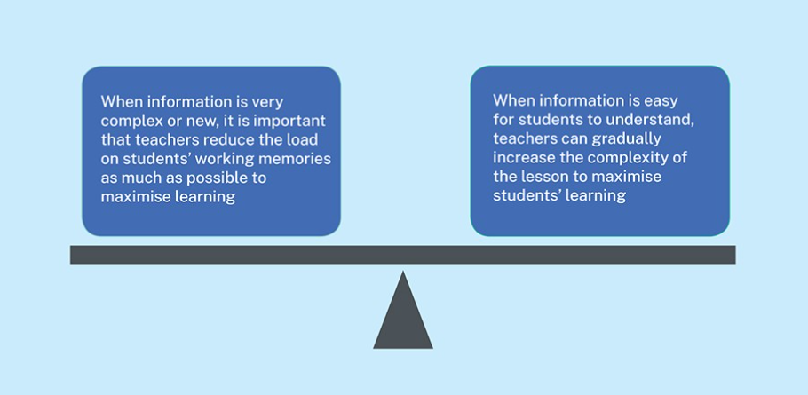
#4 Expertise reversal
Notes:
One of the most important implications of cognitive load theory for teaching practice is the need to optimise students’ cognitive load, by striking the right balance between too much and too little load.
To do this effectively, teachers need to have a strong understanding of where students already sit in their learning.
When information is very complex or new, there is less room in students’ working memories to process any more information. In this case, teachers should focus on reducing the cognitive load. For example, students who are still learning to decode words will be devoting their working memory to word reading and will have low cognitive capacity for understanding complex vocabulary and syntax. For these students, cognitive load can be reduced by practicing with simpler texts as they develop this skill.
But when teaching a lesson that is relatively simple for students to understand, there is room in their working memories to process a little bit more information. In this case, teachers should aim to increase the complexity of the task to challenge their students.

Slide 37
Explicit teaching

Slide 38
The science of learning points to explicit teaching as being highly effective
The key elements of effective instruction are designed to maximise understanding, retention, and transfer.
Systematic
methodical and planned to a high level of detail
Sequential
the order of content builds skill development
Structured
time is allocated to ensure all content and skills are covered and connected
Clear and concise
content is presented in small amounts with clear explanations and examples
Cumulative
content and skills are built and revisited through repetition, practice, and recall
Mastery
students demonstrate mastery or understanding before new content is taught
Notes:
In other words, they are designed to minimise extraneous cognitive load, work against the forgetting curve, and give students the skills to learn independently

Slide 39
Explicit teaching is effective teaching
 | Cognitive load | Schema | Forgetting curve | Expertise reversal
Systematic
Sequential
Structured
Clear and concise
Cumulative
Mastery
Notes:
This table shows how the key practices of explicit teaching have their basis in key findings of the science of learning. As with everything in education, there are overlaps and multiple connections.
*Give example from table*
These aspects of explicit teaching and the science of learning apply to mastery of both knowledge and skills, including behaviour which is the focus of the rest of today’s session.
Thank you..

Slide 40
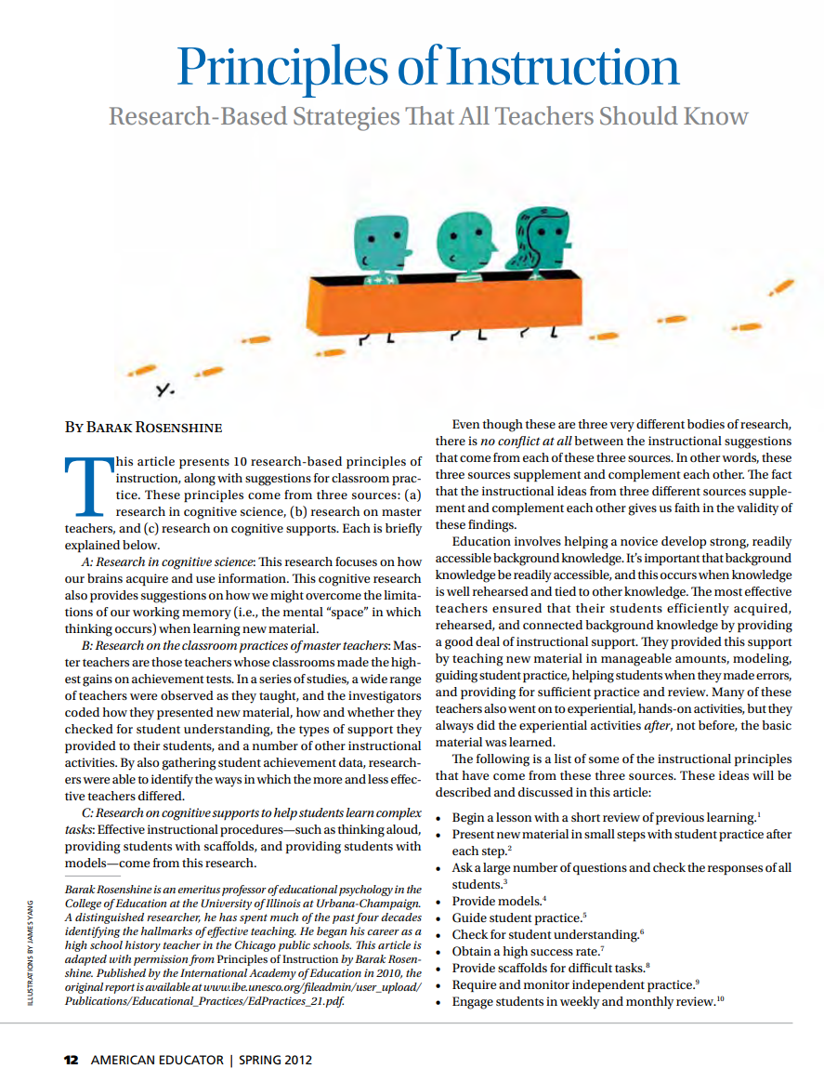
Principles of instruction
Begin each lesson with a short review of previous learning
Present new material in small steps (‘chunks’) with student practice after each step
Ask questions and check the responses of all students (
Provide models
Guide student practice
Check for student understanding (
Obtain a high success rate
Provide scaffolds for difficult tasks
Set and monitor independent practice
Daily, weekly and monthly review
(Rosenshine, 2012)

Slide 41
A non-categorical approach

Slide 42
A non-categorical approach to teaching reading
When students begin school, there is no conclusive way of knowing which students will have difficulties learning to read. Therefore, all students should have evidence-based explicit teaching from the first weeks of school.
Any student who does not make good progress in reading should be offered a targeted intervention, irrespective of a diagnosis of disability or a learning difficulty.
This is an efficient, equitable, and child-centred approach.
Intervention is tailored to the specific educational need of the child, not the perceived needs of a ‘category’ of diagnosed difficulty or disability.
Intervention is more effective if it is a more intensive form of classroom instruction.
Notes:
Before non-categorical approaches became widely adopted, the process of identifying and delivering support to students relied on a medical model of disability. This assumed that any learning difficulties originated from an impairment in the student. Students had to be assigned a diagnostic label or category and it was assumed that students in that category needed some kind of special instruction,. This diagnosis requirement meant that provision of support was slow and if no diagnosis was obtained, withheld.
A non-categorical approach is also more equitable. An official diagnosis of dyslexia is typically an expensive process whereby parents engage a clinical psychologist to undertake a lengthy assessment process. For this reason, students from poorer socio-economic circumstances may be less frequently diagnosed. This does not mean that dyslexia is only a phenomenon in affluent sections of society. What it does mean is that there may be many students with dyslexia who are undiagnosed.
Within the field of research and practice in reading and reading disability, there has been a preoccupation with the diagnosis of the underlying causes of reading difficulties, specifically to identify those students who may be said to be dyslexic as against being so-called ‘garden variety’ low-progress readers. However, unless the student has a physical disability that requires specialised accommodations, a diagnosis does not significantly add information beyond what can be determined through valid and reliable reading assessments.
Two of the most common types of reading difficulties are dyslexia and developmental language disorder. Dyslexia is typically characterised by difficulties with decoding and fluency, while DLD is typically characterised by difficulties with vocabulary and oral language. These represent the two components of the Simple View of Reading and therefore can cause significant reading impairment.
However, while these disorders describe the type of reading problem their treatment still relies on the use of what we understand to be effective instruction albeit with higher dosage and repetition in the aspects of reading the child is having difficulty with.
The number of potential causes of dyslexia have led to a proposed definition of ‘an unexpected reading difficulty’. That is, students who have persistent reading difficulties despite high-quality instruction and in the absence of other explanatory causes (Catts & Petscher, 2022).

Slide 43
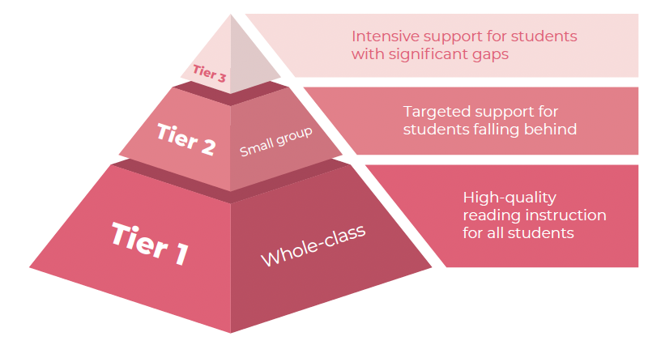
Response to Intervention
Tier 1 + Tier 3
Tier 1 + Tier 2
Wheldall, Wheldall & Buckingham (2023). Effective instruction in reading and spelling.
Notes:
A non-categorical approach also aligns very well with the Response to Intervention model (sometimes now called Multi-tiered systems of support, or MTSS), providing a stronger basis for reaching conclusions about the severity of a child’s difficulties in reading and spelling than the discrepancy models used in the past.
RtI is a tiered model of instruction for students experiencing difficulties in acquiring basic skills and appropriate social behaviours. The RtI m.odel argues for a phased intervention model of increasing support, determined by regular monitoring of the child’s reading progress.
Tiered instruction commonly (but not always) comprises instruction at three increasing levels of intensity. In the widely adopted three tier pyramid model of RtI, it is anticipated that 80% of children will make good progress towards learning to read given exemplary ‘universal’
or Tier 1 whole class instruction. A further 15% are likely to be caught up or ‘recovered’ by the provision of Tier 2 small group supplementary reading instruction based on evidence-based best practice, leaving only 5% who are likely to need even more intensive Tier 3, one-to-one instruction.

Slide 44
How to be sure students are learning: Assessment and progress monitoring

Slide 45
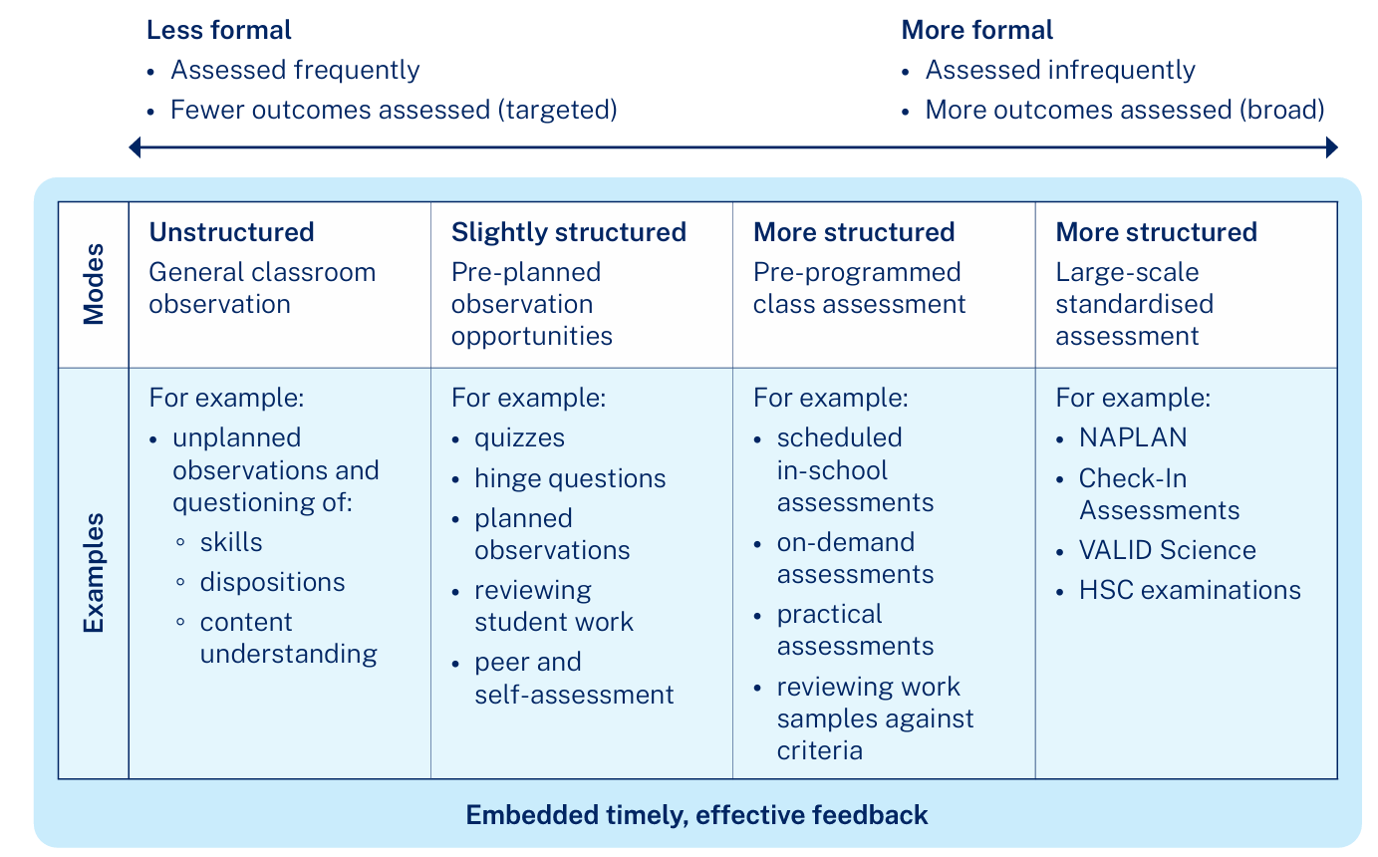
Modes of assessment
Notes:
Explicit teaching involves constant on-the-spot assessment of learning through checks for understanding and retrieval practice.
However, more structured types of assessment are also necessary to ensure all students are making good progress.
Assessment is integral to teaching and learning. It can be time consuming but it provides essential information to guide teaching decisions. It is impossible to implement the Response to Intervention approach without good assessment data.
Good assessments will help to identify students who have reading difficulties or disabilities such as dyslexia and developmental language disorder and provide targeted and timely interventions.

Slide 46
Assessment decision criteria
A research-informed assessment schedule is one that
aligns with an evidence-based theoretical framework (e.g., the Simple View of Reading) and pedagogical framework (e.g., Response to Intervention).
has a clear purpose for each assessment used
uses assessments that have strong psychometric attributes, based on research that the test publishers (or others) have conducted.

Slide 47
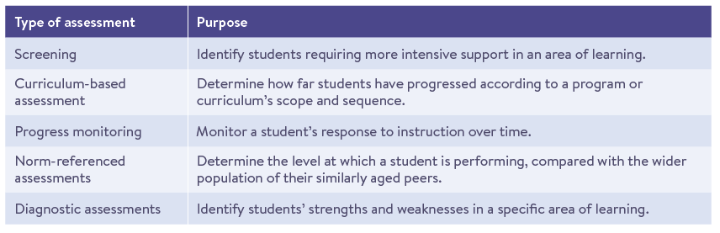
Purpose of assessment determines the type
Wheldall, Wheldall & Buckingham (2023). Effective instruction in reading and spelling.
Notes:
Most assessments fall into at least one of five different categories, depending on the intended purpose, whether that be to screen, place, monitor, compare or diagnose students.
These are…

Slide 48
Attributes of high-quality assessments
Validity: accurately measures those things the teacher is attempting to measure.
Reliability: produces stable and consistent results over time, and with different learners and assessors.
Sensitivity: correctly identifies all students with difficulties
Specificity: correctly identifies all students without difficulties
Objectivity: the conclusions are dependent on which specific assessment task is used or who does the assessing.
Inclusiveness: does not underestimate nor overestimate achievement or progress because of student gender, physical ability, cultural background, socioeconomic status or geographical location.

Slide 49
Planning for teaching and assessment

Slide 50
Planning for teaching and assessment
Ideally there will be a scope and sequence that extends across the whole school for each of the components of reading, spelling and writing as well as knowledge building.
Instruction time will be allocated to ensure all components are taught, assessed and mastered to the appropriate level.
Instruction time should include ample time for practice and consolidation.
The sequence and instruction time allocations will shift from an emphasis on foundational to complex skills as students move through school.
Assessment will be planned at critical decision points for intervention and reporting.

Slide 51



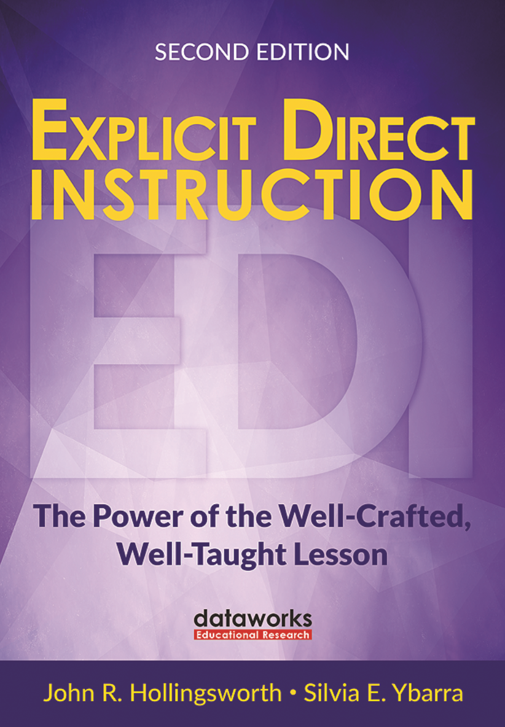
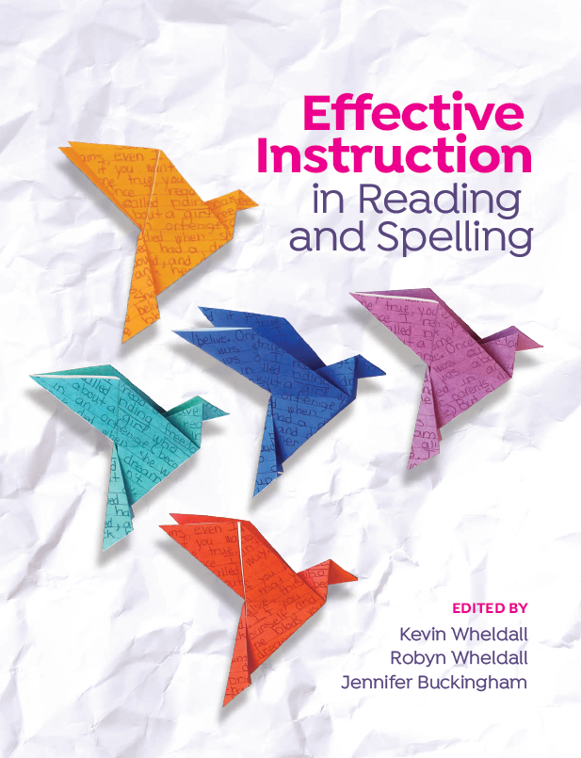
Resources
Notes:
What Works Best 2025 – Evidence guide for excellent schools

Slide 52
Thank you jennifer.buckingham2@det.nsw.edu.au

