Slide 1




Identifying markers of individual differences in literacy across languages: Common approaches to early screening and diagnosis
.
Markéta Caravolas
Bangor University, Wales, UK
Notes:
… will present data from a few longitudinal studies that compared aspects of early literacy development in four European languages. Today, the main focus is on studies of reading skills.
The broad aim of these studies was to elucidate the universal and the language –specific aspects of early alphabetic literacy, with a focus on the moderating influence of orthographic consistency.

Slide 2


Framework:
Cross-linguistic perspective on foundational literacy development
Triple Foundation Model (TFM) as theoretical framework
Aims:
Consider possible generalizations about cognitive foundations of literacy across languages, over time – empirical studies
Key cross-linguistic studies from the ELDEL project
Following a chronological sequence of events, I will then focus on an evidence-based application arising from the ELDEL research
MABEL – Multilanguage Assessment Battery of Early Literacy - extensions to additional languages, notably Portuguese
New results from Portuguese LER Project
Mini MABEL – proof of concept and pilot data assessing a multilanguage screening tool
ELDEL Project 2008-2012
MABEL Project 2018- present
Mini MABEL Project 2024- present
Notes:
We will take a X-ling perspective on foundational literacy dev.
And we will do this mainly through the lens of the TFM as our theoretical framework.
Our aim will be to consider what aspect of the cognitive foundations of literacy is generalizable across different languages, at least those with alphabetic orthographies.
I also aim to highlight an multilanguage assessment tool that resulted from the ELDEL project and is called the MABEL.
We will glimpse some new data from the current exciting LER project, co-ordinated by Isable Leite.
Finally, time permitting, I will briefly talk about a new screening battery that the MABEL consortium is currently developing.

Slide 3


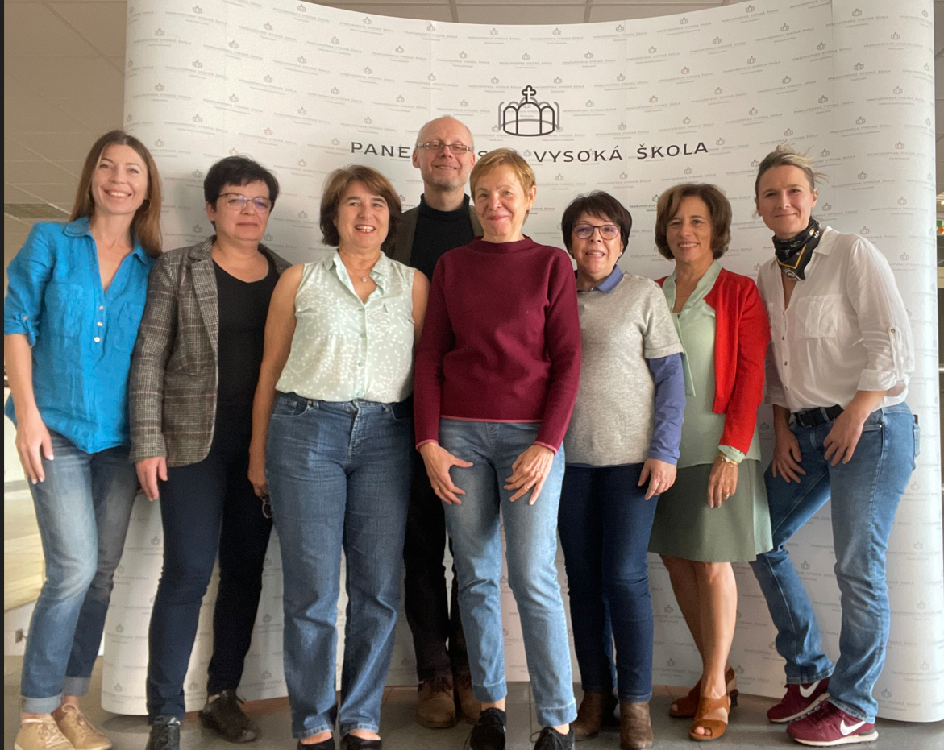














Acknowledgement of contributing colleagues
The MABEL Group @ 2026
Notes:
So, since 2018, the MABEL tool has been extended to include EU PT, PL, UA and CA French. These new language versions are available, with some elements still forthcoming.
And, the current MABEL group is here, represented by researchers from now nine universities.
It is important to say that our new language work was forged at the ELN summit in conversations with colleagues who were interested in creating versions of the MABEL for their countries and languages.

Slide 4
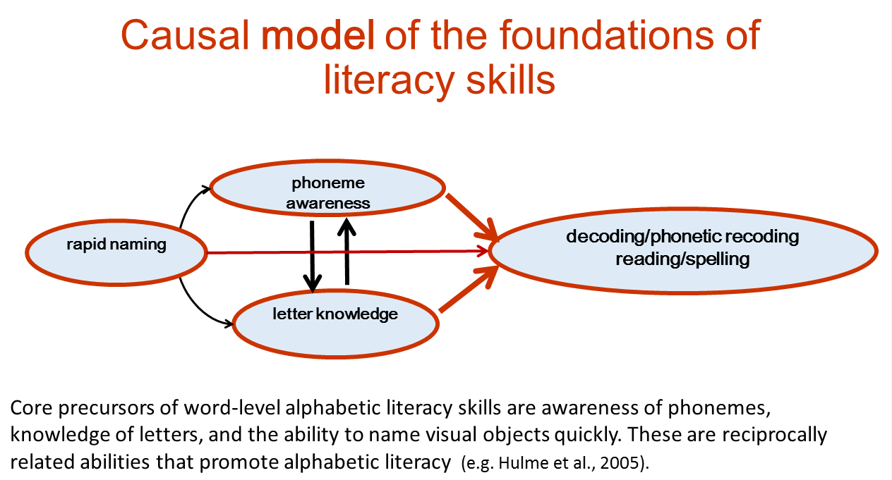
Theoretical Framework: Triple Foundation Model Core foundational predictors of underpin word-level skills in languages across the alphabetic consistency spectrum in the earliest phase of reading development are PA, LK, RAN
Cons.
✓ English
✓ French
✓ Spanish
✓ Czech
✓ Slovak
✓ Dutch
…
Cons.
Do inconsistent orthographies require greater emphasis on language-based, phonological skills?
Do consistent orthographies require greater emphasis on speed of naming (proxy for reading speed) to read?
e.g., Melby-Lervåg et al. (2012); National Institute for Literacy (2008); Snowling and Melby-Lervåg (2016)
Notes:
The known cognitive precursors of alphabetic literacy are PA (the ability to consciously manipulate phonemes – and an index of phonological processing), LK and RAN (rapid naming of visually presented stimuli – a probable index of the efficiency of the associations between visual and spoken forms, with letters and phonemes as key instances most relevant to alphabetic literacy).
We now have evidence of the relative universality of the foundations and early cognitive markers of literacy difficulties, but confirming directly across languages is useful for advancing our knowledge and our confidence in our current understanding.
One long-held, but not uncontested, view is that orthographic inconsistencies elicit a stronger and longer term reliance on phonological skills in English than is the case in more consistent orthographies, where reliable letter-sound associations are quickly learned and can compensate for any underlying weaknesses in phonemic awareness. In contrast, the stronger and more stable predictor is assumed to be RAN, assumed the best proxy of reading speed.
We confirmed this model in a direct cross-linguistic study that contrasted four languages with alphabetic orthographies.

Slide 5









+Cons.
~.99
.96
.92
.86
.72
Figure: Marjou (2021)-- Mean G-P and P-G Consistency Estimates by Language
0.0
- Cons.
B. Kessler (2011)
Notes:
Grapho-phonemic consistency can be estimated as the statistical probability of producing the correct pronunciation/spelling for a given orthographic unit. The more options that exist, the lower the probability. The overall probabilities of orthographies fall on a continuum from highly predictable/ consistent (like Finnish, Spanish, Czech, Slovak), through to moderately inconsistent (like German, Portuguese), to relatively poorly predictable/inconsistent (like French, and especially English).

Slide 6

Early Literacy Development in European Languages
INVESTIGATED DEVELOPMENT OF READING AND SPELLING SKILS
Tracked > 970 children (n = 150-200) in five countries in transition from kindergarten to second grade
Compared foundational underpinnings of emergent reading abilities
Compared children’s rate and pattern of growth of silent and aloud word reading
Feb 2009
T1
June 2009
T2
Nov 2009
T3
June 2010
T4
Nov 2010
T5
June 2011
T6
5 yrs-
6 yrs
5;6-
6;6
6 yrs-
7 yrs
6;6-
7;6
7;0-
8;0
7;6-
8;6
Mid-R/K End-R/K Mid-Gr.1 End-Gr.1 Mid-Gr.2 End-Gr.2
Notes:
This was the purpose of the ELDEL early literacy studies. Today, we are looking at studies of Reading development (not spelling)
We tracked almost a thousand children across 5 languages in transition from Kindergarten to 2nd grade, on studies investigating some of the major claims about the impact of consistency, namely the foundational underpinnings, the rate and pattern of word-level skills growth, and the predictors of RC.

Slide 7

Testing the TFM: Foundations of Reading Development Multi-group path model predicting growth in early word reading
Caravolas et al., 2012
Mid-K/R
Reading
Mid-Gr.1
R² = .62
.63**
.40**
.69**
Phoneme Awareness
.17**
.71**
.37**
-.42**
Letter Knowledge
.20**
Reading
.32**
-.36**
-.36**
-.14**
ENG
SP
CZ
SK
.40**
RAN
.35**
.05ns
-.20**
N.B. No other variable predicted reading development in this phase!
Word Span
Model fit: χ² (63, N = 675) = 39.70, p < .991, CFI =1.00, TLI =1.02,
RMSEA = .000 [.000-.000], SRMR =.041
Notes:
The pattern of predictive relationships for spelling is identical (with prior spelling as the autoregressor substituted for prior reading).
The fact that in both models the path weights are constrained to be equal provides a stringent test of the idea that these measures are equally important as predictors of progress in learning to read and to spell across the four languages considered here. Both models provide truly excellent fits to the data (there are no significant differences between these constrained models and equivalent models where all parameters are freely estimated over languages) and account for very high proportions of the variance in reading skills (R² = .62) and spelling skills (R² = .63) in all four languages.

Slide 8
Summary of Cross-linguistic Foundations
Universal Foundations: PA, LK, & RAN (but not VSTM) are universal predictors of alphabetic literacy.
Weighting: As the reading/spelling system is being established, these core predictors are equally important across languages.
Timing & Persistence: All 3 play a role from the beginning of the literacy development process, and their effects persist at least into the middle of grade 1.
Moderating effects of orthography: Possibly, orthographic consistency will begin having a moderating effect on the relative weighting of the predictors as reading/spelling skills begin to exert a reciprocal impact on component cognitive abilities

Slide 9
In later stages of reading and spelling development…
Letter Knowledge and Phoneme Awareness tend to correlate very strongly, and their influences become statistically difficult to tease apart.
As children begin to read and spell autonomously, variance in PA and LK becomes subsumed in concurrent Reading and Spelling variances (e.g., Caravolas, Hulme, & Snowling, 2001; Caravolas et al., 2013)
Therefore in studies with older readers, PA and LK may not emerge as independent predictors of reading/spelling over and above the autoregressive effects of reading and spelling themselves.
RAN is typically found to be a moderate but stable predictor of reading accuracy and a robust predictor of reading speed (Araújo et al., 2015; Lervag & Hulme, 2009)

Slide 10
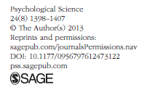
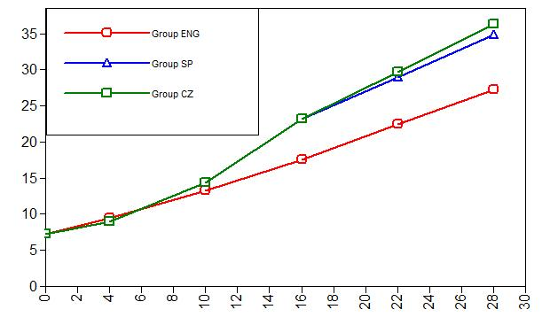
Predictors of Growth – Silent Reading
Caravolas et al., 2013
PA
LK, PA → early growth (gr. 1)
RAN → acceleration of growth (to end gr. 2)
Beyond end-Grade 1, no predictor accounted for unique variance, once lower-level constructs were controlled
LK
RAN
Mid-K End-K Mid-1 End-1 Mid-2 End-2
Pattern of prediction was the same across languages.
Notes:
A study illustrating this effect is one where we investigated the growth of silent reading skill and its predictors through to the end of second grade, in two consistent orthographies and one inconsistent one.
Confirming the prediction that all three core skills predict early reading, this did not continue beyond the first grade, while RAN continued to predict the acceleration of growth – but no skill uniquely predicted attainment levels in reading beyond first grade.

Slide 11

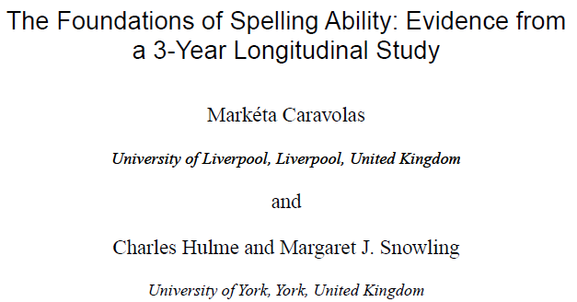
Foundations of Spelling Development
(Caravolas, Hulme, & Snowling, 2001)
Predictors of Phonological (ph) and Conventional (cn) spelling
Mid-R
End-R
Mid-Yr.1
End-Yr 2
Read
Read
Read
.47*
Read
.46***
Spell (cn)
Spell (cn)
.35***
.25***
.36*
.18*
Spell(ph)
Spell(ph)
.15*
Spell(ph)
.26***
.16*
PA
PA
.19**
PA
.43***
.59***
Lett Snd
Lett Snd
Lett Snd
Lett Nm
Lett Nm
Lett Nm
Notes:
Similar effects were found for PA and LK in a longitudinal study of spelling development in English.
Whereas the earliest stages of invented, phonological spelling is predicted consistently by PA, LK and Spelling itself throughout the first two years of school, by the end of second grade, conventional spelling is heavily dependent upon prior reading ability and phonological spelling, but no longer on unique effects of PA and LK.

Slide 12
Summary of the roles of PA, LK, and RAN in later reading and spelling
Results confirm that the influences of PA, LK eventually become subsumed in reading and spelling measures.
RAN continues to contribute independently to individual differences in reading and spelling, and its effects are stable
Moreover, PA, LK, and RAN are discriminators of typical and dyslexic populations across the orthographic spectrum (e.g.,Araújo et al., 2015; Lervåg & Hulme, 2009; Peterson et al., 2018; Snowling & Melby-Lervåg, 2016, NRP, and others).

Slide 13

From Research to Practice: The MABEL tool From ELDEL to MABEL
A multilingual, web-based resource for tests and information about the assessment of early literacy in a variety of languages (www.eldel-mabel.net).
Current holdings include test batteries in 8 languages: English, Welsh, Spanish, Czech, Slovak, Polish, Portuguese, and Ukrainian
In development are versions in European and Canadian French
It is evidence-based
MABEL arises from a large-scale international Marie Curie ITN (ELDEL), on research on early literacy development in European languages
Test materials validated in six major, international, research publications, and numerous publications (papers, books) across participating languages
It is freely available to qualified, registered users
It is unique in its form and scope
No comparable multi-language tool available
Notes:
At the end of the ELDEL research projects, we decided to adapt our most effective measures to a multilanguage battery of tests called the MABEL.

Slide 14
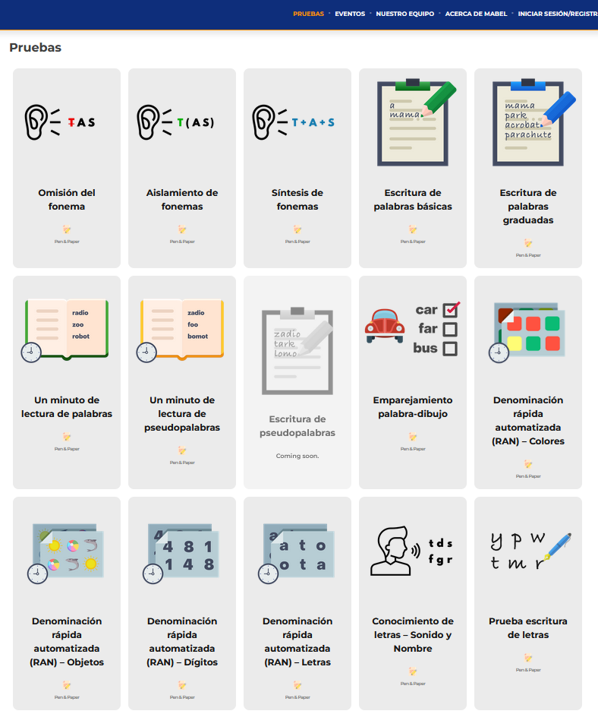
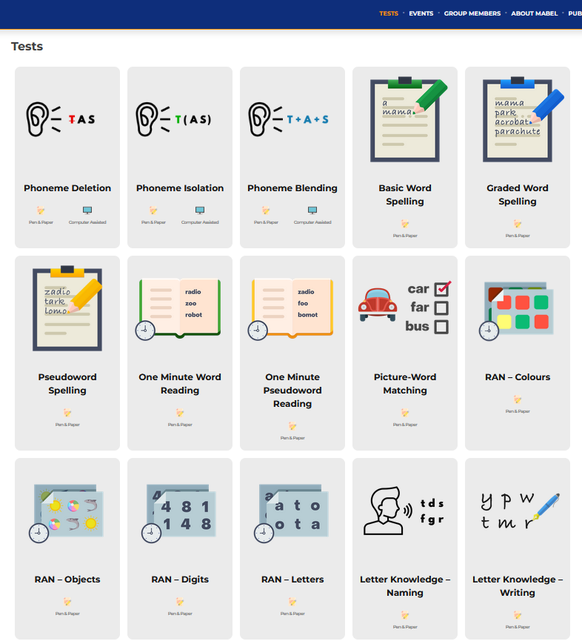

Notes:
On the MABEL website, we have some 15 tests available across most languages, with some of the materials still coming online soon.

Slide 15
Measures of the components of the Triple Foundation Model
Phon. Isolation
Phon. Deletion
Phon. Blending
PHONEME AWARENESS
OMR-Words
OMR-PWords
PWM
RAN Objects
RAN Colours
RAPID NAMING
DECODING/ SPELLING
RAN Digits
RAN Letters
LETTER KNOWLEDGE
Letter Writing
Word Spelling
P-Word Spelling
LK Names
LK Sounds
Core precursors of word-level alphabetic literacy skills are awareness of phonemes, knowledge of letters, and the ability to name visual objects quickly. These are reciprocally related abilities that promote alphabetic literacy (e.g. Byrne, 1998; Caravolas & Samara, 2015; Hulme et al., 2005).
Notes:
The Triple Foundation Model proposes that … (per schematic).
This trio of skills is thought to comprise the UNIVERSAL foundation of alphabetic literacy.
We operationalized the constructs of the model with multiple indicators, which now comprise the MABEL battery. As follows …

Slide 16
A first look at the longitudinal predictions of Reading in Portuguese
The large standardisation and validation study of literacy development in Portuguese is under way.
The study is conducted in multiple longitudinal waves with nationally representative samples of children in Kindergarten, Grade 1 and Grade 2.
In order to compare the results of the present study with the older ELDEL studies of early reading and spelling, we need to await another year, when Kindergarteners will have reached Grade 1.
Nevertheless, we were able to examine models predicting reading outcomes in slightly older children in Grades 1 and 2.
Using similar cognitive reading-related measures as in our previous work, we estimated how the Triple Foundation Model predictors of Phoneme Awareness, Letter Knowledge and RAN predicted later reading.
Notes:
Although the PT study is still running, and more data are being collected, we were able to get an early impression of the results for the predictors of reading in grades 1 and 2.

Slide 17
Measures in the Portuguese Reading Foundations Study the foundations of alphabetic literacy
Phon. Isolation
Phon. Deletion
Phon. Blending
PHONEME AWARENESS
OMR-Words
OMR-PWords
PWM
RAN Objects
RAPID NAMING
DECODING/ SPELLING
RAN Digits
RAN Letters
LETTER KNOWLEDGE
Letter Writing
Word Spelling
P-Word Spelling
LK Names
LK Sounds
Core precursors of word-level alphabetic literacy skills are awareness of phonemes, knowledge of letters, and the ability to name visual objects quickly. These are reciprocally related abilities that promote alphabetic literacy (e.g. Byrne, 1998; Caravolas & Samara, 2015; Hulme et al., 2005).
Notes:
The Triple Foundation Model proposes that … (per schematic).
This trio of skills is thought to comprise the UNIVERSAL foundation of alphabetic literacy.
We operationalized the constructs of the model with multiple indicators, which now comprise the MABEL battery. As follows …
We were able to copy the methods of the earlier ELDEL study, tracking reading development within grade for grade 1 and 2.

Slide 18
Path model predicting growth at the end of Grade 1 from measures at the start of Grade 1.
Reading_{b}
R² = .55
.54**
.37**
.59**
Phoneme Awareness
.024
-.24**
.66**
Letter Knowledge
.33**
Reading_{e}
-.27**
-.32**
-.22**
Grade 1 Results compatible with the TFM model. PA a strong correlate of LK and Reading, but not a unique predictor.
RAN
Model fit: χ² (63, N = 290) = 65.39, p < .000, CFI =1.00, TLI =1.00,
RMSEA = .000 [.000-.000], SRMR =.000

Slide 19
Path model predicting growth at the end of Grade 2 from measures at the start of Grade 2.
Reading_{b}
R² = .60
.51**
.50**
.48**
Phoneme Awareness
.13
-.58**
.58**
Letter Knowledge
.02**
Reading_{e}
-.35**
-.35**
-.27**
Grade 2 Results compatible with previous findings. RAN remains the only unique predictor of later reading.
RAN
Model fit: χ² (63, N = 245) = 39.54, p < .000, CFI =1.00, TLI =1.00,
RMSEA = .000 [.000-.000], SRMR =.000

Slide 20
Summary of the Portuguese Results to Date
Grade 1 Results are compatible with the TFM model, such that:
All proximal core skills were strongly associated with end-of grade reading outcomes (rs = -.42 (RAN) up to rs = .65).
By Grade 1, individual variation in start-of-year Phoneme Awareness was already subsumed by concurrent reading, and Letter Knowledge
Thus did not emerge as a unique predictor in this model (cf. Caravolas et al. 2001; Caravolas et al., 2019, and others)
Letter Knowledge and RAN emerged as unique longitudinal predictors, over and above the autoregressive effect of start-of-year variations in reading.
Grade 2 Results are compatible with the TFM and other research on more advanced foundational stage, such that:
All proximal core skills were moderately-strongly associated with end-of grade reading outcomes (rs = .43 up to rs = -.61 (RAN) ).
The autoregressive correlation was very high (r = .73).
By Grade 2, individual variations in start-of-year Phoneme Awareness and Letter Knowledge were already subsumed by concurrent reading skills
RAN emerged as a unique longitudinal predictors, over and above the autoregressive effect of start-of-year variations in reading (cf. Araujo, 2011; Caravolas et al., 2013).
The LER results for Portuguese, to date, are largely compatible with findings from other languages
We await the Kindergarten data for a more complete account of foundational literacy development. ☺

Slide 21

Mini MABEL A classroom Screener (in development)
Further Application Developments
Notes:
Since 2024, the MABEL consortium has been developing a multilanguage screening tool for k and grade 1 based on a much reduced set of measures from the MABEL battery, called the Mini MABEL.

Slide 22

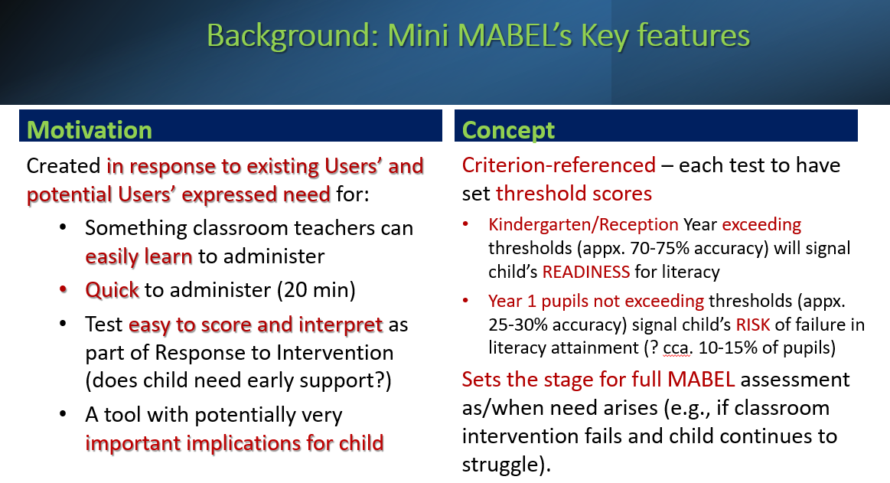
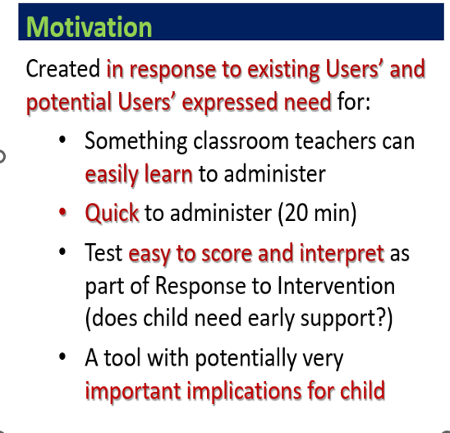

Slide 23










Multilanguage Testing
5 Tests
English
Welsh

Slide 24
Proof of Concept
Can a much reduced multilanguage battery of core precursor skills be useful in identifying very young learners for relatively low or high risk of dyslexia?
Can measures be sensitively scaled to avoid floor and ceiling effects.
We address this in our Pilot Validation study.

Slide 25
Indicative evidence from three languages: Pilot Study Participants
 | Kindergarten/Reception |  |  | Grade 1/ Year 1
Language | Mean (SD) | n | % Girls | Mean (SD) | n | n | % Girls
English | 59 (4.5) | 54 | 54 | 70 (4.3) | 76 | 76 | 49
Spanish | 67 (3.9) | 162 | 48 | 79 (3.8) | 149 | 149 | 49
Slovak | 75 (4.9) | 58 | 52 | 81.35 (5.3) | 105 | 105 | 58

Slide 26
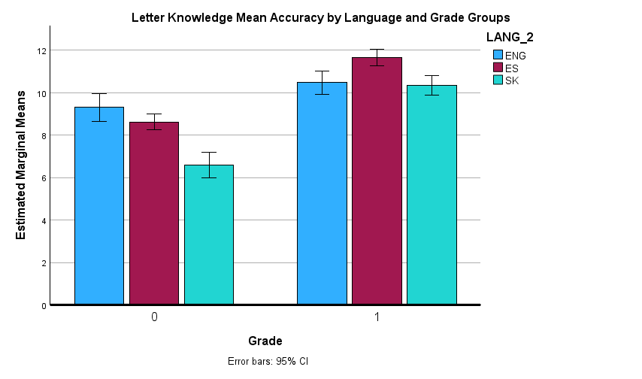
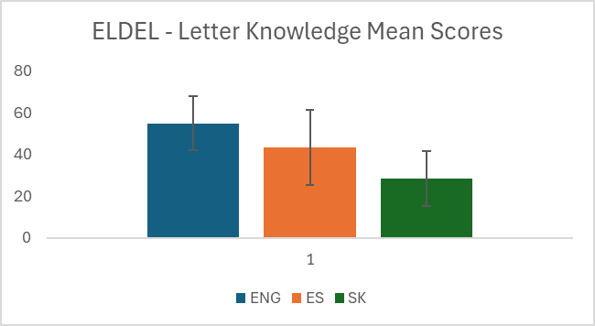
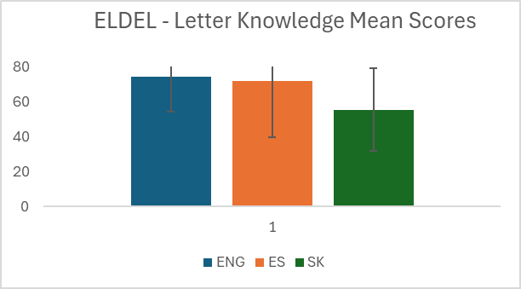
Letter Naming Accuracy in Kindergarten and Grade 1 Across English, Spanish and Slovak
No floor effects in K, mastery in Gr.1
ENG=ES
SK< ENG, ES
ENG=SK
ES > ENG, SK
Large effect of grade: η² = .21
Small interaction effect Grade x Language: η² = .02
Notes:
Accuracy comparisons:
Kinderg. Eng =ES; SK v. ENG = d = 0.78; SK v ES = d appx. 0.5
Only look at time in grade 1., re mastery levels.
Time comparisons: Cohen's d Time Eng-SK = 0.56 Eng - ES = 1.05 SK-ES = 0.58
Removing the bilingual kids improves mean time by about 4 Seconds, but does not change the pattern.
small (0.01), medium (0.06), and large (0.14)

Slide 27
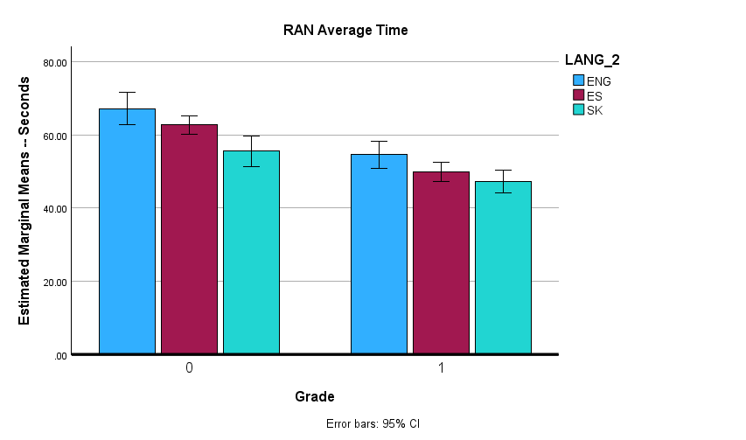
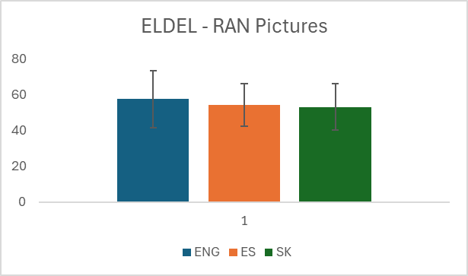
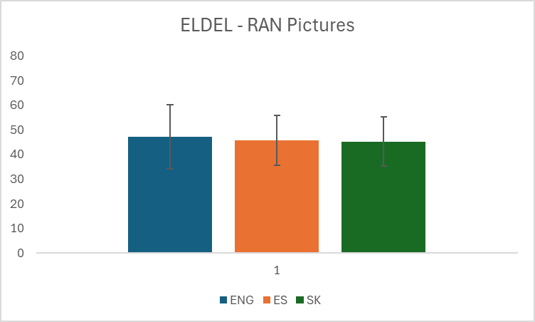
Rapid Automatised Naming Speed – Pictures - in Kindergarten and Grade 1 Across English, Spanish and Slovak
**
**
Consistent pattern in K, and Gr.1.
All getting faster over time.
ENG=ES
SK < ENG, ES
ES =SK
ENG > ES, SK
Small effect of Language: η² = .037
Moderate effect of Grade: η² = .092
Notes:
Cohen's ds Kindergarten Eng-SK 0.61, p = .01 Eng-ES NS, ES -- SK 0.41, p = .01
Grade 1 Eng-SK 0.52, p = .001 Eng-ES 0.32, p = .03 ES -- SK NS

Slide 28
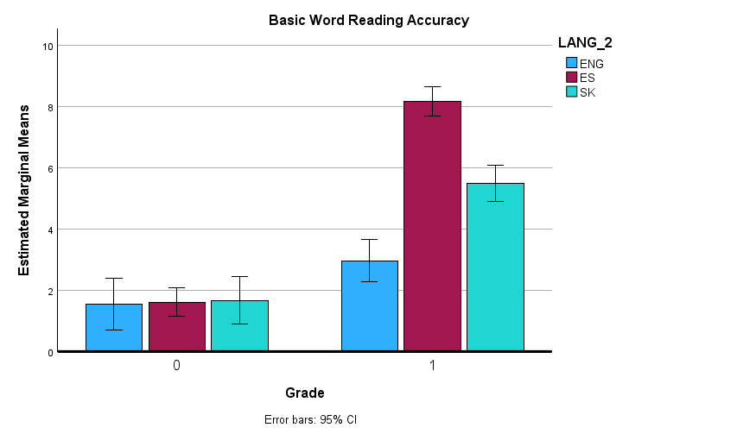
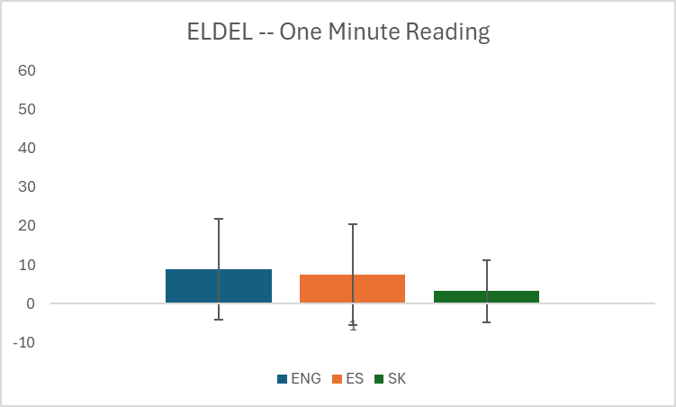
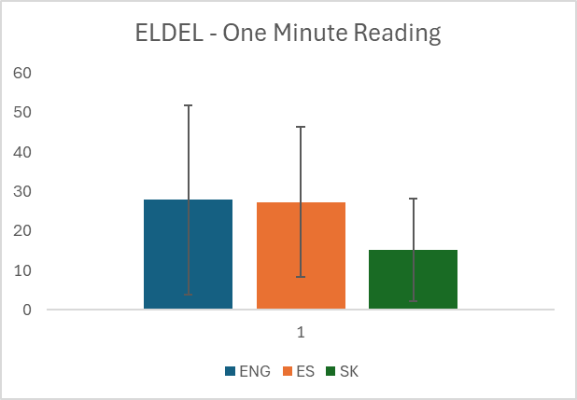
Word Reading Accuracy in Kindergarten and Grade 1 Across English, Spanish and Slovak
ENG= ES =SK
ENG < SK < ES
Large effect of grade: η² = .26
Moderate interaction Grade x Language: η² = .10
Notes:
Very lawful results. All children in mid-Reception/Kindergarten are non-readers and do not differ from each other. In Grade 1, we have the previously observed result of Spanish children attainigthe highest reading scores, Slovak children being intermediate and English children off to the slowest start.
Cohen's ds Kindergarten Eng-SK NS Eng-ES NS ES -- SK NS
Grade 1 Eng-SK 0.69, p < .001 Eng-ES 1.99, p < .001 ES -- SK 0.81, p < .001

Slide 29
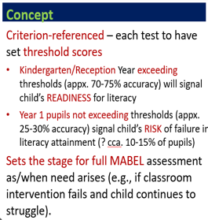
Our intended screening approach – percentile thresholds of readiness and of risk
Grade 1

Slide 30
Example Percentile Ranks and Example Cut-offs for Rapid Automatised Naming
RAN Pictures - Percentile Ranks
RAN Time | 95 | 90 | 75 | 50 | 25 | 10 | 5
ENG Reception | 36 | 43 | 53 | 67 | 75 | 100 | 116
ENG Year 1 | 34 | 36 | 42 | 50 | 65 | 78 | 91
ES Kindergarten | 41 | 44 | 49 | 60 | 71 | 89 | 101
ES Grade 1 | 34 | 37 | 41 | 47 | 57 | 69 | 77
SK Kindergarten | 35 | 38 | 46 | 55 | 62 | 71 | 90
SK Grade 1 | 34 | 36 | 39 | 45 | 52 | 61 | 72

Slide 31
Summary of patterns by language
Results of the pilot are encouraging to date.
All groups made significant gains in all skill between Kindergarten and Grade 1.
No floor effects, except as expected on reading in K.
Reliabilities to date from English, Welsh and Slovak are good to excellent (α .80 to .96)
On reading measure, a reassuring pattern of results, consistent with previous data (ELDEL) using more extensive test materials.

Slide 32
Continuities between MABEL and Mini MABEL
Currently:
MABEL battery now available in nine languages
Has near 3,000 users from 35 countries, with positive feedback of functional experiences
Users seek also shorter assessments for quick/early screening – hence, Mini MABEL.
For the near future:
Mini MABEL materials complete, data collected in six languages
Complete validation studies and then normative data sets
Eventually discriminant function analyses to test the validity of our classification approach.
To date, these two batteries seem to be well streamlined, and early indications are that the screener will be most beneficial as an aggregated across all languages tool.

Slide 33


Obrigada pela vossa atenção

Slide 34
Example Percentile Ranks and Example Cut-offs for Letter Naming
Percentile Ranks
Letter Knowledge Acc. | 5 | 10 | 25 | 50 | 75 | 90 | 95
ENG Reception | 1.20 | 4.20 | 7.00 | 11.00 | 12.00 | 12.00 | 12.00
ENG Year 1 | 5.40 | 6.60 | 10.00 | 11.00 | 12.00 | 12.00 | 12.00
ES Kindergarten | 4.00 | 5.00 | 7.00 | 9.00 | 11.00 | 12.00 | 12.00
ES Grade 1 | 10.00 | 11.00 | 12.00 | 12.00 | 12.00 | 12.00 | 12.00
SK Kindergarten | 0.00 | 1.00 | 3.00 | 8.00 | 9.00 | 11.10 | 12.00
SK Grade 1 | 6.00 | 7.00 | 9.00 | 11.00 | 12.00 | 12.00 | 12.00

Slide 35
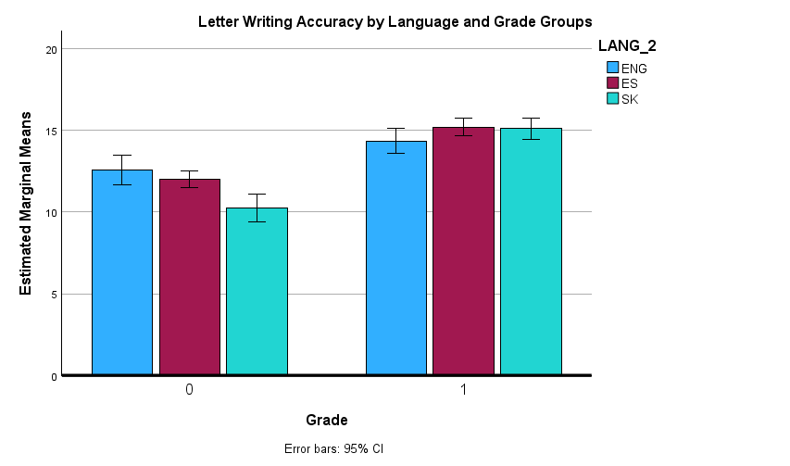
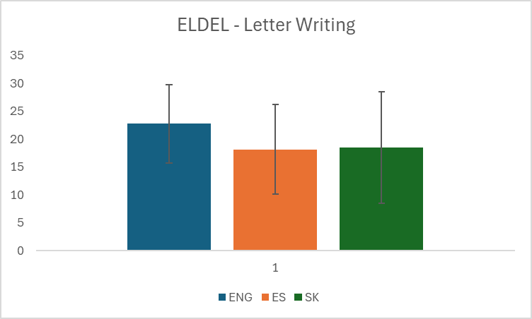
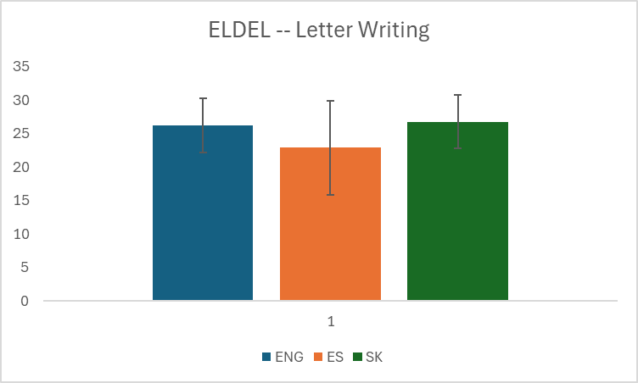
Letter Writing Accuracy in Kindergarten and Grade 1 Across English, Spanish and Slovak
ENG=ES
SK < ENG, ES
ES =SK
ENG < ES, SK
Large effect of grade: η² = .17
Small interaction effect Grade x Language: η² = .02
Notes:
Cohen's ds Kindergarten Eng-SK 0.45, p = .02 Eng-ES NS ES -- SK 0.40, p = .01 Grade 1 Eng-SK 0.36, p = .024 Eng-ES 0.45, p = .002 ES -- SK NS

Slide 36
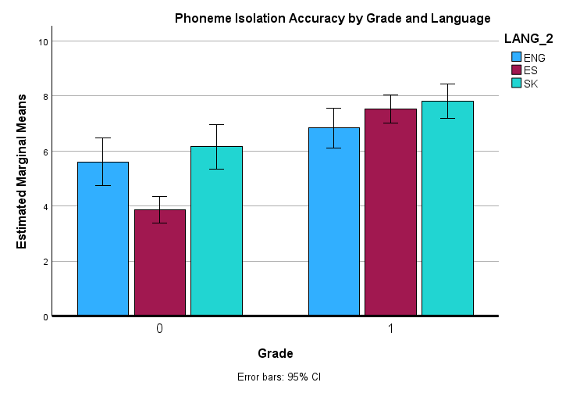
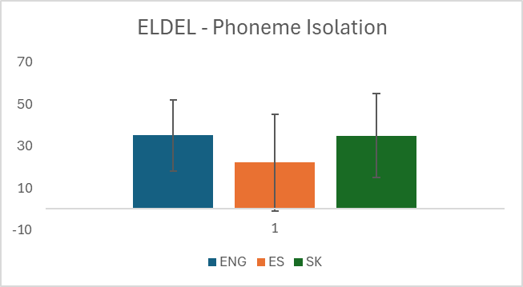
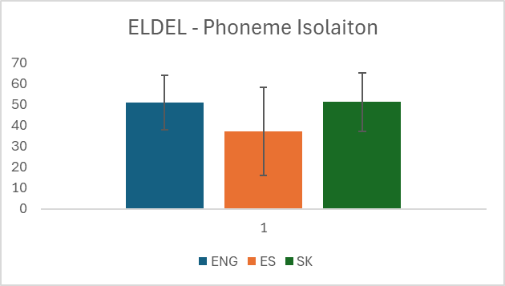
Phoneme Isolation Accuracy in Kindergarten and Grade 1 Across English, Spanish and Slovak
***
***
ENG=SK
ES < ENG, SK
ES =SK
ENG > ES, SK
Moderate effect of grade: η² = .09
Small interaction effect Grade x Language: η² = .03
Notes:
DROP SPEED FOR ISOL DUE TO NO CEILING EFFECTS.
Cohen's ds Kindergarten
Eng-SK NS Eng-ES 0.52, p = .001 ES -- SK 0.70, p < .001
Grade 1 Eng-SK 0.35, p = .024 Eng-ES NS ES -- SK NS
In accuracy, Spanish children fare least well in kindergarten, but they attain similar levels as Eng and SK peers in Grade 1.
English and SK kindergarteners attain similar levels accuracy, by grade 1, SK children score better.
In PI speed, SK children are fastest in K, by grade 1 all groups reasonably similar, English children a little slower.

Slide 37
Concurrent validity – Correlations from Spanish and Slovak Samples English Mononlingual sample yet too small.
 | Slovak (upper) and Spanish (lower) Kindergarten
 | Letter Naming | Letter Writing | Phoneme Isolation | RAN | Word Reading
Letter Naming | -- | .90*** | .61*** | -.45*** | .60***
Letter Writing | .74*** | -- | .64*** | -.41** | .49***
Phoneme Isolation | .57*** | .59** | -- | -36** | .48***
RAN | -.42*** | -.33*** | -.33*** | -- | -.35**
Word Reading | .59*** | .46*** | .46*** | -.34*** | --
 | Slovak (upper) and Spanish (lower) Grade 1
 | Letter Naming | Letter Writing | Phoneme Isolation | RAN | Word Reading
Letter Naming | -- | .76*** | .67*** | -.62*** | .77***
Letter Writing | .41*** | -- | .48*** | -.49*** | .53***
Phoneme Isolation | .45*** | .18* | -- | -.50*** | .65***
RAN | -.49*** | .22** | -.36*** | -- | -.61***
Word Reading | .52*** | .28*** | .51*** | -.51*** | --
Notes:
Swap for a overall summary of correlation ranges in each language and grade.
Note issues for further investigations.

Slide 38
Simultaneous Regressions on End-Year Reading / Spelling Accuracy from mid-year (T1) Reading and Mini MABEL Composite scores
Predicting End-Year Reading Accuracy from Mid-Year MM and Reading skill.
Predicting End-Year Spelling Accuracy from Mid-Year MM and Reading skill.
Variable | β | t | p
Kindergarten
Reading T1 | .421 | 2.88 | .01
MM_Composite | .534 | 3.65 | .001
Grade 1
Reading T1 | .398 | .424 | .01
MM_Composite | .452 | 4.36 | .01
Variable | β | t | p
Kindergarten
Reading T1 | .208 | 1.12 | ns
MM_Composite | .436 | 2.34 | .03
Grade 1
Reading T1 | .063 | .424 | ns
MM_Composite | .650 | 4.36 | < .001
Kindergarten: R² = .58, p < .001
Grade 1: R² = .43, p < .001
Kindergarten: R² = .27, p = .03
Grade 1: R² = .44, p < .001
Notes:
Modest Sample Sizes – K = n=25, Yr 1 n= 29

Slide 39
Testing the TFM: Foundations of Reading Development
Are inconsistent and consistent orthographies differentially
underpinned by core cognitive skills?
Do inconsistent orthographies require greater emphasis on language-based, phonological skills?
Do consistent orthographies require greater emphasis on speed of naming (proxy for reading speed) to read?
Notes:
The known cognitive precursors of alphabetic literacy are PA (the ability to consciously manipulate phonemes – and an index of phonological processing), LK and RAN (rapid naming of visually presented stimuli – a probable index of the efficiency of the associations between visual and spoken forms, with letters and phonemes as key instances most relevant to alphabetic literacy).
One long-held, but not uncontested, view is that orthographic inconsistencies elicit a stronger and longer term reliance on phonological skills in English than is the case in more consistent orthographies, where reliable letter-sound associations are quickly learned and can compensate for any underlying weaknesses in phonemic awareness. In contrast, the stronger and more stable predictor is assumed to be RAN, assumed the best proxy of reading speed.

Slide 40
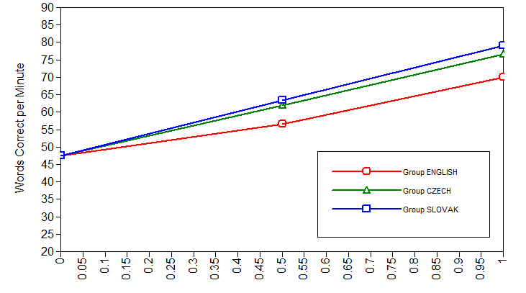
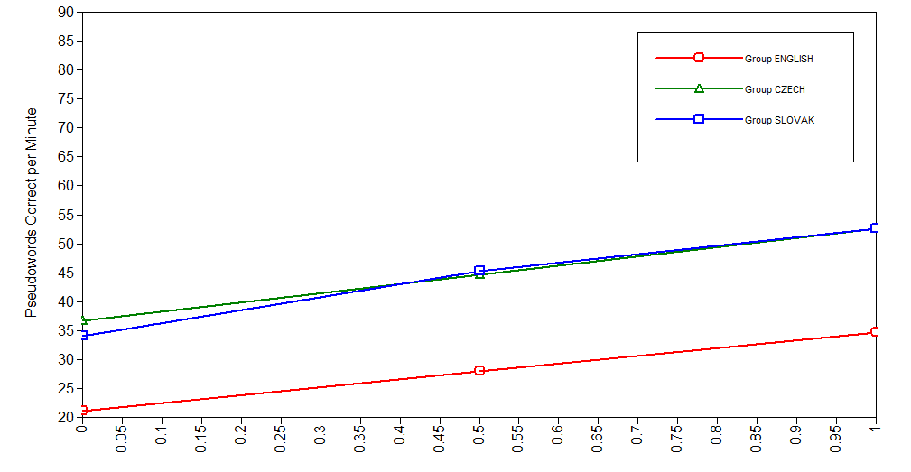
Study 2b: The Case of Word Reading Aloud
Compared children’s rate and pattern of growth between End-Grade 1 and End-Grade 2 on reading Words and Pseudowords
Estimated Means for Unconditional 2-Factor Growth Models for
Word and Pseudoword Reading Aloud Efficiency
FIGURE 1a
FIGURE 1b
End-Gr. 1 Mid-Gr. 2 End-Gr. 2
End-Gr. 1 Mid-Gr. 2 End-Gr. 2
Word Reading χ² (10, N = 462) = 18.47, p = .05, CFI =.994, TLI =.994, RMSEA = .074 (90% CI = .008-.126), SRMR = .08.
Pseudoword Reading χ² (9, N = 462) = 15.89, p = .07, CFI =.994, TLI =.994, RMSEA = .070 (90% CI = .000-.126), SRMR =.044
Caravolas (2018). JLD.
Notes:
WORDS, χ² (10, N = 462) = 18.47, p = .05, CFI =.994, TLI =.994, RMSEA = .074 (90% CI = .008-.126), SRMR = .08.
PSEUDOWORDS, χ² (9, N = 462) = 15.89, p = .07, CFI =.994, TLI =.994, RMSEA = .070 (90% CI = .000-.126), SRMR =.044
Actual reading efficiency difference for words (appx. 5 words/min) and for nonwords (appx. 15 words/min).
While English children are reading words at relatively similar rates, their novel word decoding is significantly less efficient.

Slide 41
Study III Summary
Confirmed, in all languages, the predictive role of decoding (WR) skill and its code-related precursors on reading comprehension over first 2.5 years of reading development
Moreover, in consistent orthographies, but not English: better readers relied less on WR skill for RC than weaker readers (cf. moderating effect of ability)
Confirmed, in consistent languages, that variations in oral language also account for variations in reading comprehension, but not yet in English
Revealed that at this stage, children learning consistent orthographies rely to about the same extent on oral language and decoding skills to comprehend text.
Orthographic consistency moderates reading comprehension mainly via its effects on decoding.

Slide 42

Participants
Group | N | Age (T1) Months | NVIQ Scaled | VIQ scaled
English | 185 | 60.20 | 10.13 | 9.56
Czech | 132 | 72.00 | 10.39 | 10.30
Slovak | 174 | 71.98 | 10.25 | 10.06
Spanish | 184 | 66.76 | 11.78 | 9.16
Notes:
The participants groups of today’s studies were English, Czech, Slovak, and Spanish speakers, in typically developing samples from about 130 to 185.

Slide 44
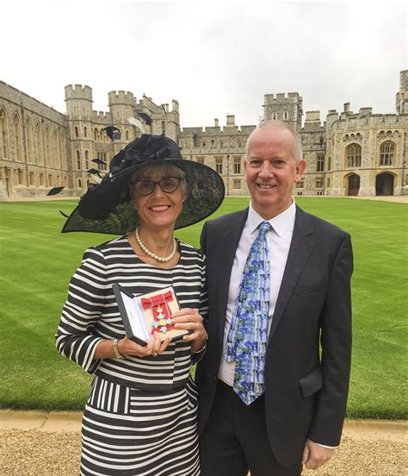
Standing on the shoulders of giants
Profs. Maggie Snowling and Charles Hulme, in Oxford, UK

Slide 45
Acknowledgements 2017- …
Scientists Original Project
M Caravolas- UK
Marina Mikulajová - SK
Gabriela Seidlová Málková - CZ
Sylvia Defior - ES
Scientists New Languages
Sao Luis Castro, Ana Paula Vale -- PT
Marcin Szczerbinski, Anna Ewert – PL
Victoriia Kishchak - UA
Notes:
The studies were carried out within a large EU research network called ELDEL, and I’m grateful to the Senior Scientists and Research Fellows across five countries, who contributed to this work.

Slide 46
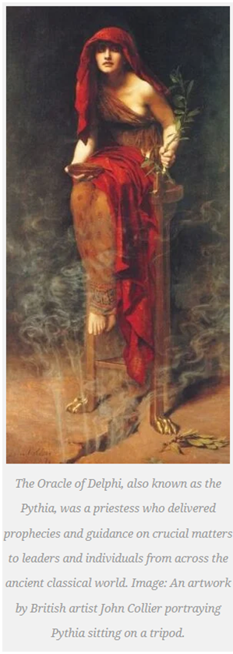
Delphi Definition of Dyslexia new in 2024 (Carroll, J., Holden, C., Kirby, P., Snowling, M. J., & Thompson, P.A. (2024)). https://en.wikipedia.org/wiki/Delphi_method
The Rose definition of dyslexia is now 15 years old. The advantages of the Delphi definition are that it:
Addresses the nature and complex causal basis of dyslexia.
Focuses on a range of underlying processing difficulties and the impact on reading and spelling fluency.
Is applicable across all age ranges.
Directs greater attention to co-occurrence and secondary consequences
Notes:
is a structured communication technique or method, originally developed as a systematic, interactive forecasting method that relies on a panel of experts.^{[1][2][3][4][5]} Delphi has been widely used for business forecasting and has certain advantages over another structured forecasting approach, prediction markets.^{[6]}
Delphi can also be used to help reach expert consensus and develop professional guidelines.^{[7]} It is used for such purposes in many health-related fields, including clinical medicine, public health, and research.^{[7][8]}
The experts answer questionnaires in two or more rounds. After each round, a facilitator or change agent^{[10]} provides an anonymised summary of the experts' forecasts from the previous round as well as the reasons they provided for their judgments. Thus, experts are encouraged to revise their earlier answers in light of the replies of other members of their panel. It is believed that during this process the range of the answers will decrease and the group will converge towards the "correct" answer. Finally, the process is stopped after a predefined stopping criterion (e.g., number of rounds, achievement of consensus, stability of results), and the mean or median scores of the final rounds determine the results.^{[11]}

Slide 47
Delphi Definition: Nature and Manifestation of Dyslexia https://osf.io/preprints/osf/tb8mp_v1
The nature and developmental trajectory of dyslexia depends on multiple genetic and environmental influences.
Manifestation
Dyslexia is a set of processing difficulties that affect the acquisition of reading and spelling.
The most commonly observed cognitive impairment in dyslexia is a difficulty in phonological processing (i.e. in phonological awareness, phonological processing speed or phonological memory).
However, phonological difficulties do not fully explain the variability that is observed. Working memory, processing speed and orthographic skills can contribute to the impact of dyslexia.

Slide 48
Delphi Definition: Impact and Variance of Dyslexia
Variance and co-occurrence
Dyslexic difficulties exist on a continuum and can be experienced to various degrees of severity.
Dyslexia can affect the acquisition of other skills, such as mathematics, reading comprehension or learning another language.
Dyslexia frequently co-occurs with one or more other developmental difficulties, including developmental language disorder, dyscalculia, ADHD, and developmental coordination disorder.
Impact
Some or all aspects of literacy attainment are weak in relation to age, standard teaching and instruction, and level of other attainments.
Across languages and age groups, difficulties in reading and spelling fluency are a key marker of dyslexia.

Slide 49
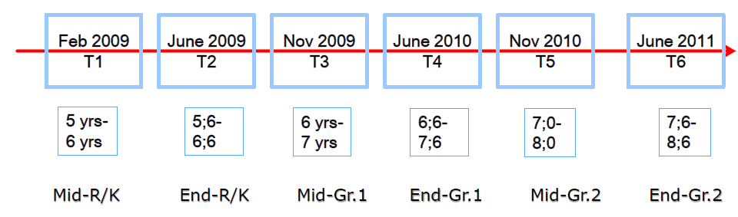
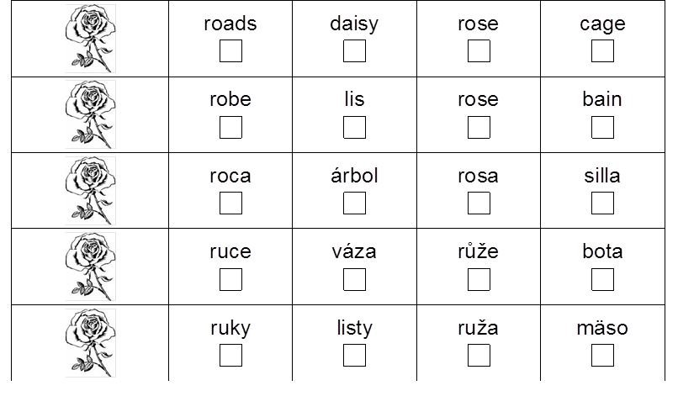
Study II: Growth of word-level reading skills Different Growth Rates, Same Foundations?
Assumption 2: Learners of consistent (Spanish, Czech) orthographies undergo faster skill growth in word reading than learners of inconsistent (English) orthographies
Study 2a: The Case of Silent Word Reading
Compared children’s rate and pattern of growth between Kindergarten/Reception and Grade 2
Compared predictors of growth
PA, LK, RAN
Silent Picture-Word Reading Measure
Notes:
So what about reading development in the longer term, and the second assumption?
In study 2, we tracked children rate of reading growth, this time contrasting English with Spanish and Czech. Here we focused on silent reading efficiency using a 3-minute limited PWM test, which consisted of a set of 60 cognate target words.
We tracked children’s reading gains over six time points K-end-2, and also compared the roles of the predictors of growth – the core skills of study 1.

Slide 50
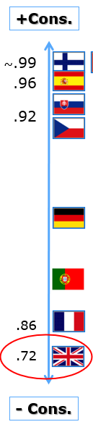
Implications for reading development in Portuguese
Portuguese has a moderately consistent orthography
Based on studies with languages that span the orthographic consistency spectrum:
- expect the same universal precursor skills to “drive” early word-level literacy
∴ Early markers of risk for word-level literacy skills -- Dyslexia -- Universal
expect PT children to acquire basic reading skills more slowly than , e.g., Spanish peers,
and slower emerging impacts of OL on reading comprehension than, e.g., Spanish.
Early markers of risk for RC skills need to consider OL skills along with efficiency of decoding.

Slide 51
Sample of letter cards for Letter Naming
Sample instruction….”Here is a card with a letter from your name. Do you know what sound this letter makes?”
The letter cards are NOT ordered alphabetically. Important to follow the order set out in the test.

Slide 52




RAN (Colours)
RAN Tests
RAN tasks Practice items
Pre-readers
RAN (Objects)
RAN (Letters)
a s d p o
Readers
RAN (Digits)
2 3 6 7 9

Slide 53
Test building approach -- Key considerations
How we went about it in the ELDEL project –
Item selection – Guiding principles
Nonword Items: Parity in item form (CV structure, length, phonological legality/plausibility)
Word Items: Parity in form and in frequency, familiarity, meaning (when relevant)
Ensuring scale parity -- length, difficulty, validity
Cultural factors – educational and societal considerations
Age of schooling, typical literacy curricula in early stages of schooling, etc.
Notes:
So how, in a nutshell, did we go about creating the initial and later the more recent language versions of so many tests?

Slide 54
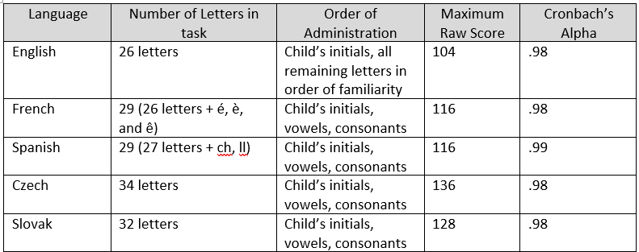
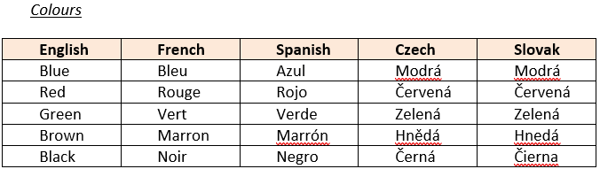
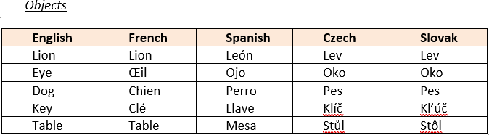
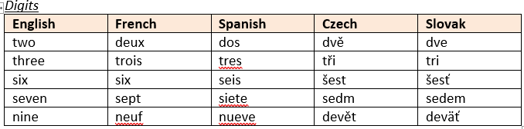
Examples of commensurability aims of PA, LK, RAN measures across languages
LK – stimulus form and content equivalence
E.g., English, French, Spanish, Czech, Welsh
PA – Stimulus form equivalence x-ling
E.g., CVC, CCVC and CVCC structure
in English, French, Czech, Spanish
RAN – Stimulus content equivalence x-ling
E.g., colours objects digits letters
PHONEME ISOLATION TEST EXAMPLE ITEMS
r= .80 - .90
r= .82-.89
r= .79-.84
r= .85 - .92
Notes:
Swap in videos from MM?

Slide 55
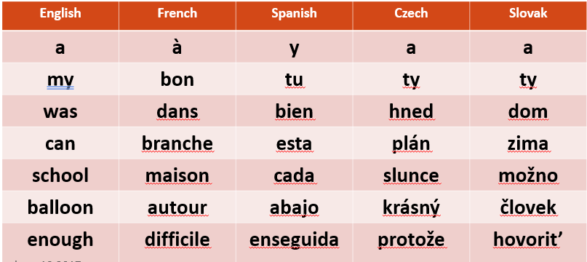
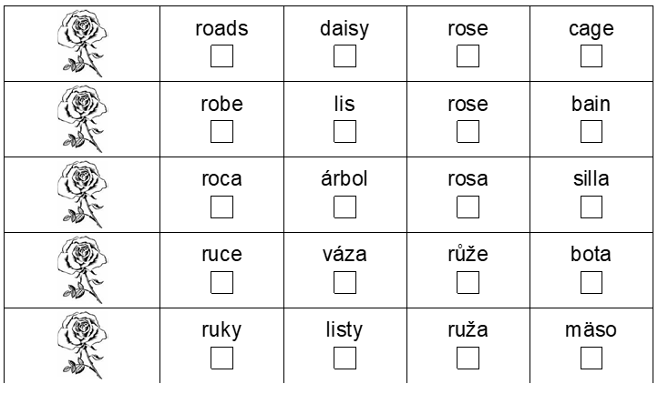
Two Approaches to Matching Reading Tests in ELDEL (& MABEL)
Sampling comparable frequency strata
Item matching
Frequency-matched lists:
in ELDEL relatively High Frequency items, conceptually familiar to young school children
Criteria: 140 HF words of 1, 2, 3 syllables.
Proportion of 1, 2, 3-syll words to reflect their distribution in the language.
Match on factors such as frequency, length, syllable structure, N, familiarity, AoA, imageability, etc.
The ultimate in matching: Cognates
Sample of Words from the One Minute Word Reading Test
Sample of Words from the Picture-Word Matching Test
ENGLISH
FRENCH
SPANISH
CZECH
SLOVAK
Notes:
N. C. Ellis et al., 2004), [The effects of orthographic depth on learning to read alphabetic, syllabic, and logographic scripts. Reading Research Quarterly, 39, 438–468.]
N. C. Ellis and Hooper (2001) compared Welsh and English using frequency-matched lists compiled by sampling words from 100 successive strata of decreasing written word frequency in each language, each successive item representing a successively lower frequency 10,000 word band.
All other variables—such as length, syllable structure, meaningfulness, etc. —were left free to vary.
Oral reading accuracy among English speakers/readers reached the 52% mark, compared with 61% for Welsh. This indicates that the Welsh group (ages 6 and 7 years) were able to read twice as many words in their printed language than were English readers. In their Welsh–English study,
Spencer and Hanley (2003) reported a similar outcome using conventional item-matching methods (cognates and derived nonwords);
Welsh group (ages 6 and 7 years) was able to read twice as many words in their printed language than were English readers.

Slide 56
Phoneme Isolation Accuracy | Phoneme Isolation Percentile Ranks
 | 5 | 10 | 25 | 50 | 75 | 90 | 95
ENG Reception | 0.00 | 0.00 | 3.00 | 6.00 | 9.00 | 10.00 | 10.00
ENG Year 1 | 0.00 | 1.00 | 5.00 | 8.00 | 10.00 | 10.00 | 10.00
ES Kindergarten | 0.00 | 0.00 | 1.00 | 3.00 | 6.00 | 9.00 | 10.00
ES Grade 1 | 0.50 | 1.00 | 6.00 | 9.00 | 10.00 | 10.00 | 10.00
SK Kindergarten | 0.00 | 1.90 | 4.00 | 7.00 | 9.00 | 10.00 | 10.00
SK Grade 1 | 4.00 | 4.00 | 7.00 | 9.00 | 10.00 | 10.00 | 10.00
Letter Writing Percentile Ranks
Letter Writing Acc. | 5 | 10 | 25 | 50 | 75 | 90 | 95
ENG Reception | 1.60 | 4.20 | 10.00 | 15.00 | 16.00 | 16.00 | 16.00
ENG Year 1 | 8.00 | 11.00 | 14.00 | 15.00 | 16.00 | 16.00 | 16.00
ES Kindergarten | 5.15 | 7.00 | 8.00 | 14.00 | 16.00 | 16.00 | 16.00
ES Grade 1 | 12.00 | 14.00 | 14.00 | 16.00 | 16.00 | 16.00 | 16.00
SK Kindergarten | 0.00 | 2.00 | 4.00 | 12.00 | 16.00 | 16.00 | 16.00
SK Grade 1 | 10.00 | 12.00 | 15.00 | 16.00 | 16.00 | 16.00 | 16.00

Slide 57
Phoneme Isolation Accuracy | Phoneme Isolation Percentile Ranks
 | 5 | 10 | 25 | 50 | 75 | 90 | 95
ENG Reception | 0.00 | 0.00 | 3.00 | 6.00 | 9.00 | 10.00 | 10.00
ENG Year 1 | 0.00 | 1.00 | 5.00 | 8.00 | 10.00 | 10.00 | 10.00
ES Kindergarten | 0.00 | 0.00 | 1.00 | 3.00 | 6.00 | 9.00 | 10.00
ES Grade 1 | 0.50 | 1.00 | 6.00 | 9.00 | 10.00 | 10.00 | 10.00
SK Kindergarten | 0.00 | 1.90 | 4.00 | 7.00 | 9.00 | 10.00 | 10.00
SK Grade 1 | 4.00 | 4.00 | 7.00 | 9.00 | 10.00 | 10.00 | 10.00
Letter Writing Percentile Ranks
Letter Writing Acc. | 5 | 10 | 25 | 50 | 75 | 90 | 95
ENG Reception | 1.60 | 4.20 | 10.00 | 15.00 | 16.00 | 16.00 | 16.00
ENG Year 1 | 8.00 | 11.00 | 14.00 | 15.00 | 16.00 | 16.00 | 16.00
ES Kindergarten | 5.15 | 7.00 | 8.00 | 14.00 | 16.00 | 16.00 | 16.00
ES Grade 1 | 12.00 | 14.00 | 14.00 | 16.00 | 16.00 | 16.00 | 16.00
SK Kindergarten | 0.00 | 2.00 | 4.00 | 12.00 | 16.00 | 16.00 | 16.00
SK Grade 1 | 10.00 | 12.00 | 15.00 | 16.00 | 16.00 | 16.00 | 16.00

Slide 58
RAN Pictures - Percentile Ranks
RAN Time | 95 | 90 | 75 | 50 | 25 | 10 | 5
ENG Reception | 36 | 43 | 53 | 67 | 75 | 100 | 116
ENG Year 1 | 34 | 36 | 42 | 50 | 65 | 78 | 91
ES Kindergarten | 41 | 44 | 49 | 60 | 71 | 89 | 101
ES Grade 1 | 34 | 37 | 41 | 47 | 57 | 69 | 77
SK Kindergarten | 35 | 38 | 46 | 55 | 62 | 71 | 90
SK Grade 1 | 34 | 36 | 39 | 45 | 52 | 61 | 72
Basic Word Reading Percentile Ranks
Word Reading Acc. | 5 | 10 | 25 | 50 | 75 | 90 | 95
ENG Reception | 0.00 | 0.00 | 0.00 | 0.00 | 2.00 | 6.00 | 6.55
ENG Year 1 | 0.00 | 0.00 | 1.00 | 2.00 | 4.75 | 7.00 | 9.35
ES Kindergarten | 0.00 | 0.00 | 0.00 | 0.00 | 2.00 | 6.00 | 9.00
ES Grade 1 | 2.00 | 4.00 | 7.00 | 9.00 | 10.00 | 10.00 | 10.00
SK Kindergarten | 0.00 | 0.00 | 0.00 | 0.00 | 2.00 | 9.00 | 9.05
SK Grade 1 | 0.00 | 0.00 | 1.00 | 7.00 | 10.00 | 10.00 | 10.00

Slide 59
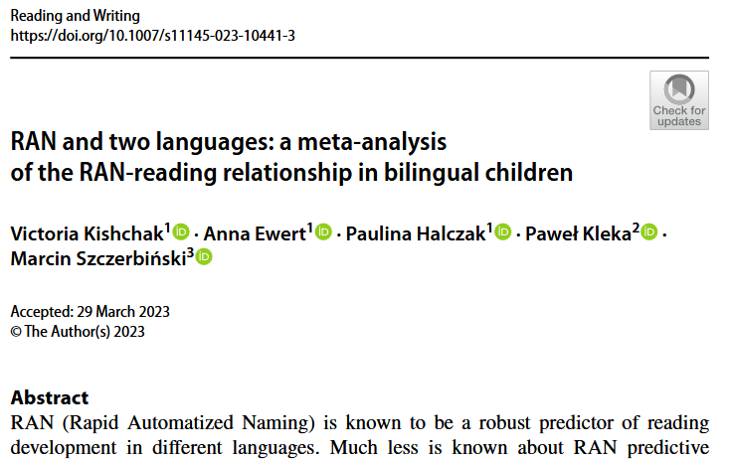
MABEL measures are proving effective in research in numerous languages.
PA, LK, RAN markers – show comparisons
-correlations, regressions of longitudinal predictors of reading, spelling.

Slide 60
Spelling results Multi-group path model predicting the growth in early spelling
Caravolas et al., 2012
Mid-Kindergarten/ Reception Yr
Spelling
Mid-Grade/Yr 1
.75**
.48**
.81**
Phoneme Awareness
.17**
-.39**
.71**
.37**
.37**
Letter Knowledge
.12**
Spelling
-.37**
-.36**
-.11**
.40**
RAN
.34**
.05ns
-.20**
R² = .63
Word Span
Model fit: χ² (63, N = 675) = 55.93, p < .724, CFI =1.00, TLI =1.00, RMSEA = .000 [.000-.036], SRMR =.041.
Notes:
The pattern of predictive relationships for spelling is identical (with prior spelling as the autoregressor substituted for prior reading).
The fact that in both models the path weights are constrained to be equal provides a stringent test of the idea that these measures are equally important as predictors of progress in learning to read and to spell across the four languages considered here. Both models provide truly excellent fits to the data (there are no significant differences between these constrained models and equivalent models where all parameters are freely estimated over languages) and account for very high proportions of the variance in reading skills (R² = .62) and spelling skills (R² = .63) in all four languages.

Slide 61
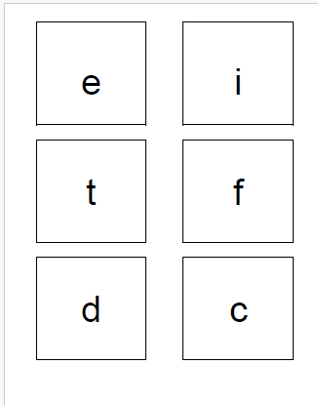
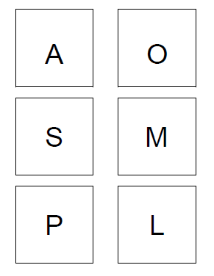
What the children see…
Mini-Mabel version – only 6 letters of each
Letter names OR sounds accepted

Slide 62

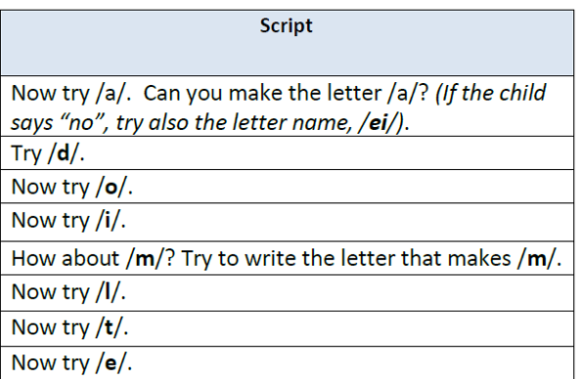
What children hear and use to write…

Slide 63

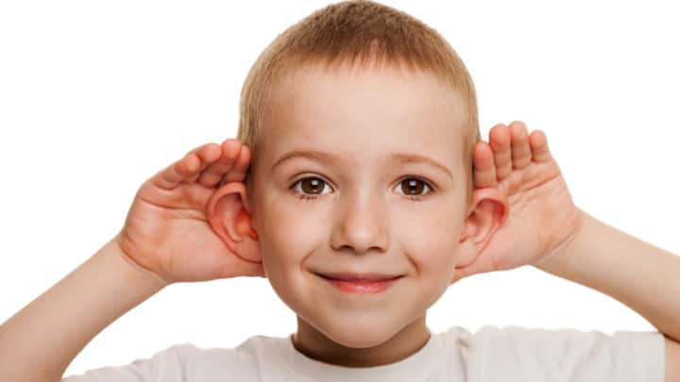
What the children hear…
“Here is a pretend word - Boff, can you say it? What is the first sound in Boff?”

Slide 64


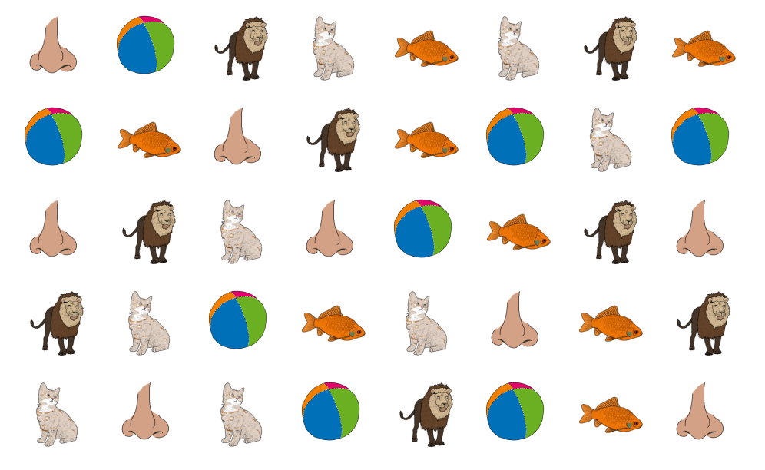
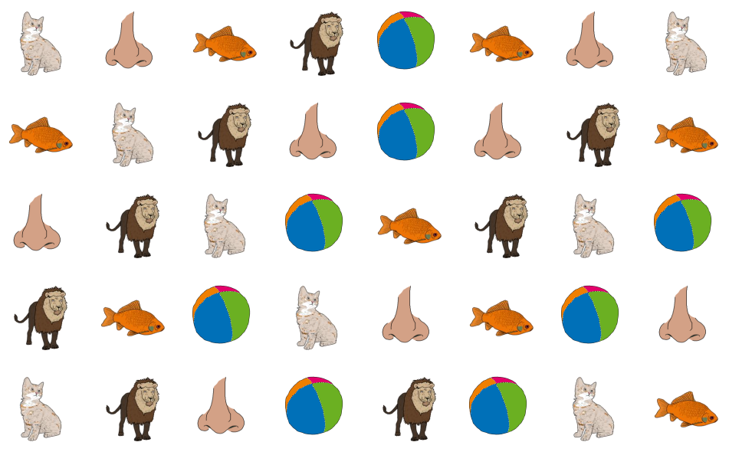
What the children see…

Slide 65
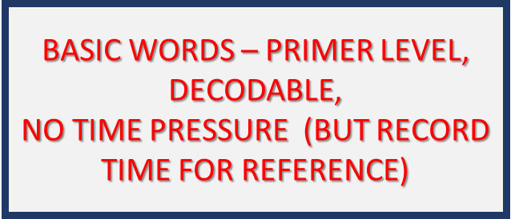
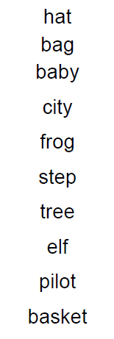
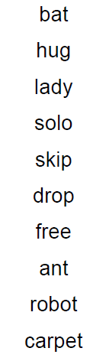
What the children see…
FORM A
FORM B
Administer only ONE form at “baseline”
The other form is for retesting at a later date (follow-up)
1- and 2-syllable words
Simple CV structure and more complex structures with CC (clusters)

Slide 66
Basic Word Reading
What the children see…
FORM A

Slide 67
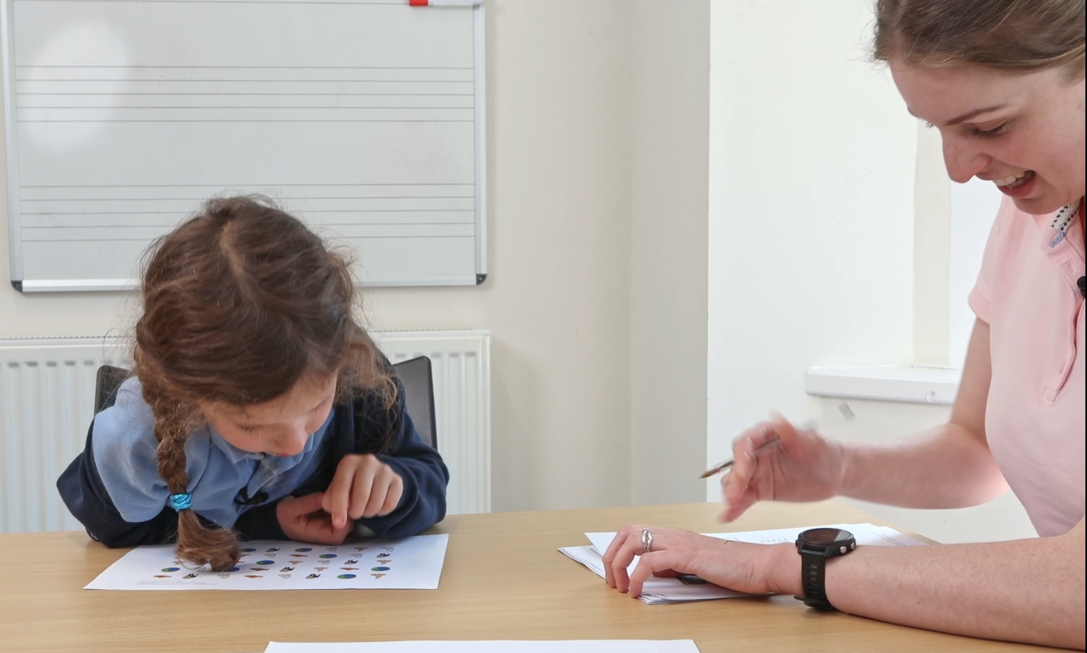
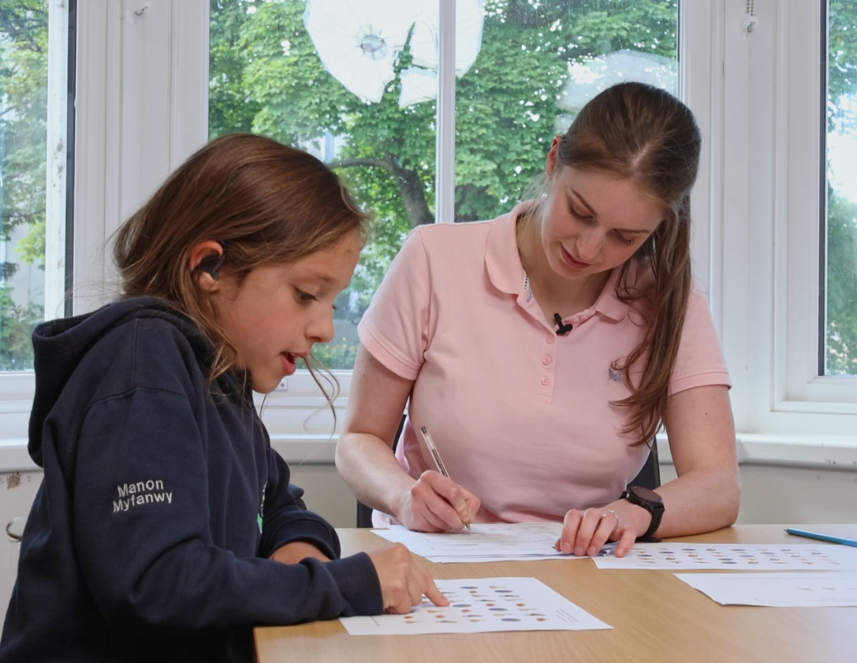
Example Videos
RAN - English
RAN- Cymraeg
Notes:
Marketa

Slide 68
Presentation Background
We now have evidence of the relative universality of the foundations and early cognitive markers of literacy difficulties, but confirming directly across languages is useful for advancing our knowledge and our confidence in our current understanding.
This was the cross-linguistic aim of the European research project – ELDEL
ELDEL gave rise to Project MABEL
The MABEL project is predicated on the idea that best cross-linguistic evidence comes from like-with-like comparisons.
Original MABEL battery included 5 languages varying in alphabetic consistency
Now we have added several new languages that complement the original set in terms of consistency and other important features --- e.g., alphabet type…
Including PT, so would like to include a look at the reliability and validity of this version.
In addition, the MABEL consortium has been serving an international practitioner population (give indication of extent) and have responded to several clear needs : e.g., screener for school use. Mini MABEL.

Slide 69
Foundations of Reading Development
(Caravolas, Hulme, & Snowling, 2001)
Reading
T1
T2
T3
T4
.53***
.74***
.61***
Read
Read
Read
Read
.46***
.47*
.28***
.10*
Spell (cn)
Spell (cn)
.35***
.36*
.25***
.18*
Spell(ph)
Spell(ph)
.15*
Spell(ph)
.26***
.16*
PA
PA
.19**
PA
.43***
.59***
Lett Snd
Lett Snd
Lett Snd
.14**
Lett Nm
Lett Nm
Lett Nm
Notes:
Reading development mainly on prior reading and phonological spelling, but also letter-name knowledge.
Reading at T2 predicted by reading and phoneme isolation, but not phon spelling

Slide 70
Foundations of Spelling Development
(Caravolas, Hulme, & Snowling, 2001)
Phonological (ph) spelling
T1
T2
T3
T4
Read
Read
Read
.25***
.18*
Spell(ph)
Spell(ph)
Spell(ph)
.26***
PA
PA
.19**
PA
.43***
.59***
Lett Snd
Lett Snd
Lett Snd
Lett Nm
Lett Nm
Lett Nm
Notes:
Only showing the unique predictors here.

