Slide 1



From the Womb to the Classroom:
Typical and Atypical Reading Development and Implications for a Preventative Education Model
Nadine Gaab, PhD
Silvana and Chris Pascucci Professor in Learning Differences
Harvard Graduate School of Education
www.gaablab.com

Slide 2

When does reading development start?
Notes:
Reading is one of the most complex skills in which we engage daily and is crucial for functioning in modern society.
It is associated with many indices of health as well as academic, social, vocational, and economic success (XX)

Slide 3
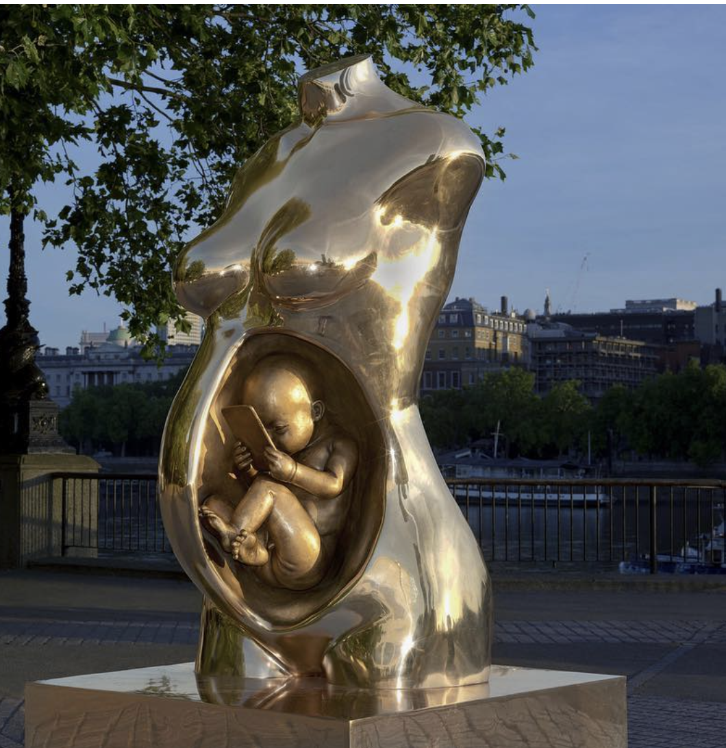
(Frederico Clapis)

Slide 4

Learning to read is a process that requires the mastering of a series of developmental stages in response to environmental input, starting with language processing in utero and ending with proficient reading years later (e.g., Chall, 1983).
Learning to read is NOT a natural process
Notes:
As discussed earlier: The structural and functional architecture of the brain is formed by an interactive
process between genes and the environment, which begins in utero and continues
throughout the lifespan.

Slide 5

Typical reading development
Learning to read
Reading to learn
Notes:
Learning to read is a process that requires the mastering of a series of developmental stages in response to environmental input, starting with language processing in utero and ending with proficient reading years later (e.g., Chall, 1983).

Slide 6
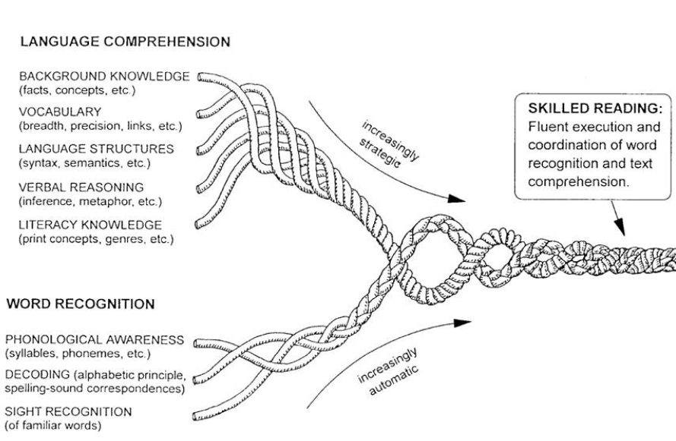
Theoretical models suggest a dynamic interplay between lower-level foundational and
cognitive-linguistic skills
(Scarborough, 2001)
Notes:
Theoretical models explaining variability in reading skills suggest a dynamic interplay and co-development among lower-level foundational and cognitive-linguistic skills, interacting with genetic, environmental and socio-ecological factors.
These models are supported by empirical evidence from behavioral studies in K-12, but the foundational and cognitive-linguistic skills themselves start (co-) developing long before school-age.
Neuroimaging studies in school-age children have demonstrated critical mechanistic support for multifactorial models but these brain areas, tracts, and networks also begin to develop long before school-age, with the most rapid development transpiring during infancy

Slide 7
Every child has the right to learn to read well…
69% of all fourth-graders in the U.S. are reading below grade level and approximately 80% of fourth-graders from low socio-economic backgrounds are reading below grade level.
National Center for Education Statistics (2024)

Slide 8

Low reading skills are tied to
low self-esteem, feelings of shame, inadequacy, and helplessness (e.g., Valas, 1999).
greater risk for developing internalizing or externalizing symptoms (e.g., Hendren et al., 2018).
lower education levels, less income, increased health issues, higher incarceration and poverty rates (e.g., Moody et al 2000).
The National Council for Adult Learning estimates that low literacy skills cost the U.S. at least $225 billion each year.
Notes:
Difficulty learning to read can lead to low self-esteem, feelings of shame, inadequacy, and helplessness.
Students with reading diffuclties are at a greater risk for developing internalizing symptoms (anxiety, depression) and/or externalizing behavioral problems
Students with dyslexia are less likely to enroll in postsecondary education programs (Horn et al., 1999) and more likely to be incarcerated (Moody et al., 2000). They are at greater risk for internalizing symptoms associated with anxiety and depression (e.g., Dahle & Knivsberg, 2014; Jordan et al., 2014; Mugnaini et al., 2009), as well as for externalizing behavior

Slide 9
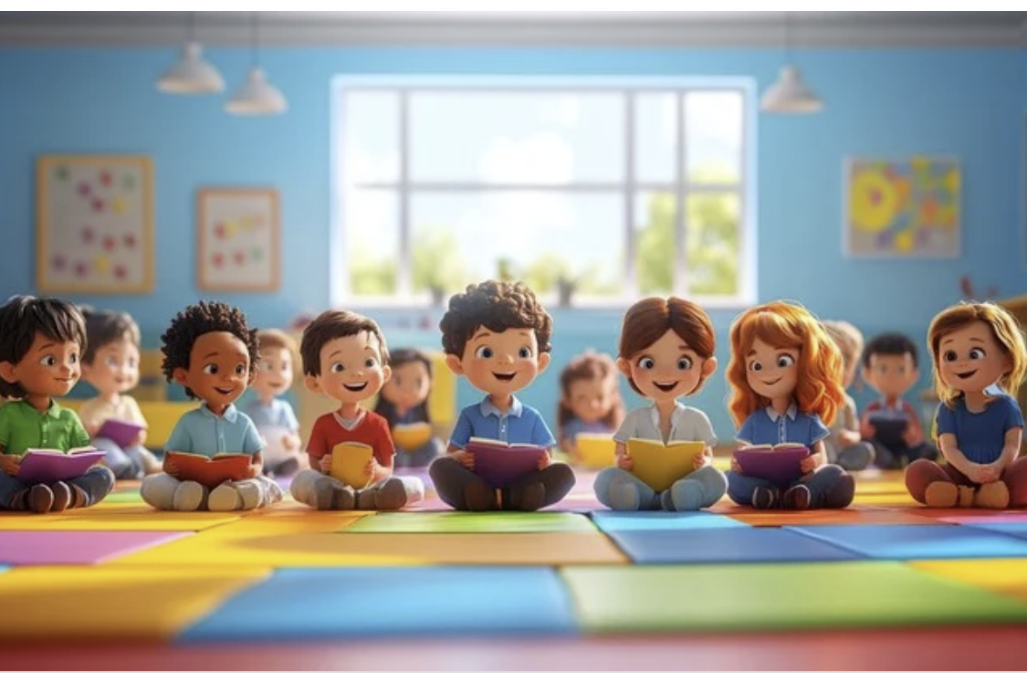
What is Developmental Dyslexia?
Affects 7-12% of children in English-speaking countries (about 2-3 in each classroom)
  difficulties with accurate and/or fluent word reading
  poor spelling and decoding abilities
  Heritability estimates are 40-60%
(Grigorenko et al., 2020)

Slide 10
Theoretical models suggest a dynamic interplay between lower-level foundational and
cognitive-linguistic skills
(Scarborough, 2001)
Notes:
Theoretical models explaining variability in reading skills suggest a dynamic interplay and co-development among lower-level foundational and cognitive-linguistic skills, interacting with genetic, environmental and socio-ecological factors.
These models are supported by empirical evidence from behavioral studies in K-12, but the foundational and cognitive-linguistic skills themselves start (co-) developing long before school-age.
Neuroimaging studies in school-age children have demonstrated critical mechanistic support for multifactorial models but these brain areas, tracts, and networks also begin to develop long before school-age, with the most rapid development transpiring during infancy

Slide 11
What is Developmental Dyslexia?
Affects 7-12% of children in English-speaking countries (about 2-3 in each classroom)
  difficulties with accurate and/or fluent word reading
  poor spelling and decoding abilities
  Heritability estimates are 40-60%
(Grigorenko et al., 2020)

Slide 12
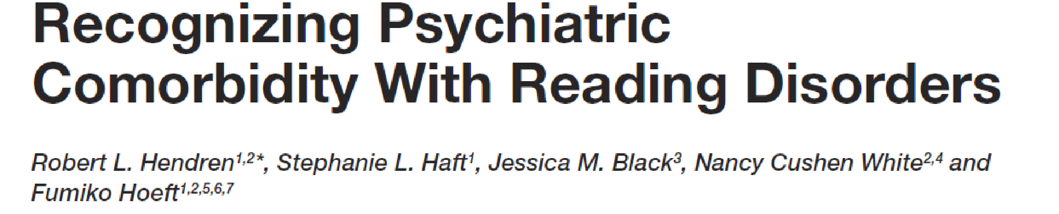
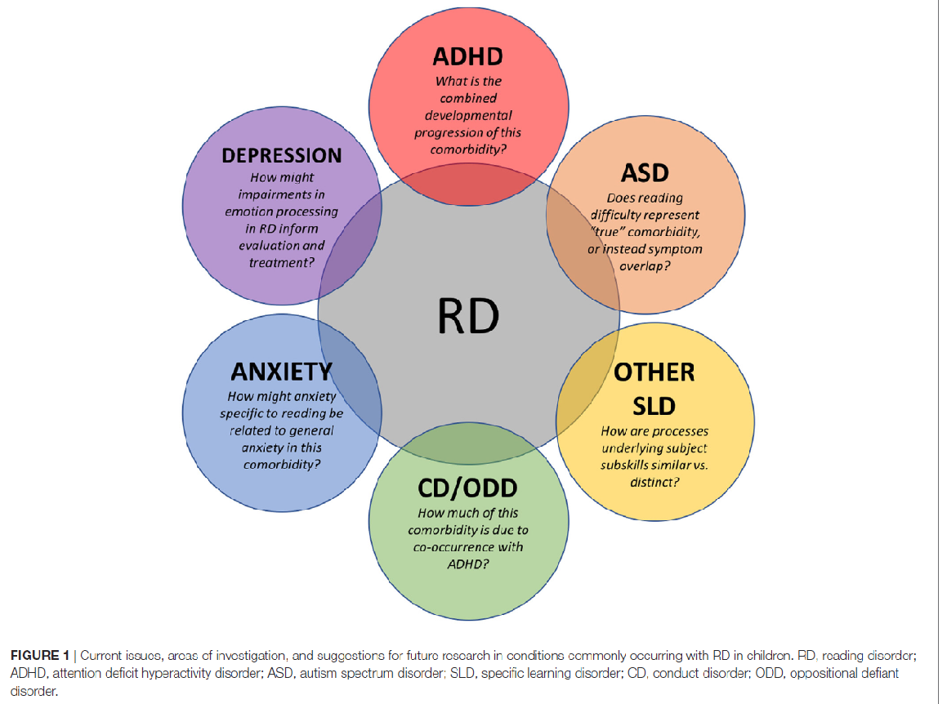

Slide 13
Factors contributing to reading disabilities
Genetics
Atypical Reading Development
Brain
Perception & Cognition
Environment
Notes:
Dynamic due to development
Influence each other
Implications for interventions
Implications for early identification

Slide 14
Notes:
Studies of families with developmental dyslexia (DD) suggest that DD is strongly heritable, occurring in up to 68% of identical twins and 40-60% of individuals who have a first degree relative with DD [Finucci et al., 1984; Volger et al., 1985; Grigorenko, 2008; Kovas et al., 2013).
Several genes have been reported to be candidates for dyslexia susceptibility and it has been suggested that the majority of these genes plays a role in early brain development. [e.g.; Galaburda et al., 2006; Hannula-Jouppi et al., 2005; Meng et al., 2005; Skiba et al., 2011; Doust et al., 2021].

Slide 15
Factors influencing the development of Reading Disabilities
Genetics
Typical/Atypical Reading Development
Brain
Perception & Cognition
Environment
Notes:
Dynamic due to development
Influence each other
Implications for interventions
Implications for early identification

Slide 16
Environmental risk factors for poor literacy outcomes
Home Language and Literacy
Neighborhood factors/learning environment
Child neglect/abuse
Trauma
Poverty/SES/Housing insecurity
Inadequate Reading Instruction
Multilingual learners /ELL
Immigration status
Caregiver’s education
Caregiver with substance abuse/chronic illness

Slide 17
Factors contributing to reading disabilities
Genetics
Atypical Reading Development
Brain
Perception & Cognition
Environment
Notes:
Dynamic due to development
Influence each other
Implications for interventions
Implications for early identification

Slide 18
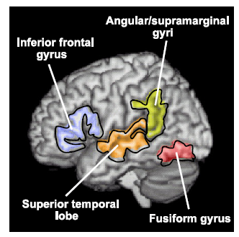
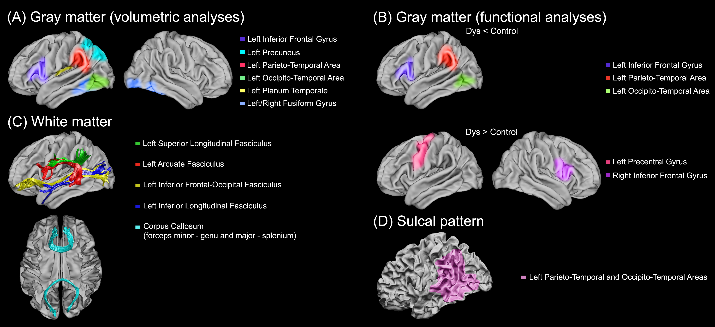
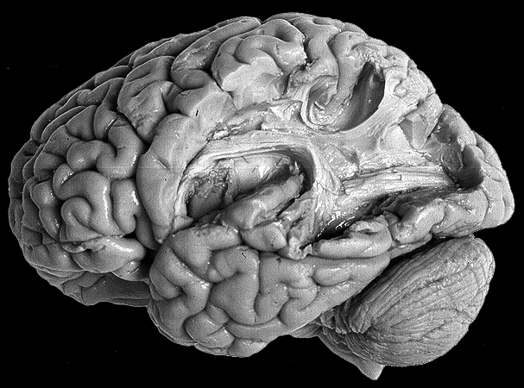
Brain studies in school-age children and adults have demonstrated critical mechanistic support for multifactorial models of reading
Sound-symbol
connection
Reading fluency & comprehension
Oral Language
Processing
Print and Word
recognition
(Ozernov-Palchik & Gaab , 2016; Wiley Interdiscip Rev Cogn Sc)
Notes:
Do we need this teaching session?
HIGHLIGHT ARCUATE FASCICULUS

Slide 19
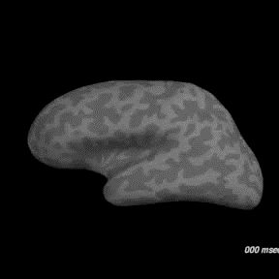
Reading words…
[Video: Showing brain activation while an adults is reading a word]
(Dale et al., 2000)
Notes:
A total of 370 concrete nouns, 3–11 letters long, representing objects and animals were used as stimuli. Each word was presented for 240 ms with a 1600 ms stimulus onset asynchrony on a back-projection screen using an LCD video projector. The subject pressed a key with his/her right hand if the object or animal that the word represented was usually more than a foot in its longest dimension

Slide 20

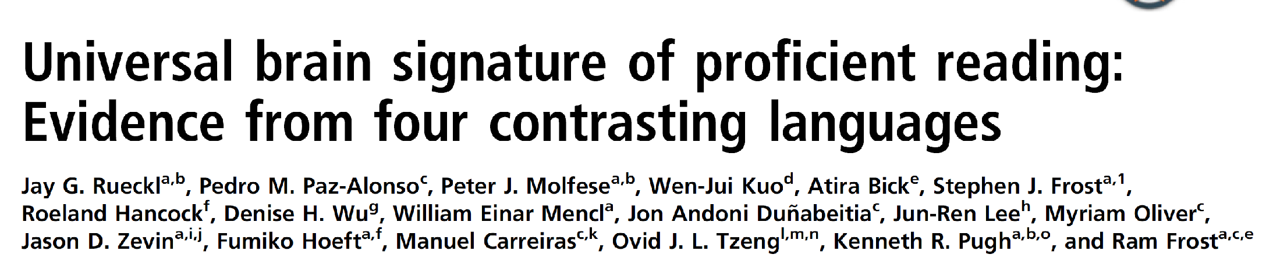
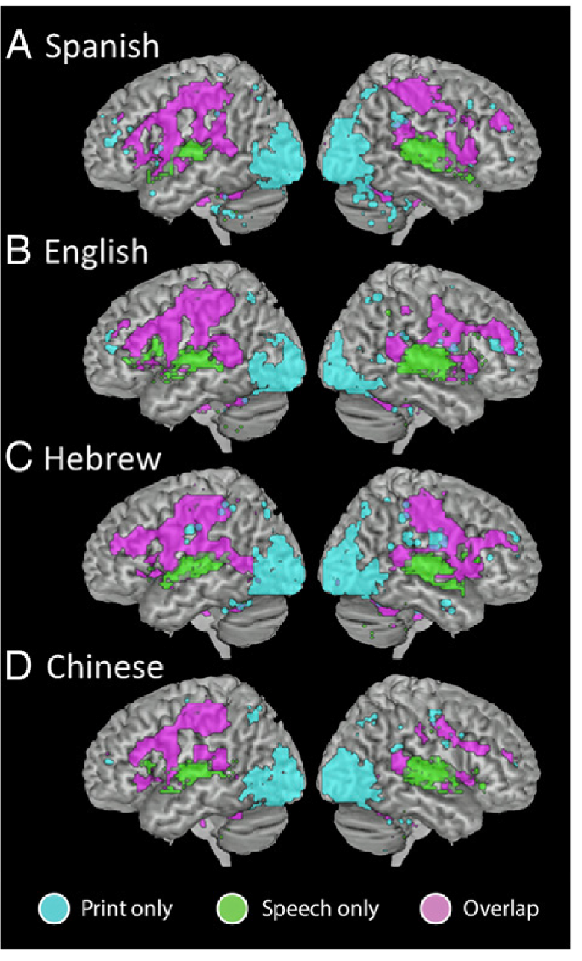
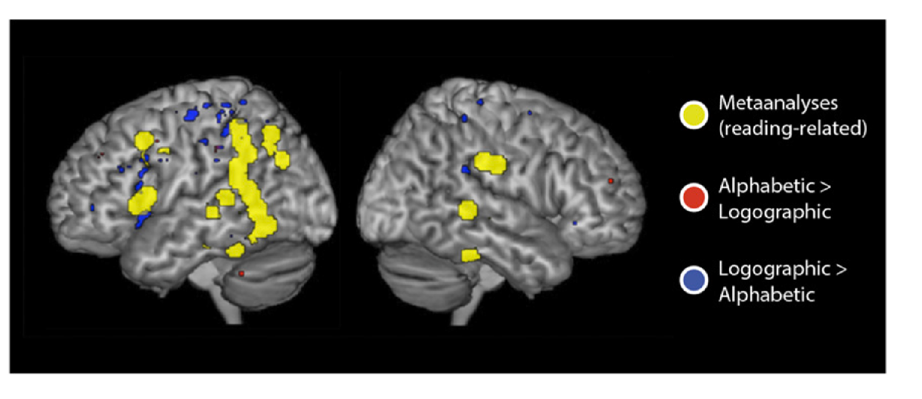
2015

Slide 21
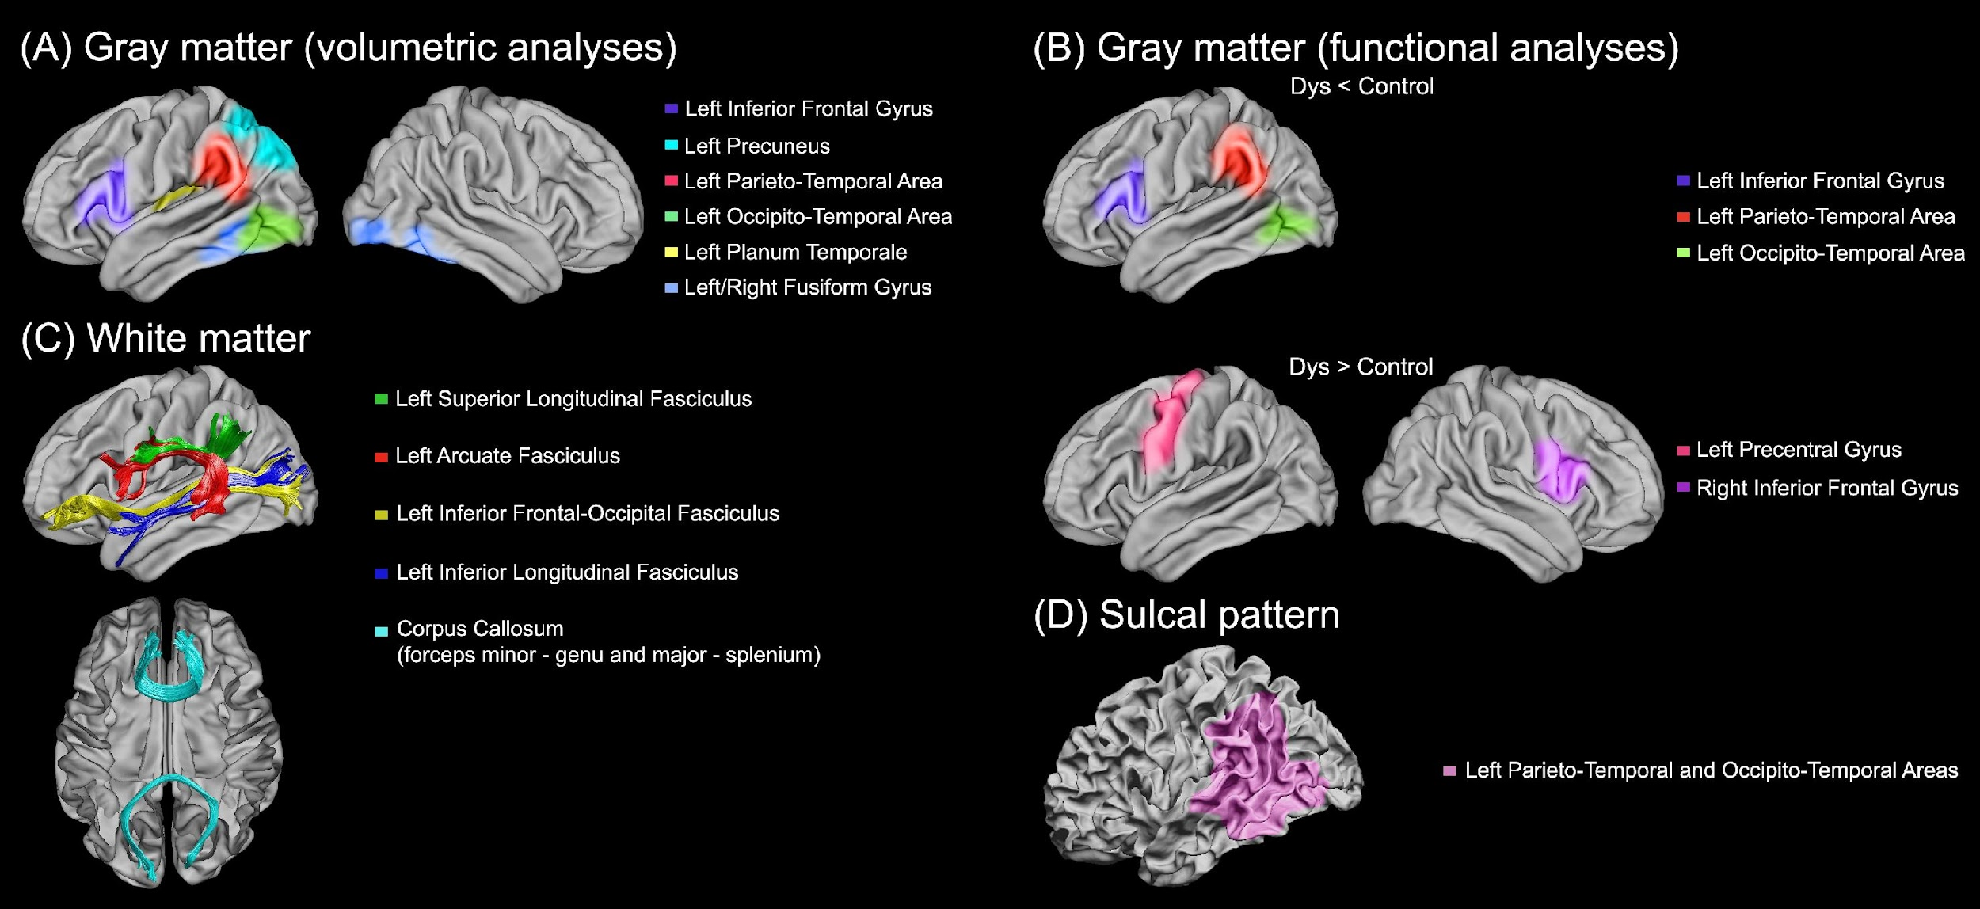
Structural and functional brain alterations in individuals with dyslexia
(Ozernov-Palchik, … & Gaab, 2016; Curr Opin. Behav. Sci)

Slide 22
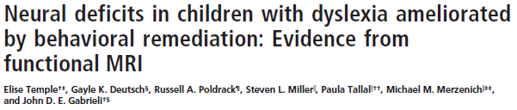
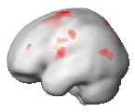
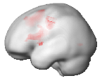
n= 45
8 weeks intervention
Control
Frontal
AND Temporo-parietal
Dyslexia
Frontal
but NOT Temporo-parietal
Example:
B D = Rhyme
B K = Do Not Rhyme
[Temple et al. (2003) PNAS, 100]
Notes:
To remind you of the results obtained previously
we showed that during phonological processing, the normal readers have both left frontal and left temporo-parietal activity
while the dyslexic children have only left frontal and no left temporo-parietal at all

Slide 23
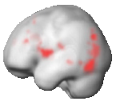
Neural effect of intervention
Pre-Intervention
Frontal
but NOT Temporo-parietal
Post-Intervention
Increased activity in Frontal AND Temporo-parietal
After training, metabolic brain activity in dyslexics more closely resembles that of typical readers.
[Temple et al. (2003) PNAS, 100]
Notes:
When we look at the neural effects of remediation,
Here are the dyslexic children before training
And here are the brain areas which showed an increase after training, relative to before, during the letter rhyme task.
First fucusing on the left hemisphere and specifically the temporo-parietal cortex,
we do see increased response in the left temporo-parietal area.

Slide 24
Cause or consequence?
An important question for practice and policy
Birth
Pre-K
K
1
2
3
4
5
24
Notes:
Rti, MTSS are also reactive
Mental health implications

Slide 25
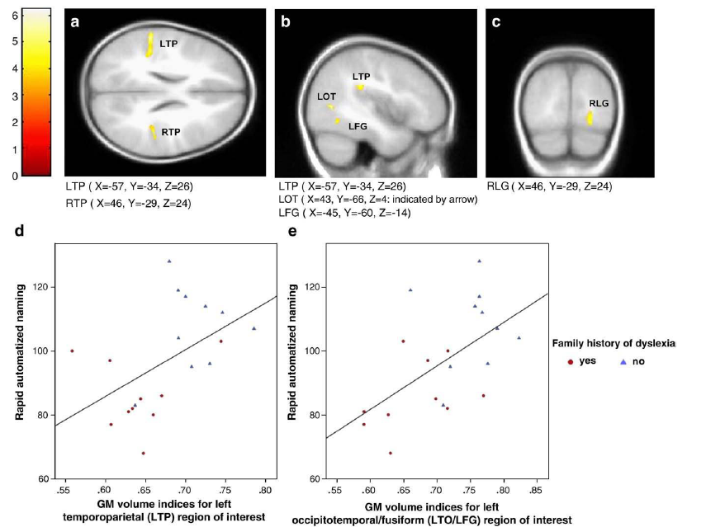
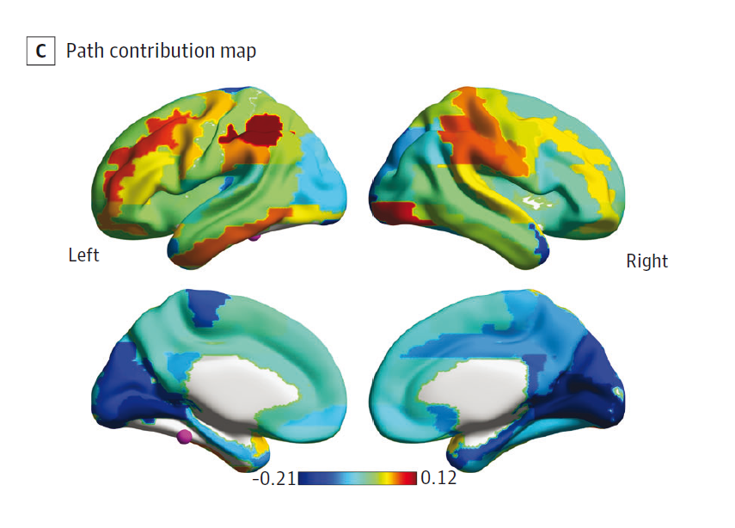
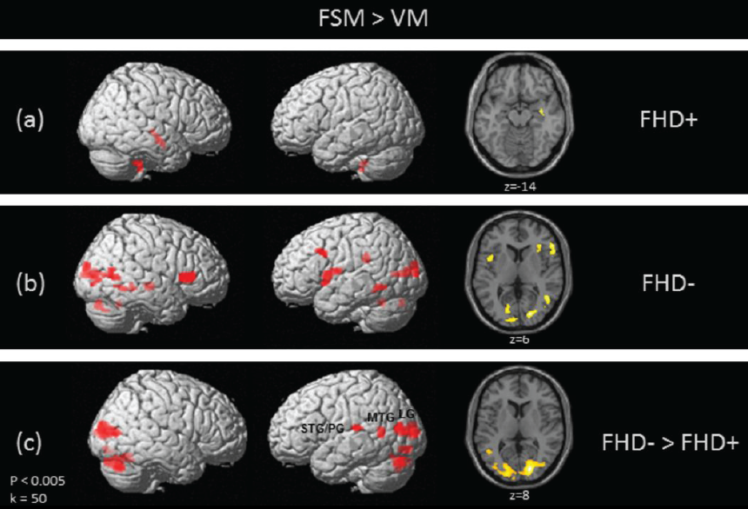
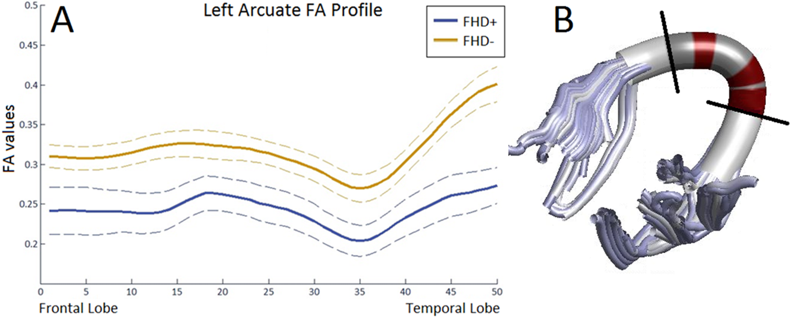
Some of the brain alterations in struggling readers predate formal reading instruction
Wang,…Gaab, 2017;
Cerebral Cortex
Raschle, …Gaab, 2010;
Neuroimage
Yu, …Gaab, 2022;
JAMA Pediatrics
Langer, …Gaab, 2016;
Cerebral Cortex
Raschle, … Gaab, 2012; PNAS
Notes:
The first phase of our work focused on cross-sectinoal studies and showed that brain function, white matter, gramy matter volume and sulcal patterns (the topography of the cortex) differs between children with and without a familial risk. We could also show that infants with a parent show atypical white matter. However, this did not answer our questions regarding trajectories of brain development, the link to behavioral outcomes and the role of the environment

Slide 26
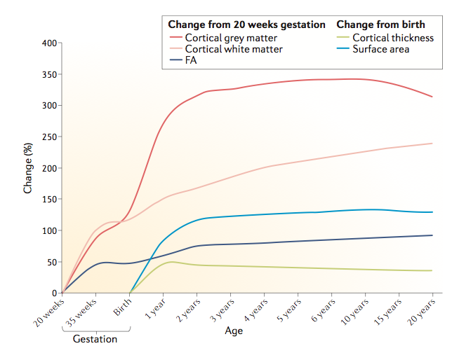
Early Infancy:
Rapid Period of Brain Development
(Gilmore, Knickmeyer, & Gao, 2018)

Slide 27
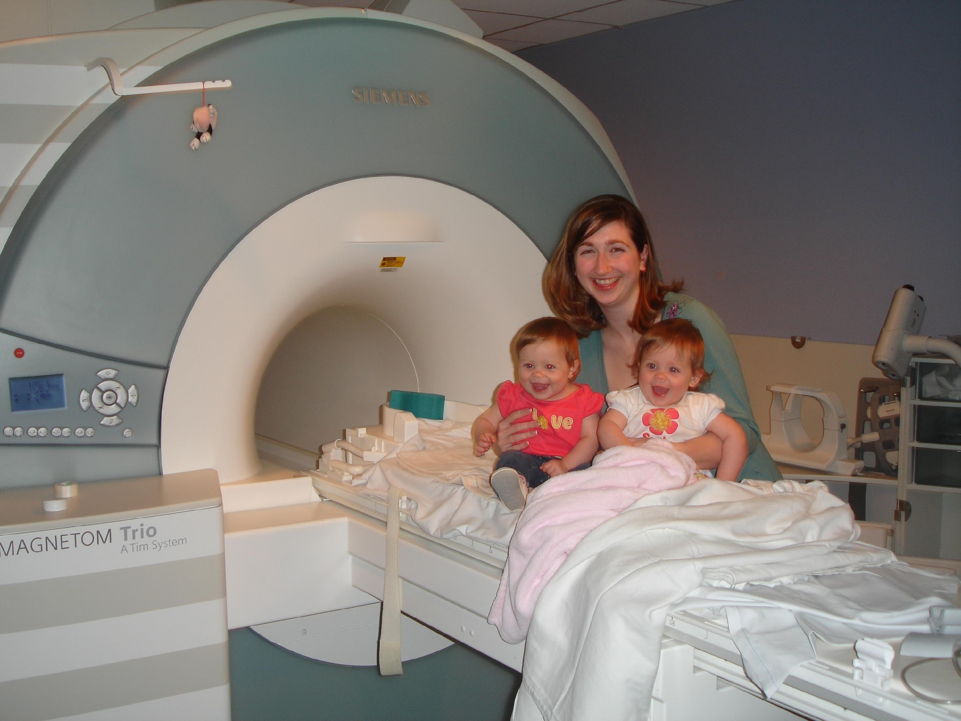
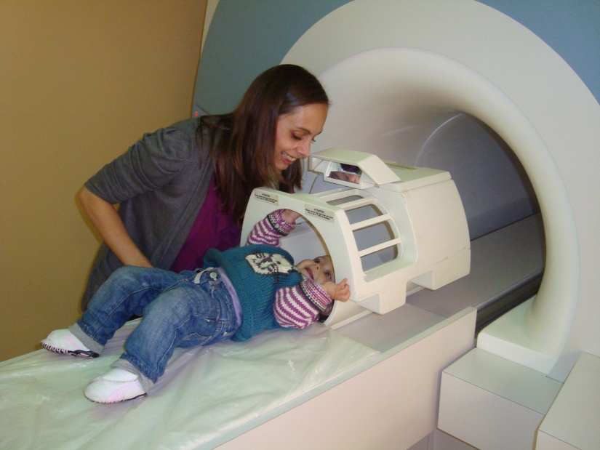
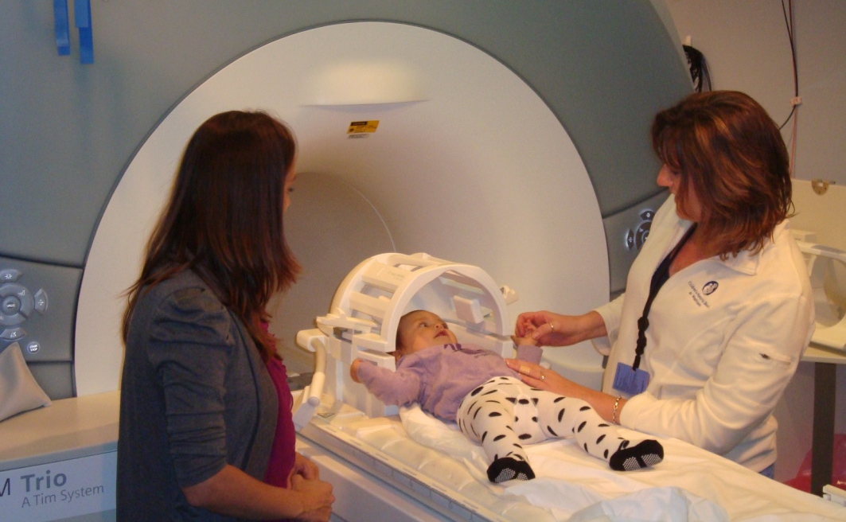
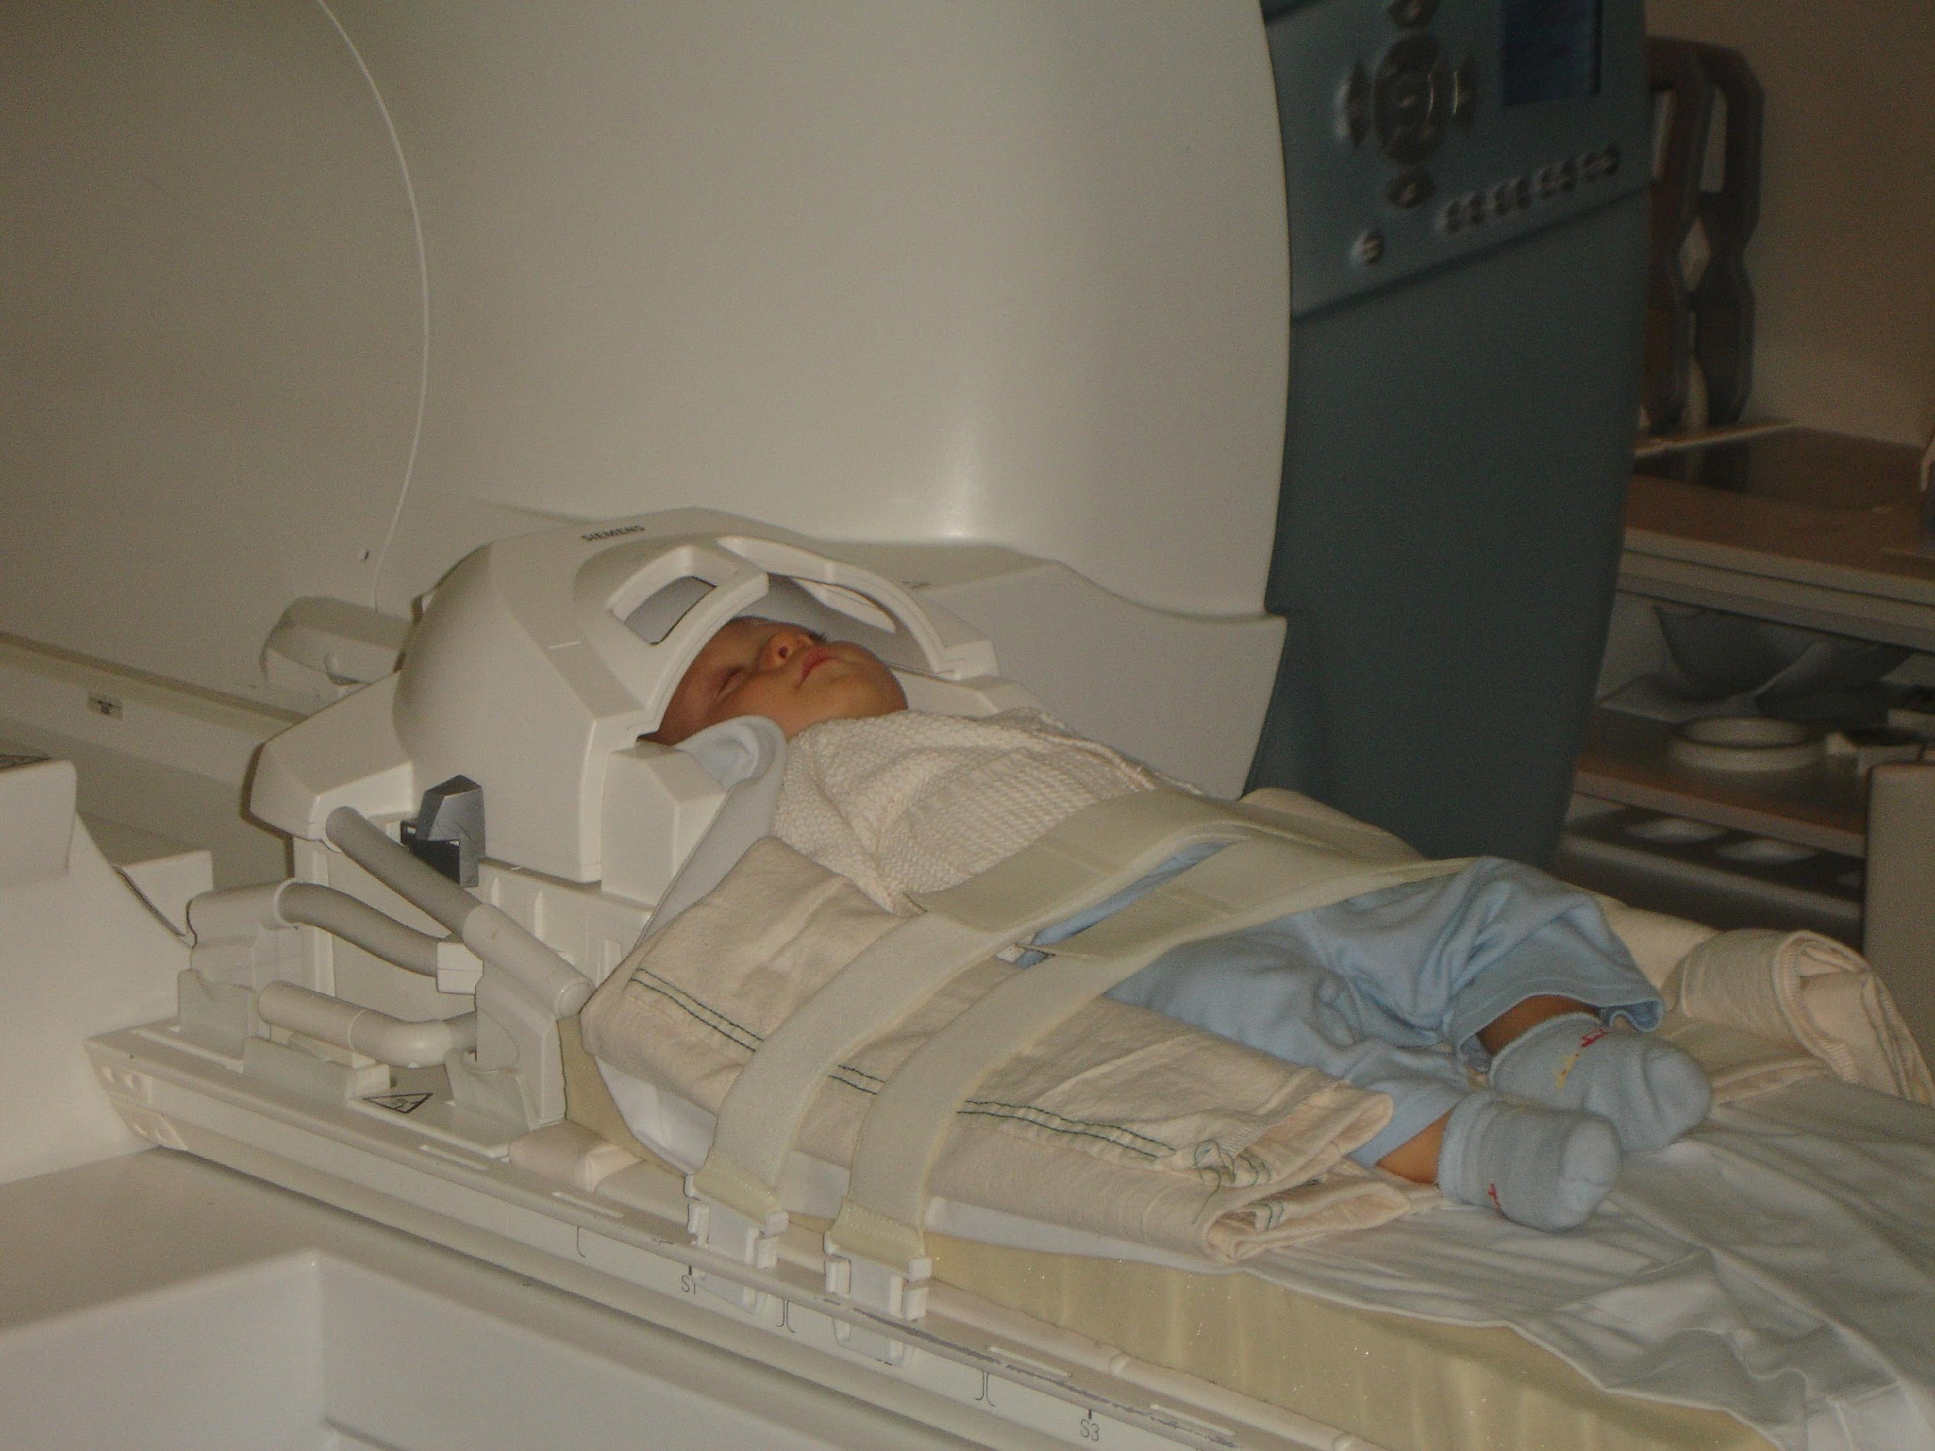
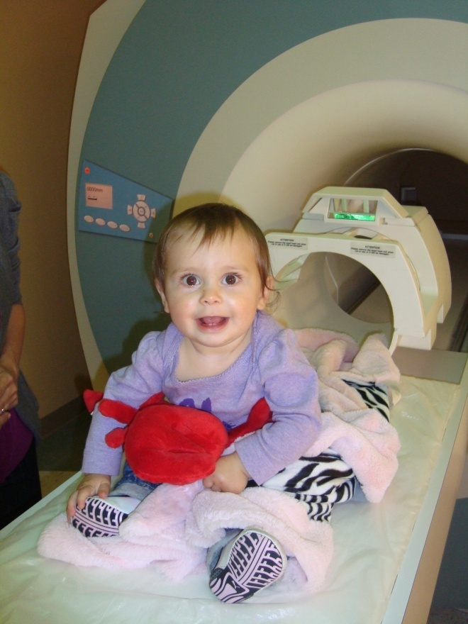
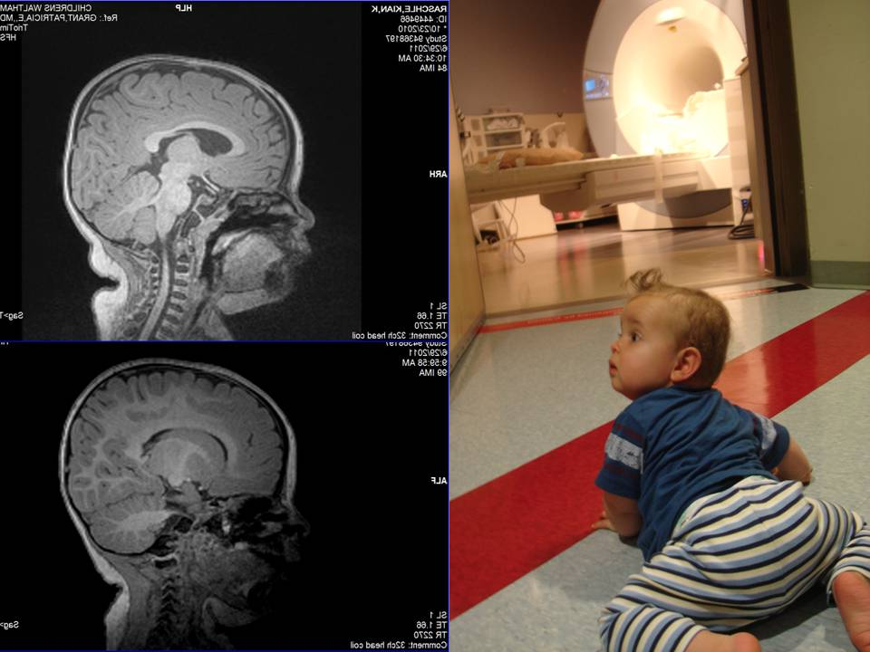
Neuroimaging the rapidly developing brain
(Turesky, … & Gaab, 2021; Dev. Cog. Neur.)
Notes:
We followed almost 80 kids, which is quite a large sample size for this type of work…”.
Neuroimaging as an alternative or complementary perspective
We developed this

Slide 28
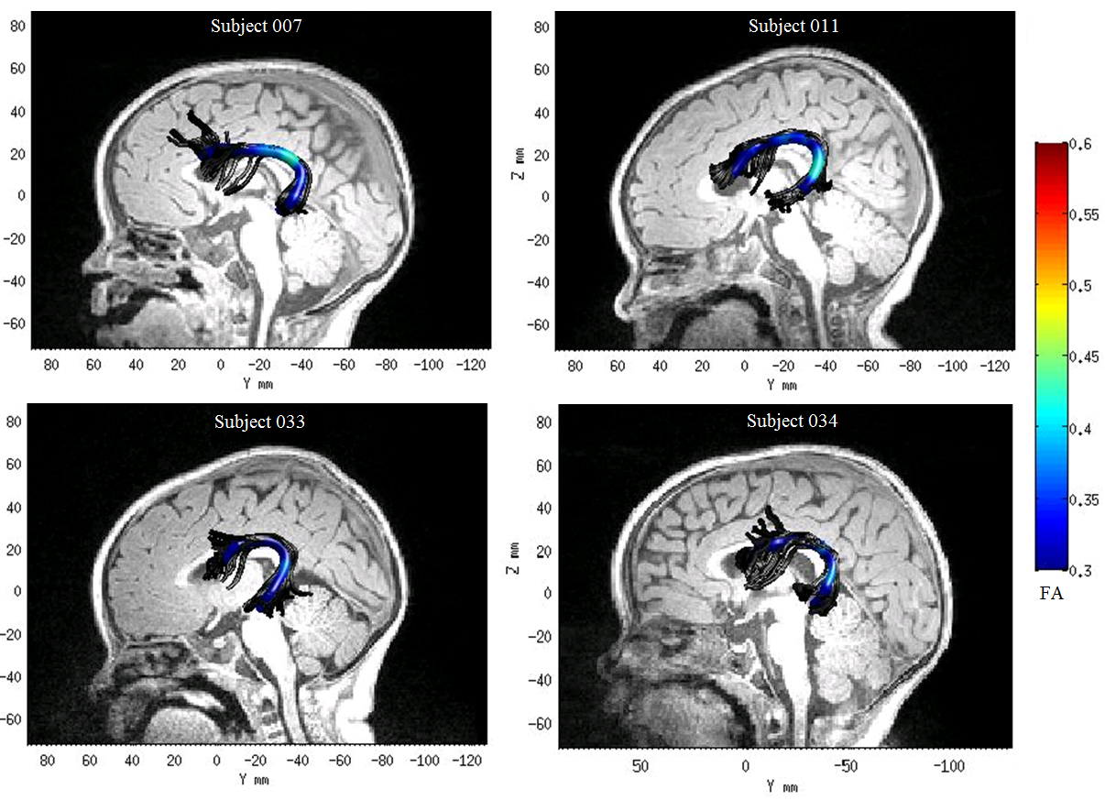
Examples of variability in brain structure

Slide 29
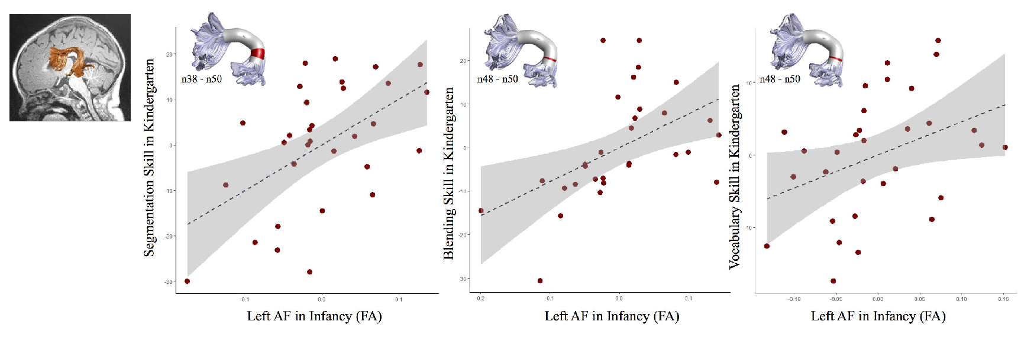
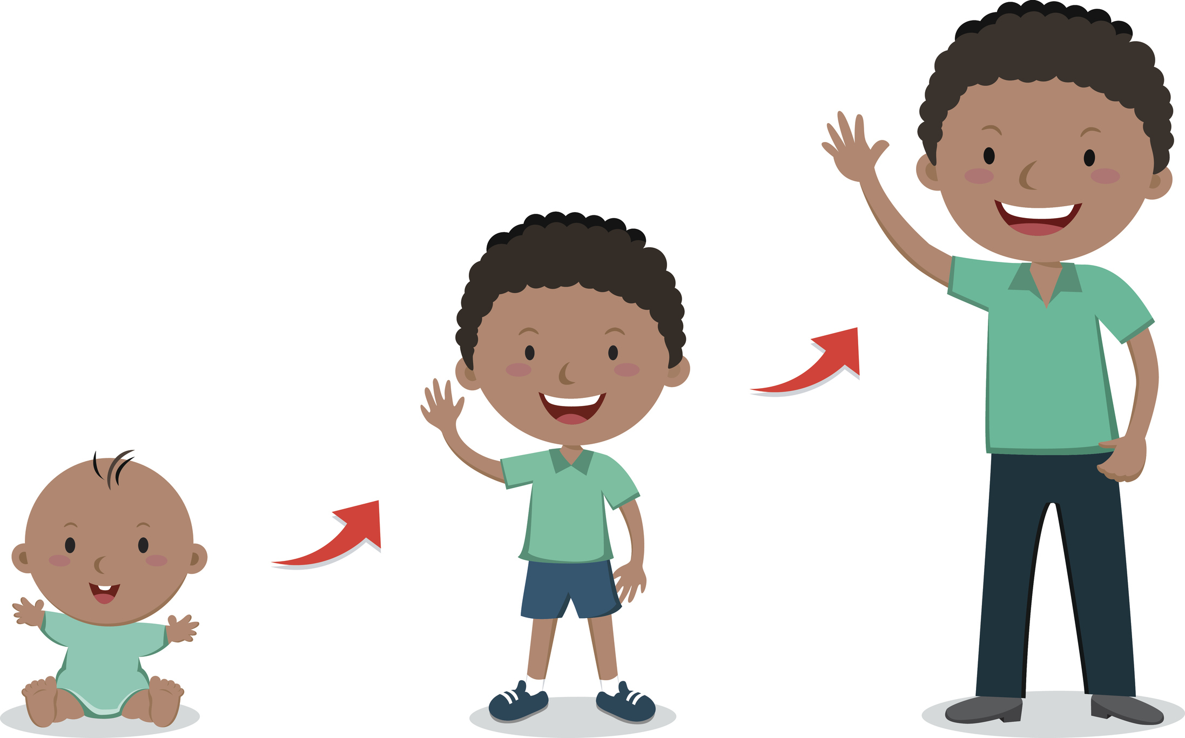
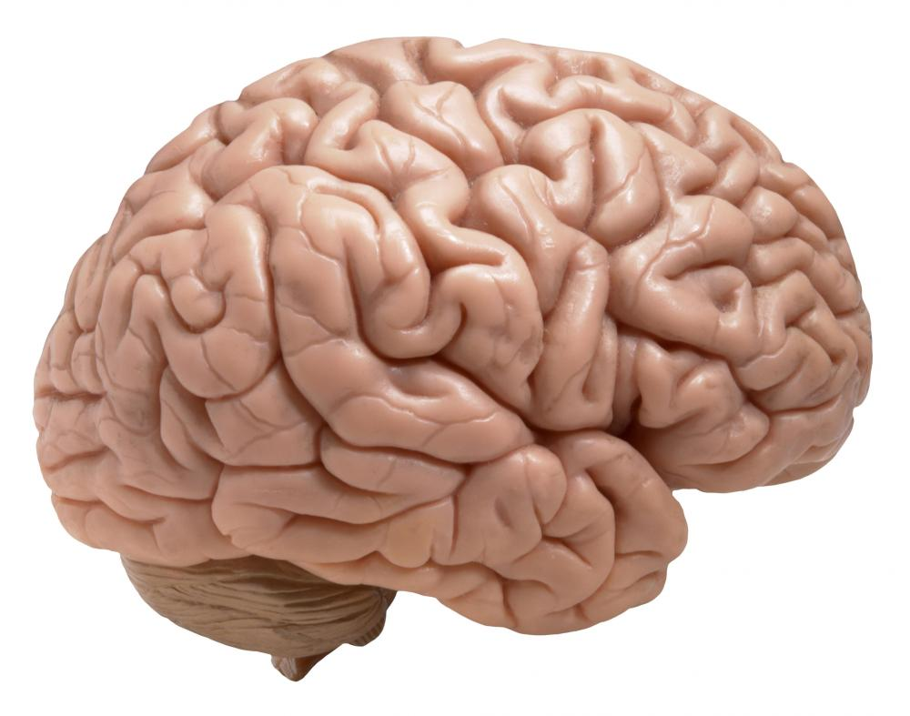

White matter in infancy is prospectively associated with language outcomes in kindergarten
(Zuk, … & Gaab, 2021; Dev. Cog. Neur.)
Microstructure in left arc
Microstructure in left arc
Microstructure in left arc
Microstructure within the left arcuate fasciculus is prospectively associated with phonological awareness and vocabulary skills
(controlling for age and the home language/literacy environment)

Slide 30
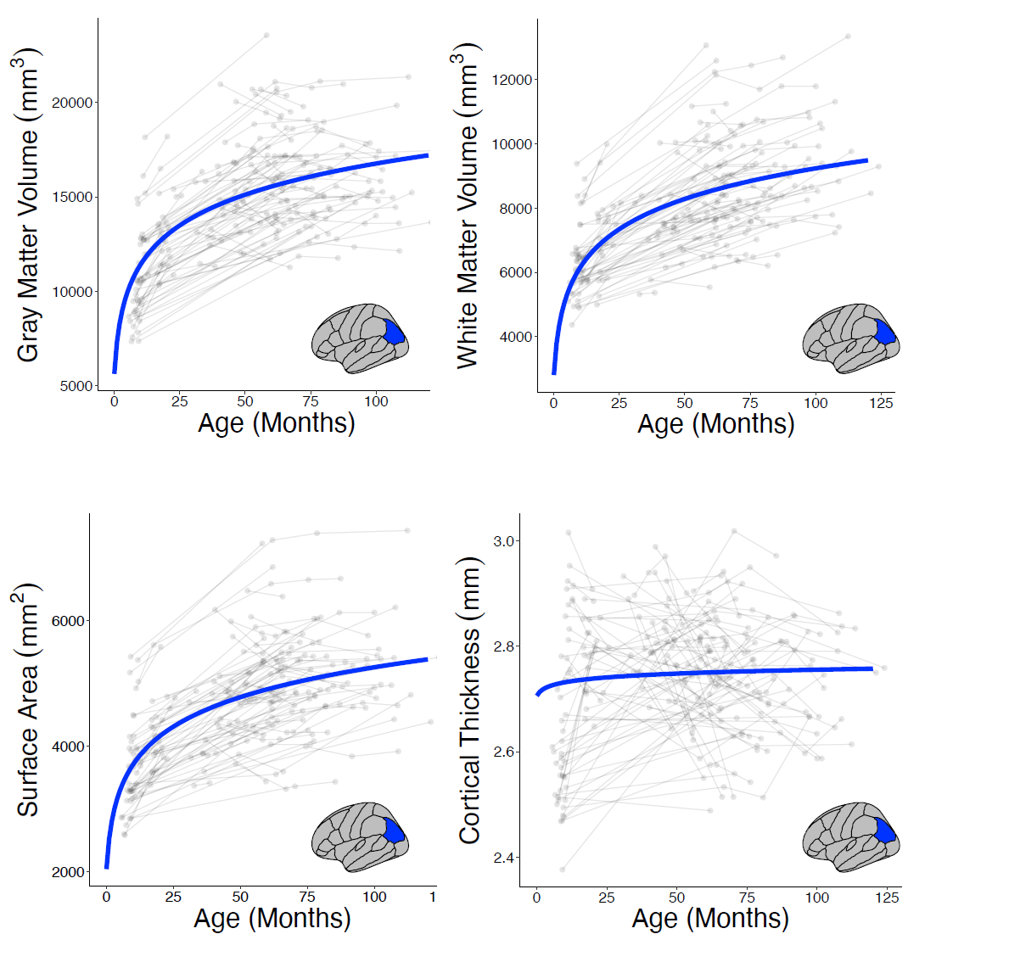

Longitudinal trajectories of brain development from infancy to school age and their relationship to literacy development
Turesky et al., in press; PNAS)
n ≈ 137
with 441 observations
controlled for biological sex,
maternal education and cohort.
→ Further assessed whether familial risk or home literacy environment show influences
Notes:
Control factors?

Slide 31
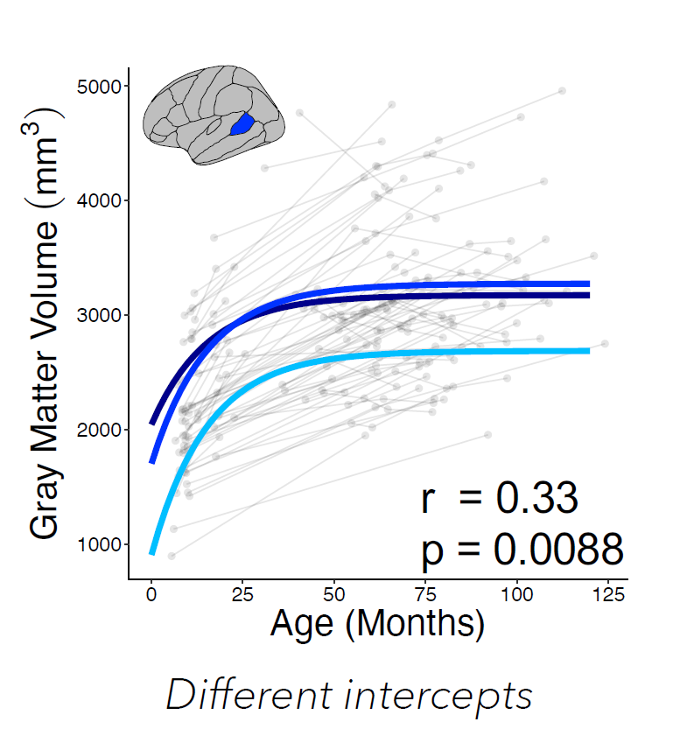
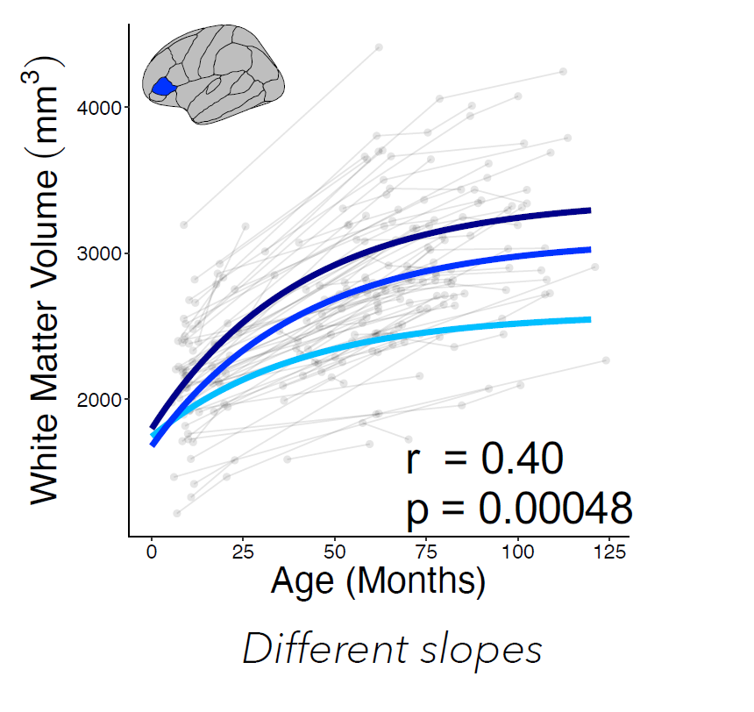
Growth curves differ depending on pre-literacy outcomes
Turesky et al., in press; PNAS)
Phonological Processing at 60 months:
Notes:
Generated individual growth curves from overall model and then correlated intercepts (i.e., age = 0 months) and slopes with language outcomes at ~60 months.
One language outcome from word recognition side of SVR (i.e., WJ phonological processing) and one language outcome from language comprehension side (i.e., WJ oral language cluster).
N~=80
Controls: Sex, maternal education

Slide 32
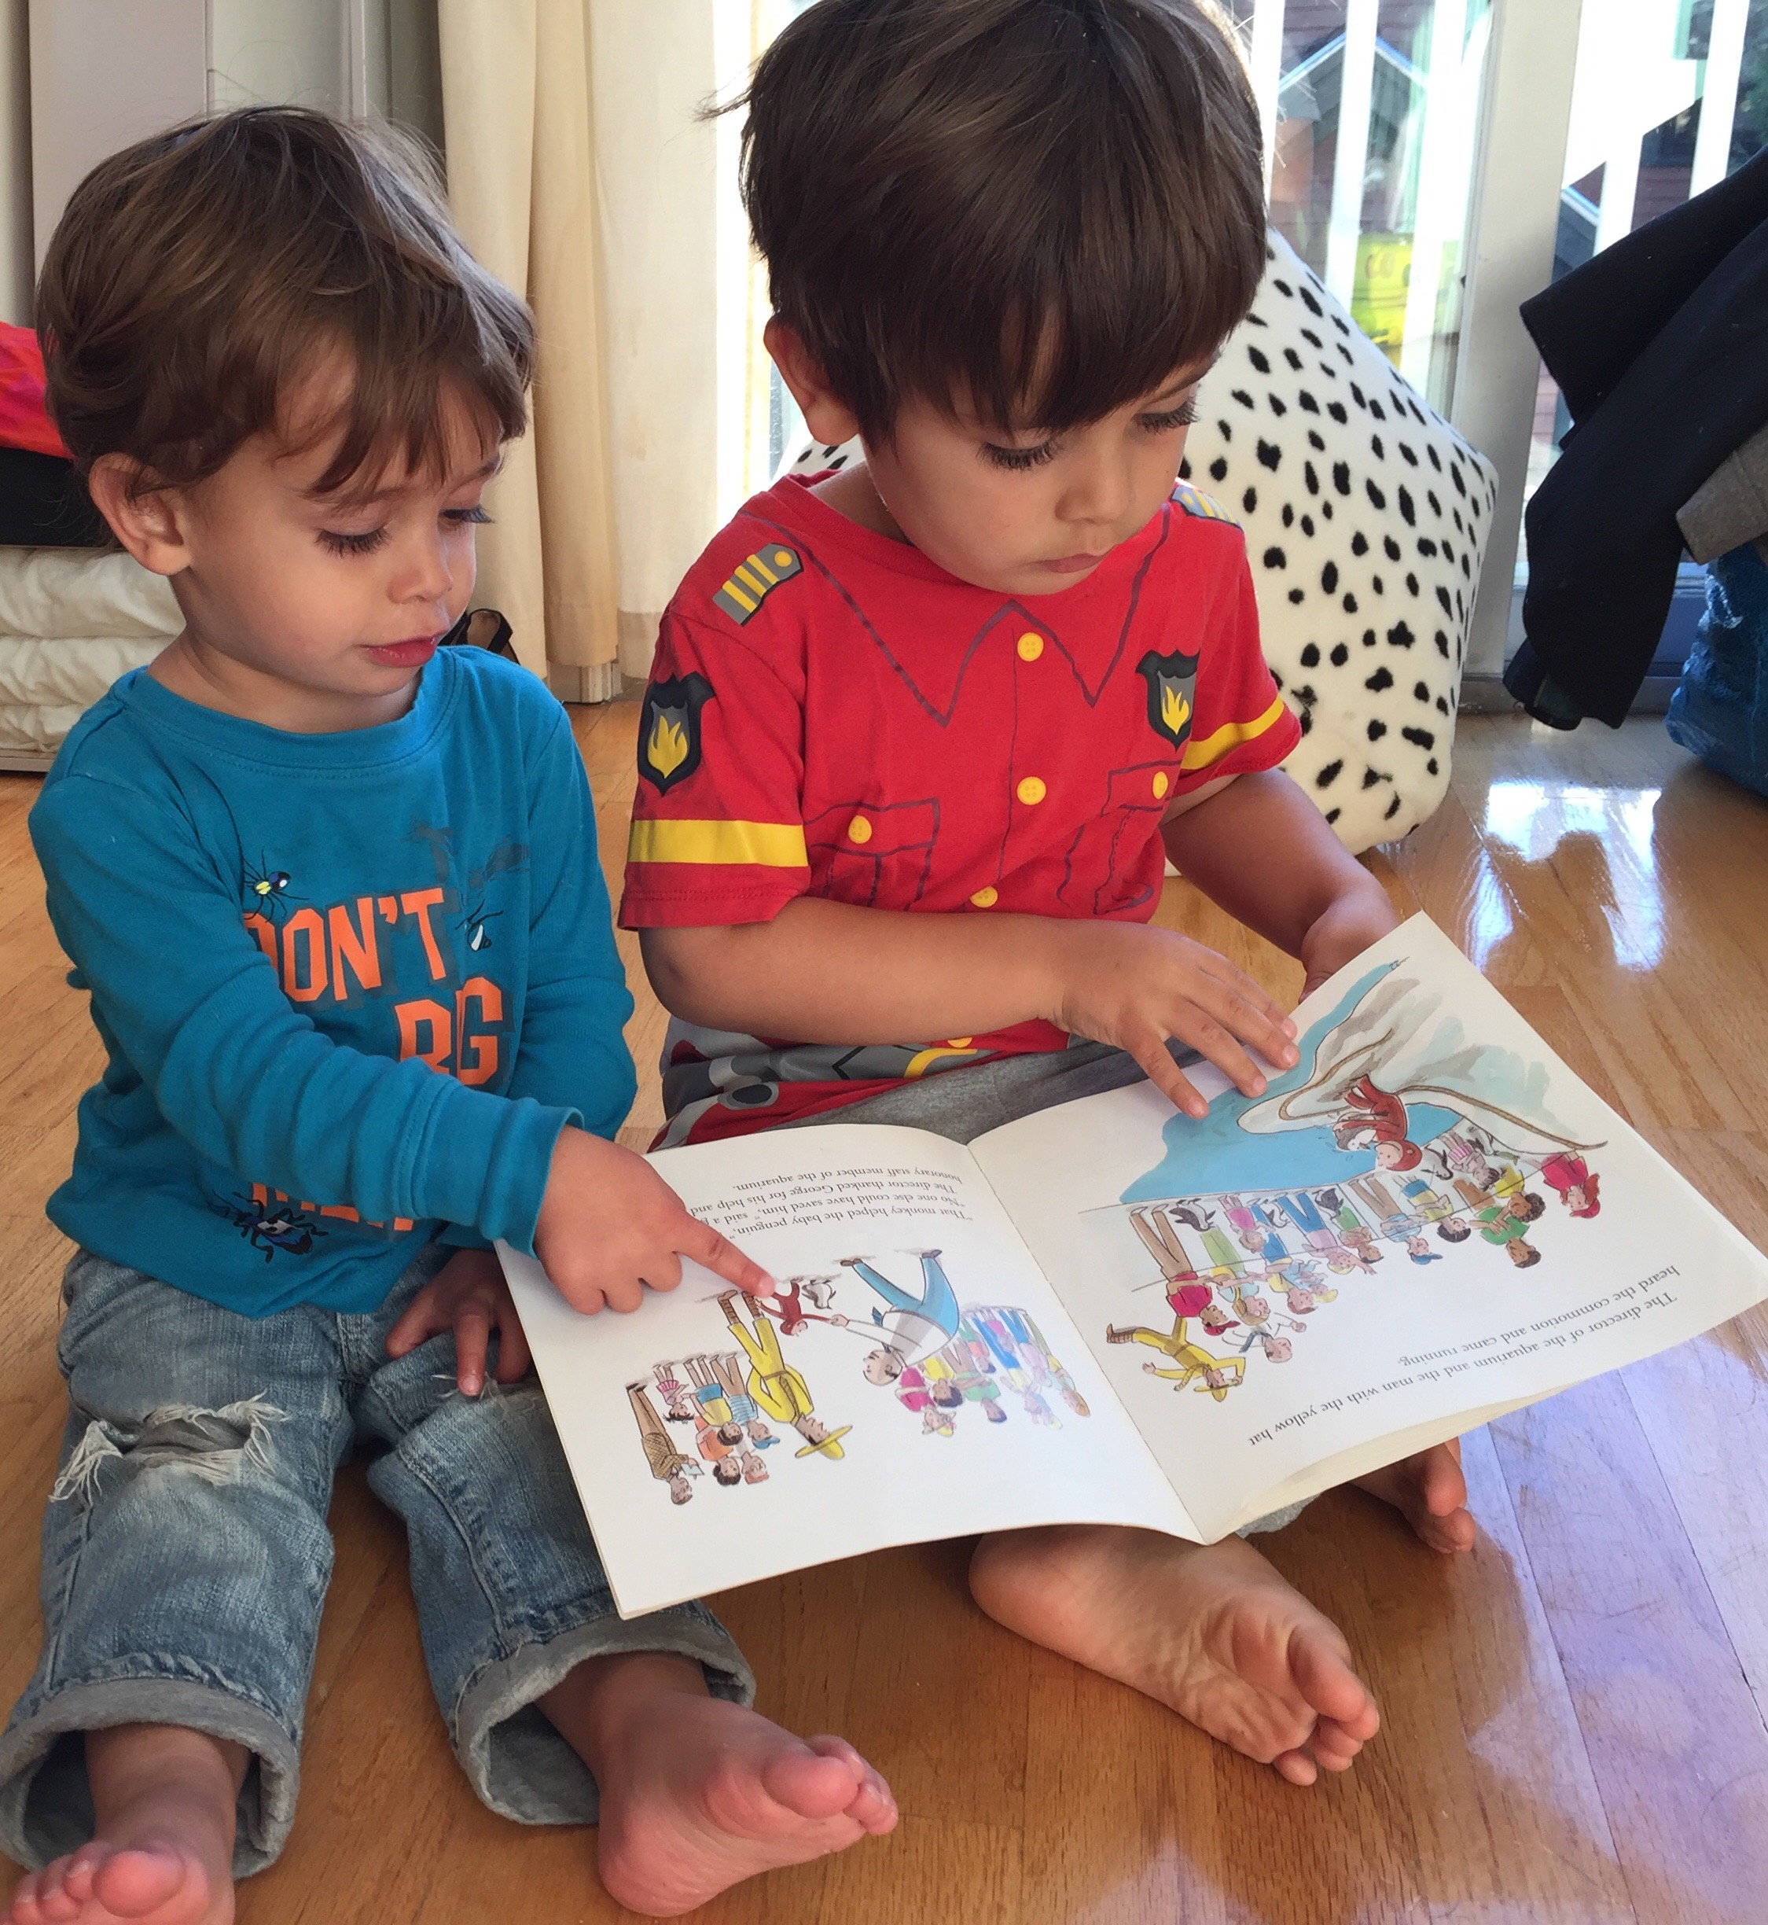
Home Language and Literacy
Environment (HLLE)
Aspects of HLLE that are most predictive of future language and literacy skills include (e.g., Hamilton, 2013; Payne, Whitehurst, & Angell, 1994; Bus et al., 1995; Rodriguez et al., 2011):
  Age of onset of shared reading
  Frequency and quality of book reading
  Frequency of library visits
  Parental knowledge of storybook titles
  Parental mediating style during shared reading
  Parental language during shared reading
  …
  → …but there are large cultural differences….

Slide 33
Notes:
Examining Shared Reading and White Matter Organization in Kindergarten in Relation to Subsequent Language and Reading Abilities: A Longitudinal Investigation
Kelsey E. Davison, Jennifer Zuk, Lindsay J. Mullin, Ola Ozernov-Palchik, Elizabeth Norton, John D. E. Gabrieli, Xi Yu,
Nadine Gaab

Slide 34
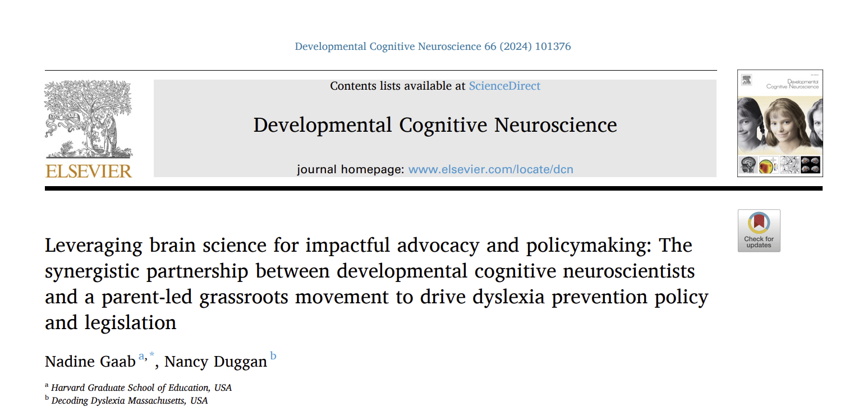

Slide 35

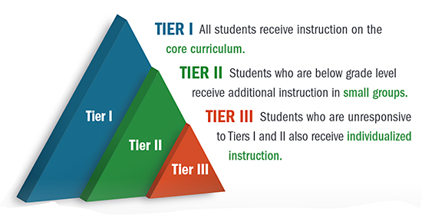



For at least 25 years, our society has invested millions of dollars to improve educational opportunities and outcomes for struggling readers
2000
National Reading Panel
2002
No Child Left Behind Act
2004
The Individuals with Disabilities Education Act 2004 (IDEA)
2015
Every Student Succeeds Act
Notes:
“There have been considerable efforts to improve reading outcomes. For example, in the last 25 years…”
Intervention service delivery models

Slide 36
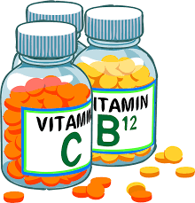

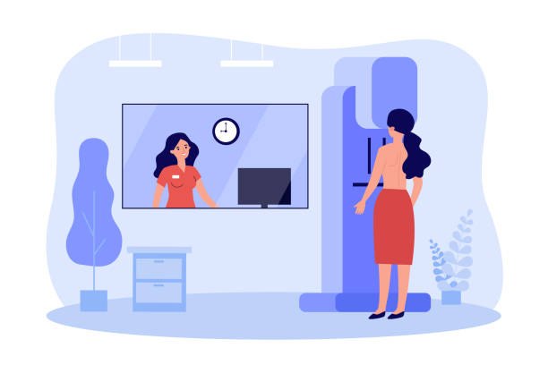


As a society, we embrace preventative medicine, but we have not prioritized preventative education strategies to the same extent.

Slide 37
Overall, our dominant approach has been a reactive, deficit-driven, “wait-to-fail” model.
The dominant approach has been a
reactive, deficit-driven, “wait-to-fail” model
Identification/
Diagnosis/Start of intensive Intervention
Pre-K
K
1
2
3
4
As outlined in
(Ozernov-Palchik, … & Gaab, 2016; Curr Opin Behav Sci)
(Ozernov-Palchik & Gaab , 2016; Wiley Interdiscip Rev Cogn Sci)
37
Notes:
Rti, MTSS are also reactive
Mental health implications

Slide 38
The “Dyslexia Paradox”
A reading disability is generally identified after the most effective intervention window
Overall, our dominant approach has been a reactive, deficit-driven, “wait-to-fail” model.
Window for most effective Intervention
Identification/
Diagnosis/Start of intensive Intervention
1
3
4
Pre-K
K
1
2
3
4
As outlined in
(Ozernov-Palchik, … & Gaab, 2016; Curr Opin Behav Sci)
(Ozernov-Palchik & Gaab , 2016; Wiley Interdiscip Rev Cogn Sci)
38
Notes:
Rti, MTSS are also reactive
Mental health implications

Slide 39

Early versus late intervention
A meta-analysis comparing intervention studies offering at least 100 sessions, reported larger effect sizes in kindergarten/1st grade than in 2nd and 3rd grades (Wanzek & Vaughn, 2007; Wanzek et al., 2013; Wanzek et al., 2016) .
When “at risk” beginning readers receive intensive instruction, 56% to 92% of at-risk children across six studies reached the range of average reading ability (Torgesen, 2004).
Overall, converging research points to the importance of early interventions for at-risk students for improving the effectiveness of remediation (Connor et al., 2013; Catts, et al., 2015; Denton & Vaughn, 2008; Connor et al., 2009; Shaywitz, Morris, & Shaywitz, 2008, Torgesen, et al., 1999; Flynn, Zheng, & Swanson, 2012; Vellutino et al., 1996; Morris, Lovett, Wolf et al., 2012; Morris et al., 1997).
Notes:
modest effect sizes for interventions ranging from 0.07 to 0.56, according to a meta-analysis (Wanzek et al., 2013).
For example, Wanzek and Vaughn (2016), in a meta-analysis, found that word reading interventions were significantly more effective for improving reading outcomes when administered in kindergarten and first grade then they were when administered during later grades

Slide 40


Replacing the wait-to-fail model with a preventative support model
Overall, our dominant approach has been a reactive, deficit-driven, “wait-to-fail” model.
Lower rates of dyslexia and improved reading outcomes in children with a diagnosis / better mental health
Comprehensive early risk
screening and evidence-based
response to screening
1
3
4
Birth
Pre-K
K
1
2
3
4
40
Notes:
Rti, MTSS are also reactive
Mental health implications

Slide 41
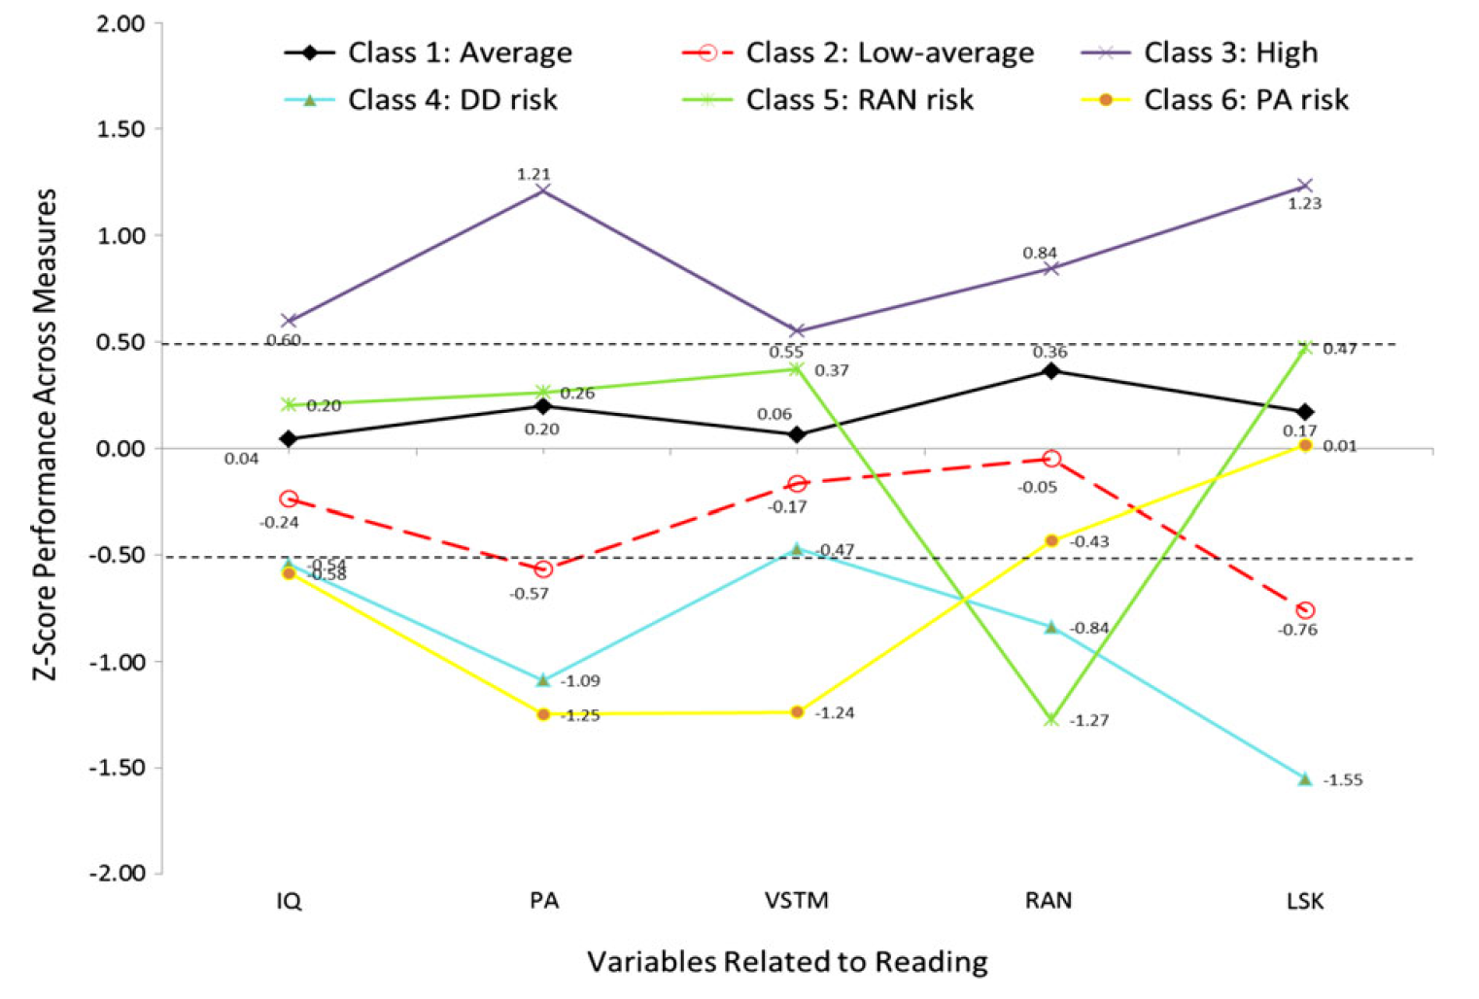
Latent profile analysis shows six distinct profiles of early reading and long-term stability
[n = 1,215 children]
General
Cognitive
Ability
Phonological
Processing
Verbal
short-term
memory
Rapid
Automatized
naming
Letter-sound
knowledge
(Ozernov-Palchik, … & Gaab, 2017; Developmental Science)
Notes:
The final sample included 1,215 participants (48% males) with diverse ethnic and racial backgrounds (54% Caucasian, 15% Hispanic, 23% African-American/Black, 5% Asian, 3% Other).
A Latent Profile Analysis (LPA) approach was employed to identify homogenous subgroups (i.e. profiles) of children based on reading-related variables. Unlike variable-centered approaches (e.g., exploratory factor analysis) that seek to identify correlations between variables of interest, LPA is a person-centered approach that groups individuals by the probability of their response patterns on each of the latent profile indicators. The interpretation of each profile is derived from those probabilities. . Specifically, the model-fitting process begins with a one-profile model (i.e. a model in which all readers are hypothesized to demonstrate a single, homogeneous profile) to which additional profiles are added one at a time (i.e., hypothesizing each time that one additional subgroup exists), and statistical tests are conducted at each step to determine if the additional profile significantly improves the goodness of fit of the model. Simulation studies in the statistical literature have found that these tests are robust and specific in determining when latent profiles can and cannot be differentiated in the population (e.g., Lo, Mendell, & Rubin, 2001; Tofighi & Enders, 2007; Yang, 2006). Several criteria are employed for testing optimal fit. These involve: (a) magnitude of R² values; (b) correct classifications versus misclassifications, e.g., in the longitudinal prediction between original class cases and their representation in the predicted classes; (c) significance of predictors; (d) significant reduction in the likelihood ratio test L² when comparing nested models; and, (e) acceptable entropy values. For continuous indicators as those involved in the present study, each latent profile was assumed to have its own mean and variance estimates as shown below:
f(yǀθ)=∑1_(Τ=1)^Τ▒〖π(_τ^Χ)f 〗(yǀμ_τ, Σ_τ) (Equation 1)
The distribution of a dependent variable y is a function of a set of unknown parameters θ. In the right side of the equation π defines the probability of person x belong in latent profile τ. Each latent profile has its own mean (μτ) and variance and covariance estimates of the latent profiles (Στ).
In the present study 1-7 profile models were fit to the data and the superior model fit was judged as a function of differences in the likelihood ratio between nested models, using the unbiased bootstrap distribution (Magidson & Vermunt, 2002). Furthermore, parsimony was taken into consideration by selecting the model with the smallest AIC or BIC values, due to the fact that the LR test will likely be influenced by the large sample size. The level of significance was set to 5% (Tofighi & Enders, 2008).
Sample size estimation in latent profile models involves comparing models and thus relates strongly to the power of the likelihood ratio test. Recommendations from previous simulation studies have suggested that 500 participants would suffice for highly demanding models (those with minimal between-profile membership differences and small numbers of indicators, Nylund, Asparouhov, & Muthen, 2007). Our sample size of 1,215 participants was more than adequate for estimating our 6-profile model. As a secondary precaution, however, and because the chi-square test is sensitive to sparse data, it is recommended to bootstrap p-value estimates in order to test the improvement in fit between two models using population-based estimates. This approach was followed in the present study using 1,000 replicated data sets, thus simulating population parameters based on our large sample-size sample. All models were run using Latent Gold 5.0 (Magidson & Vermunt, 2001).
Parameter estimates were presented in effect size metric, specifically Cohen’s d statistic (Cohen, 1992). Cohen's d is the metric of standard deviations and therefore differences in the latent class membership (figures 1 and 2) are expressed as standard deviations from the mean of zero (i.e. z-scores). As is customary, effect sizes of .5 are considered medium size and significant effects (as would be derived from inferential analyses), effect greater than .8 standard deviations as large, and effects between 0 SD and .49 as small to medium and non-significant.

Slide 42
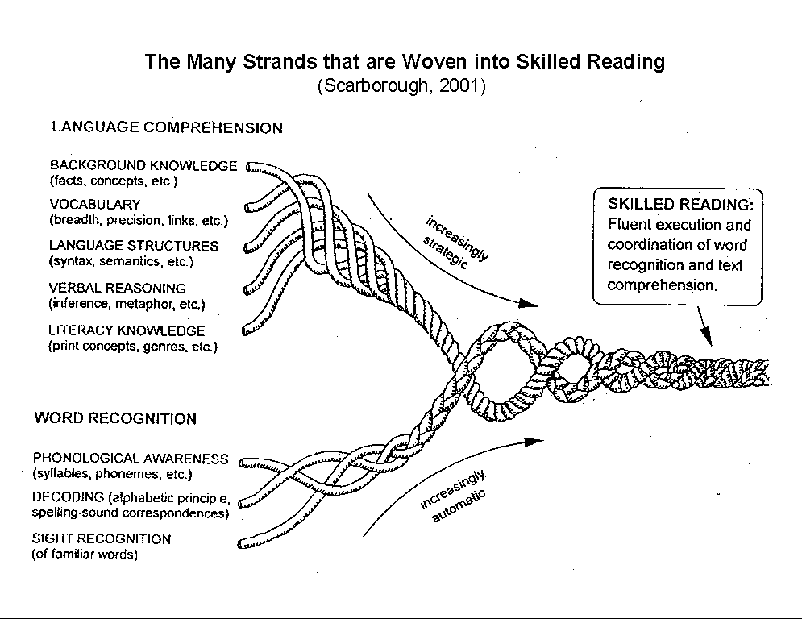
Early behavioral predictors of reading difficulties/dyslexia
Key childhood predictors of reading problems (e.g., Landerl, et al., 2013; Elbro et al., 1998; Scarborough, 1998, O’Connor & Jenkins, 1999; Lyytinen et al., 2001; Catts et al., 2001, 2015; Schatschneider et al., 2004, Pennington et al., 2001; Compton et al., 2006; Stanley et al., 2018):
Phonological awareness
Pseudoword repetition
Rapid automatized naming
Expressive/receptive vocabulary
Letter (sound) knowledge
Oral listening comprehension
Familial risk of dyslexia and language delay
Notes:
This research further indicates that risk factors do not determine whether or not a child will have dyslexia but rather the probability they will have the condition (Catts & Petscher, 2020).
There is robust research evidence that reading depends, above all, on phonemic awareness (Fletcher et al., 2019). In order to read and spell words, one needs to be able to process sound as a segmented signal, at the level of phonemes, and then to associate phonemes with the graphemes with which they are represented in a particular writing system. There is much cross-sectional research that demonstrates that dyslexia is associated with phonological processing difficulties (see Melby-Lervag et al., 2012, for a review of this research), longitudinal research that shows that early phonological processing difficulties predict later word reading difficulties (Boets et al., 2010; Hulme & Snowling, 2009; Lyytinen et al., 2006), and intervention research that demonstrates that dyslexia can be effectively remediated by means of instruction that systematically and explicitly teaches students PA and knowledge of grapheme-phoneme correspondences (Bradley & Bryant, 1985; Lovett et al., 2000; Morris et al., 2012; Vellutino et al., 2004).

Slide 43
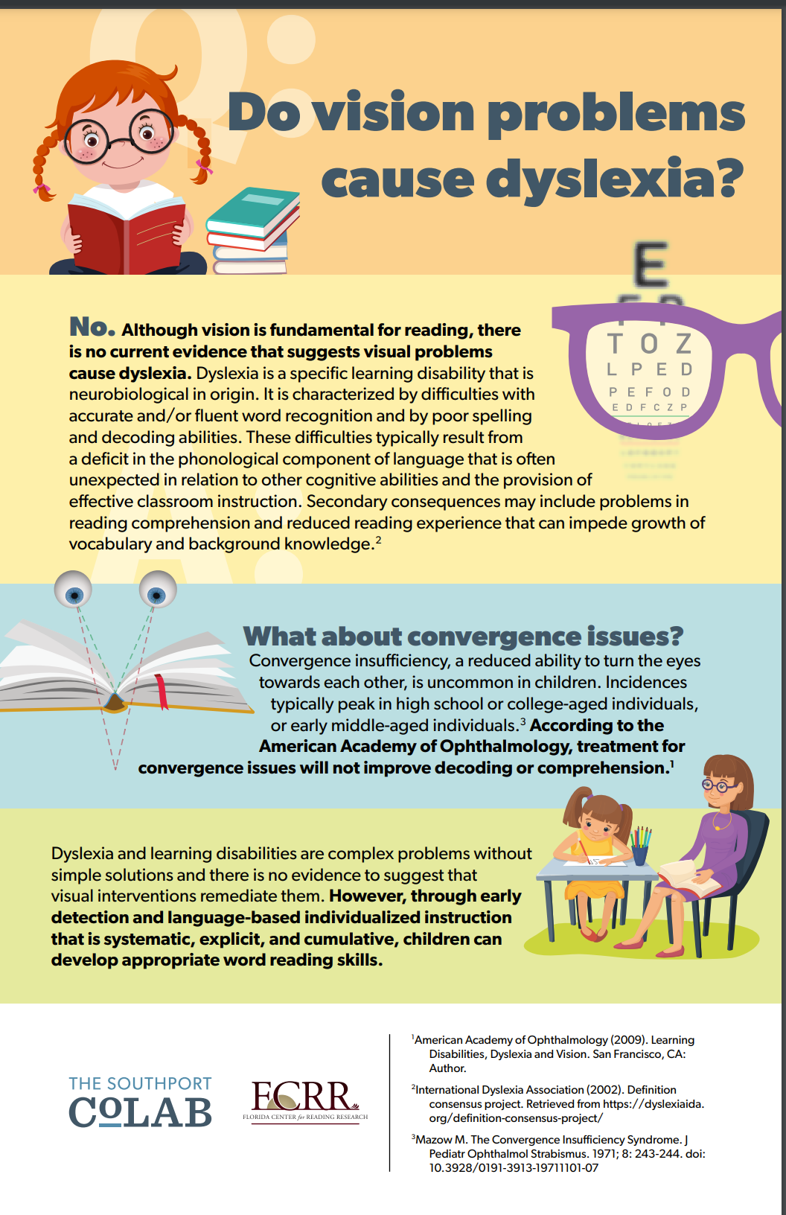

Slide 44
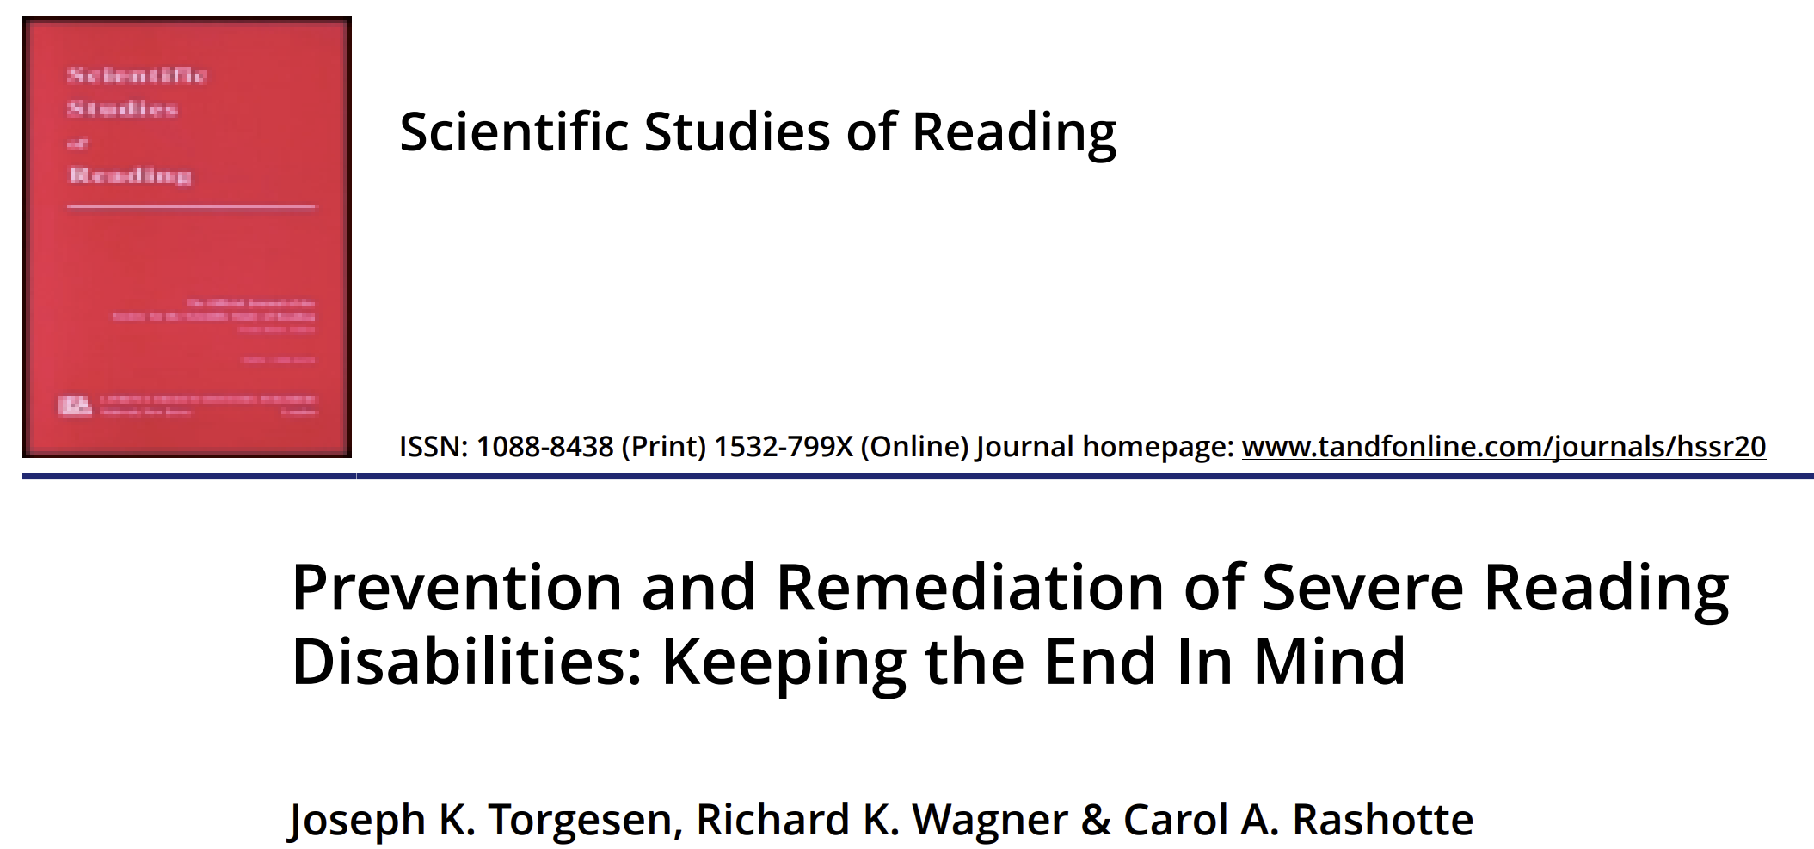


Lyon, G. R., Fletcher, J. M., Shaywitz, S. E., Shaywitz, B. A., Torgesen, J. K., Wood, F. B., Schulte, A., & Olson, R. (2001). Rethinking Learning-Disabilities. In C. E. Finn Jr., A. J. Rotherham, & C. R. Hokanson Jr. (Eds.), Rethinking Special Education for a New Century (pp. 259-287). Washington DC: Thomas B. Fordham Foundation.
National Research Council. 1998.
Preventing Reading Difficulties in Young Children.
Washington, DC: The National Academies Press

Slide 45
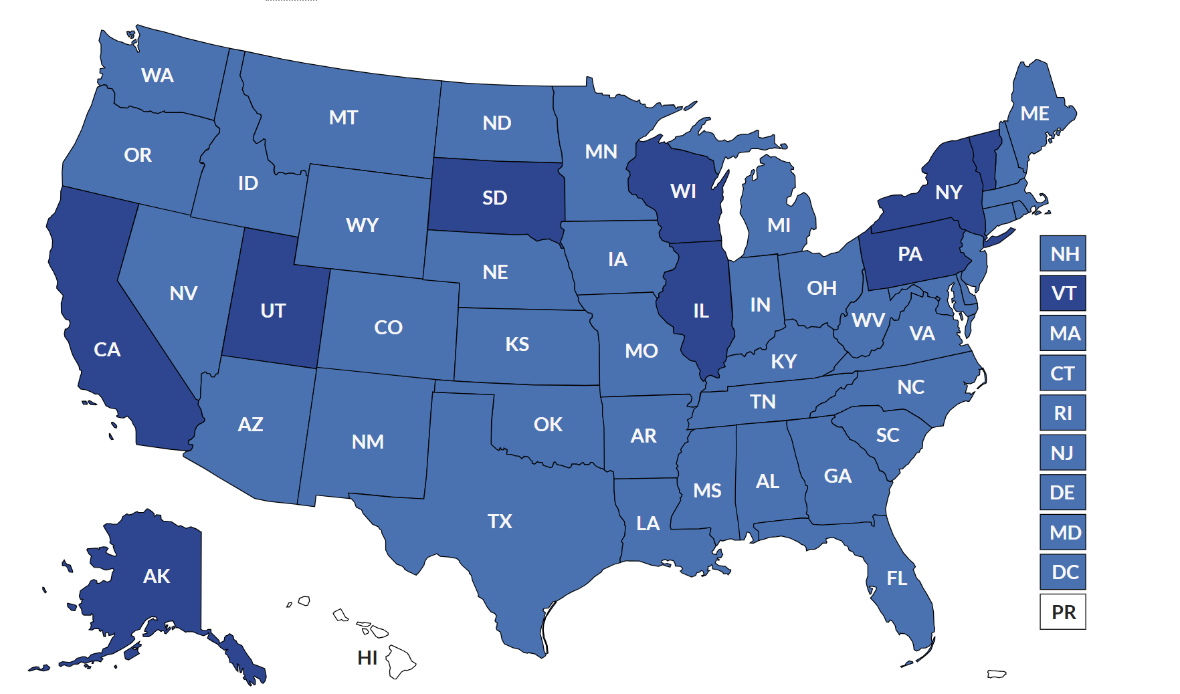

45
Notes:
Just talk about screening

Slide 46
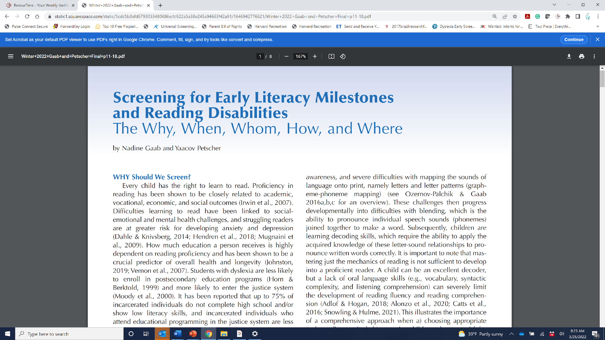
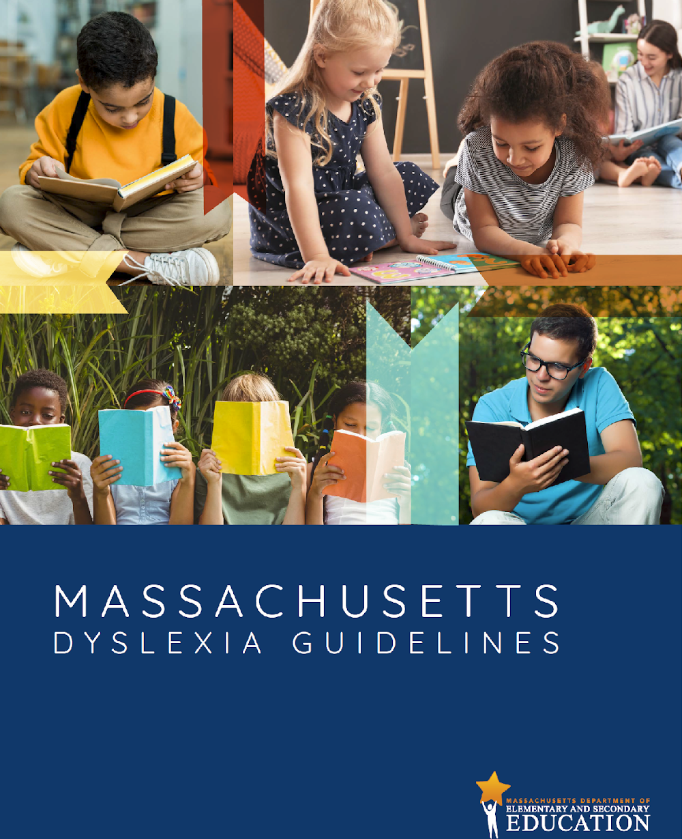
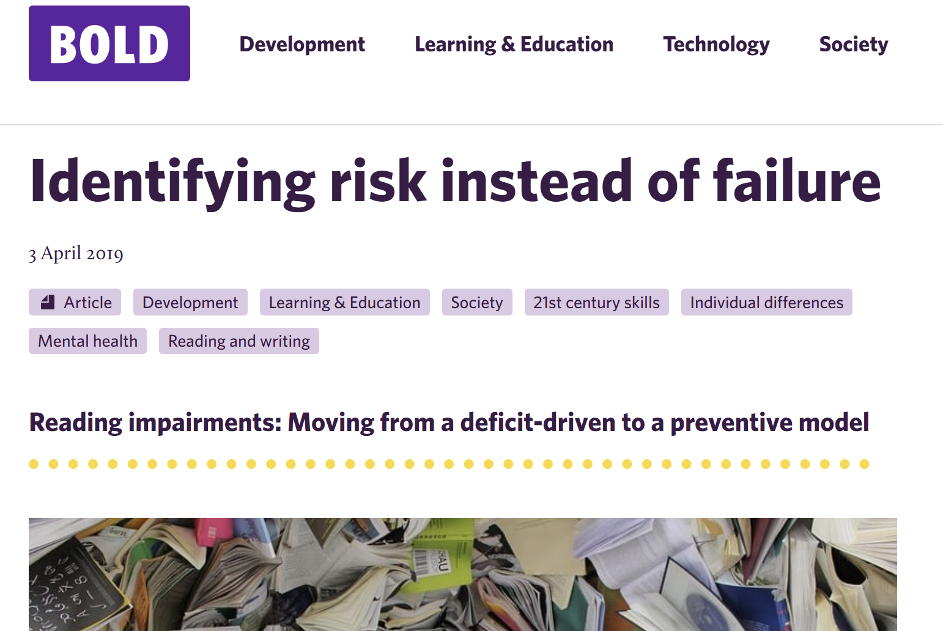
International Dyslexia Association, 2022

Slide 47
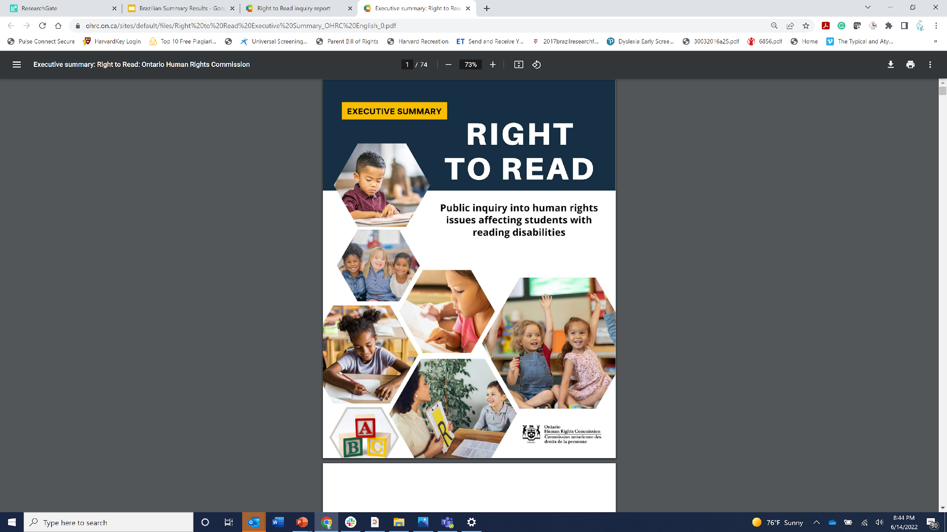
Ontario Right to Read Inquiry Report, 2022

Slide 48
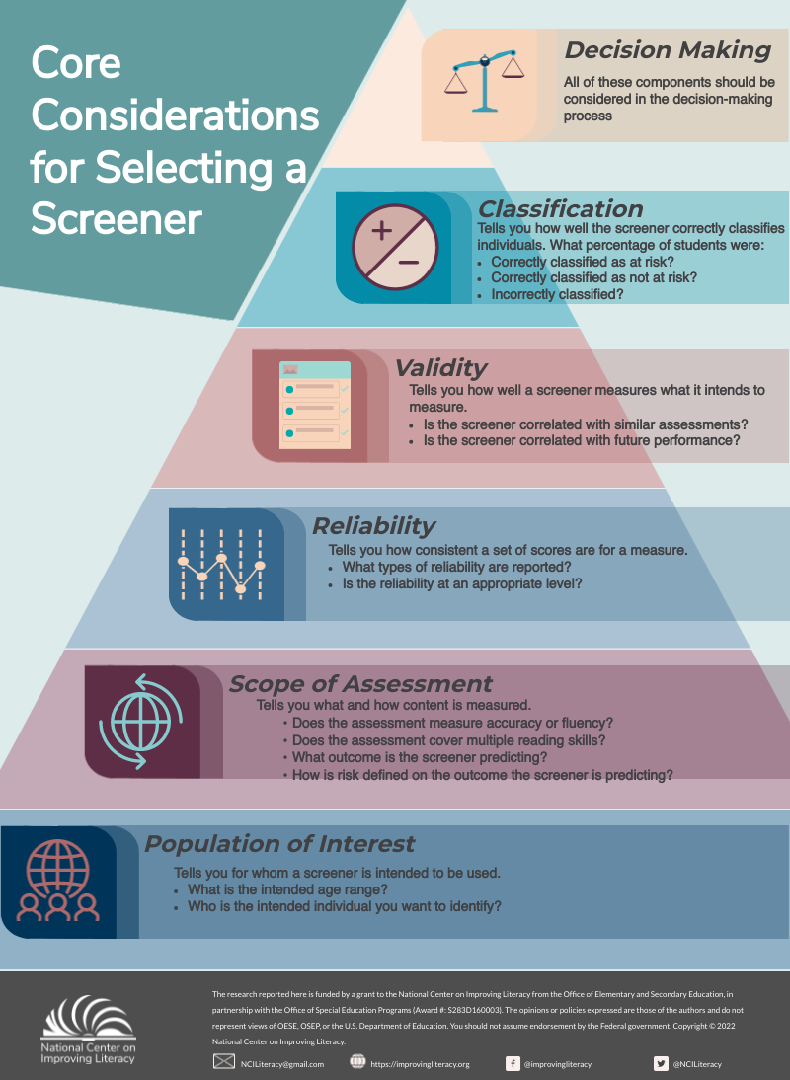

Slide 49






EarlyBird, an evidence-based, self-administered game — engages students, saves teachers time
Computer adaptive screening to provide the most precise results in the least amount of time
Incorporates AI voice technology and auto-scoring to save teachers time and to remove bias, training, fatigue, and inconsistencies in scoring
Easily administered in groups by any adult after only a brief training
Extensive end-to-end support to intuitively, efficiently and cost-effectively support educators in targeting instruction
www.earlybirdeducation.com

Slide 50
Where else should we screen?
Pediatrician’s offices (e.g. at 4 or 5 year well visit)
Social Workers
Preschools/Day Cares
Libraries
Children’s Museum
Speech and Language Therapy/Occupational Therapy sessions
Children’s homes

Slide 51

Embracing literacy as a community

Slide 52


(Sanfilippo, …Gaab, 2020; Pediatrics)
52

Slide 53

English: https://osf.io/hdxgf
Portuguese: https://osf.io/preprints/osf/4hscz
Spanish: https://osf.io/8k5de

Slide 54


Families in Society, 2022
54

Slide 55

(Ozernov-Palchik, … & Gaab, 2016; Curr Opin. Behav. Sci)

Slide 56

The development of reading proficiency
is a public health issue:
Literacy is a widely recognized determinant of health outcomes and is associated with many indices of
academic, social, vocational, and economic success
(Irwin et al., 2007)
National Academy of Medicine summary highlights that duration of education, which is highly dependent on reading proficiency, is a significant predictor of health and longevity (Johnston, 2019)

Slide 57
From the Womb to the Classroom:
Typical and Atypical Reading Development and Implications for a Preventative Education Model
Nadine Gaab, PhD
Silvana and Chris Pascucci Professor in Learning Differences
Harvard Graduate School of Education
www.gaablab.com

